Slide 1
What could we learn in the past few days?
Review of the first week

Slide 2
Getting to know GitHub
First a bit unusual, even weird, but can be learned quickly
Can be one of the most useful tools in all future projects
Public programming

Slide 3
HTML/CSS
Web Services Description Language
Easier to start with something like this (?)

Slide 4
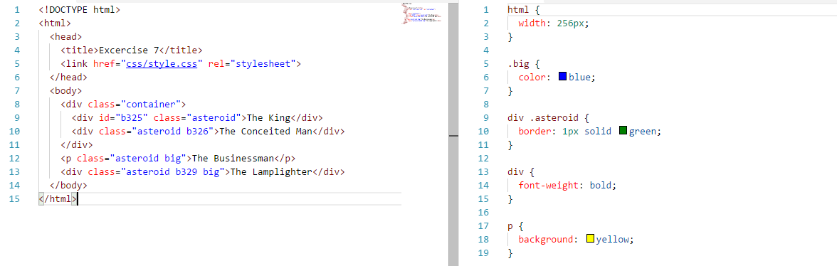
HTML/CSS
Diversifying selectors: classes, IDs, etc.

Slide 5
Other social skills
Introduction, making a team
Preparing the team to project working
Unusual, but successful methods in making the new connections
Time management
Learning not just coding, but facing with usual difficulties during coding and dealing with them

Slide 6


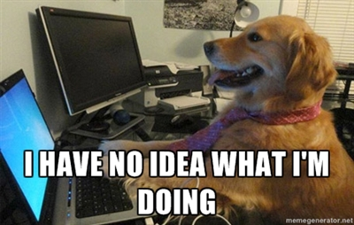

Other social skills

Slide 7
Now we can finally go home to sleep.

