Slide 1
Mind = blown
Review of the eighth week
Boldizsár Kiss

Slide 2
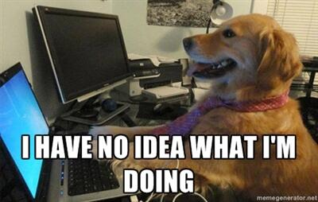
This week: more SQL + EF Core

Slide 3
Todo App
A small app to control some tasks
Four parameters: id, name, urgency and status
Tasks are updatable (urgency, status), removable and new ones can be added

Slide 4


Difficulties with this Todo
Averagely 2-3 WTFs/hour
Random errors, crashes (the last one was today)
Not all functions work correctly yet

Slide 5
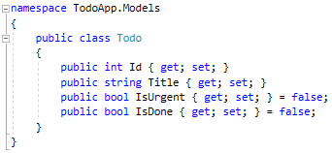
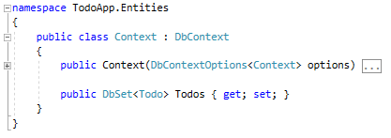
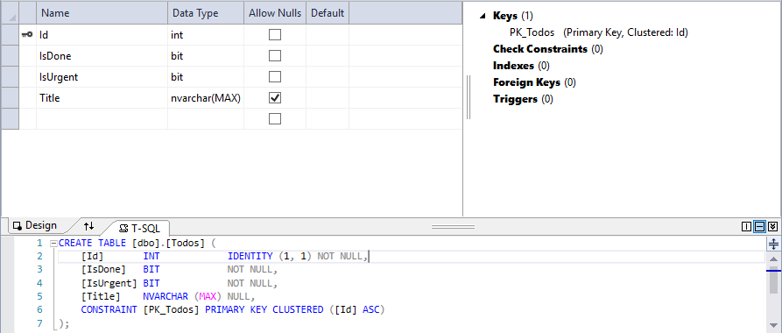
The core of the app

Slide 6
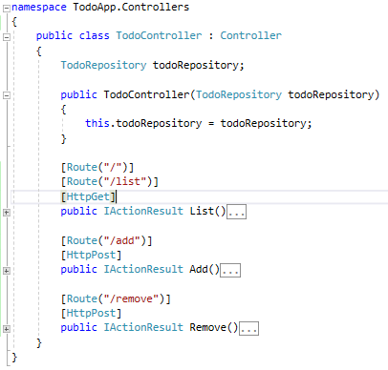
The controller

Slide 7
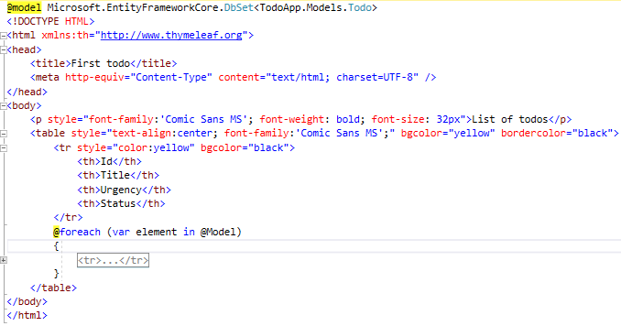
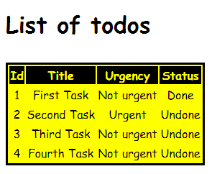
An example of the current look (Comic Sans ftw)

Slide 8

much thanks

