Slide 1
Making a small Todo app and upgrading it with Bootstrap
Boldizsár Kiss

Slide 2
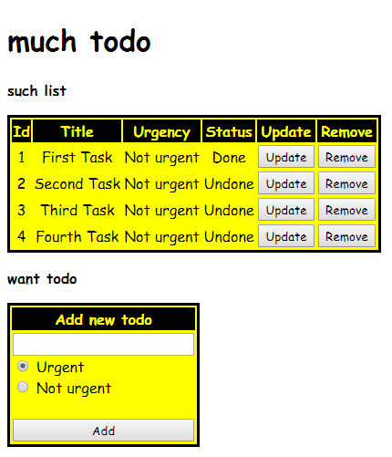
Last week: Todo app

Slide 3
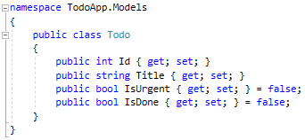
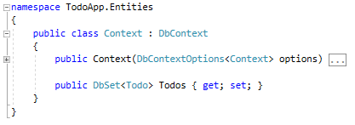
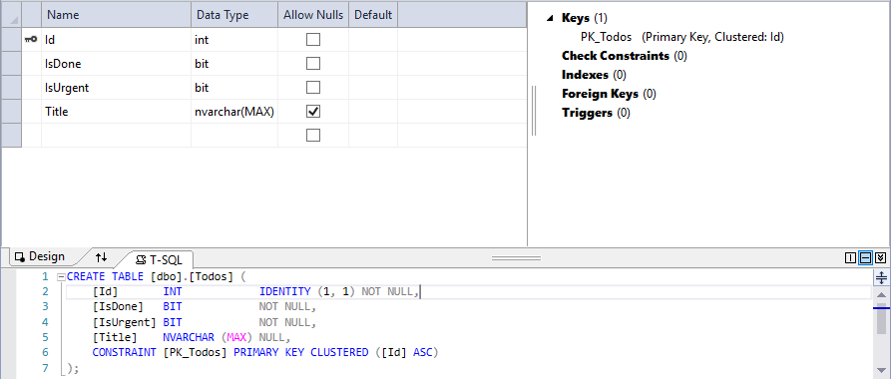
App structure

Slide 4
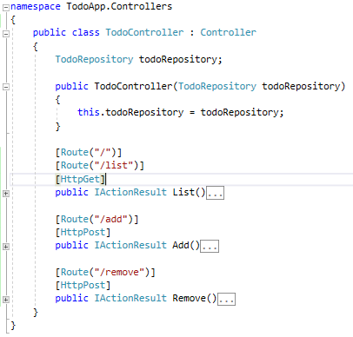
Controller

Slide 5
Todo app after Bootstrap
Bootstrap layout files (cshtml, css) in the background
Device (screen) compatibility feature
Navigation bar update

Slide 6
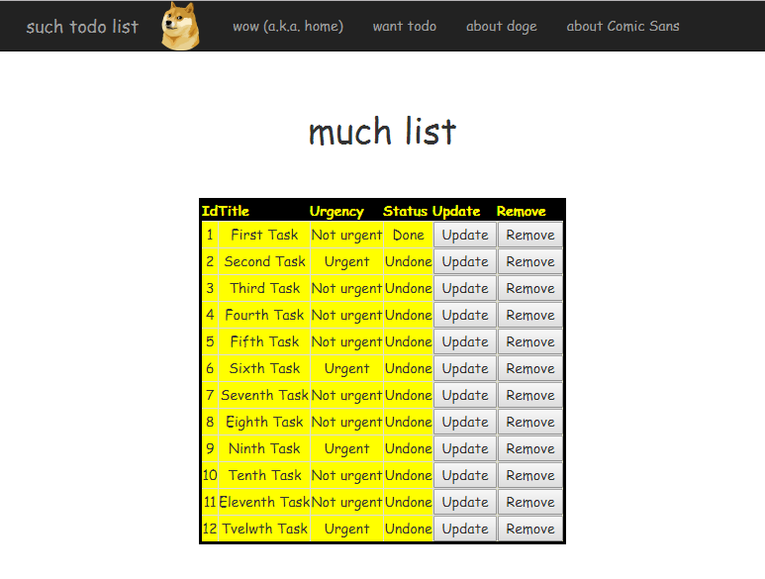
App look

Slide 7
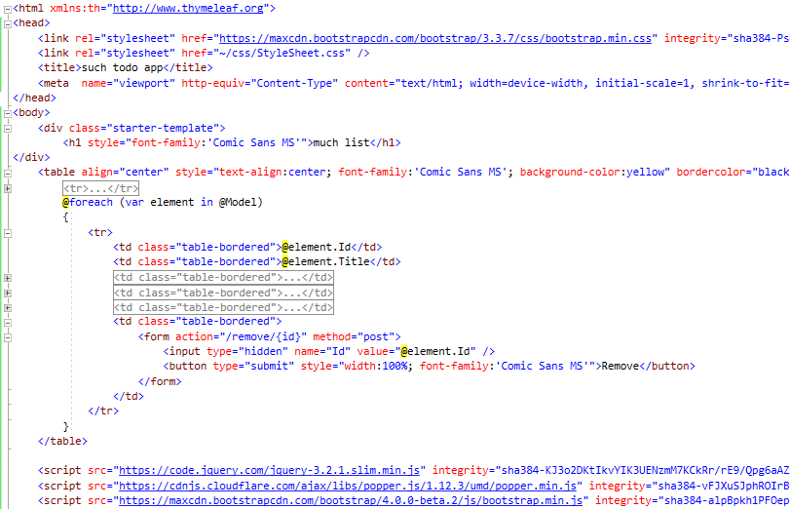
Modified listing view page

Slide 8
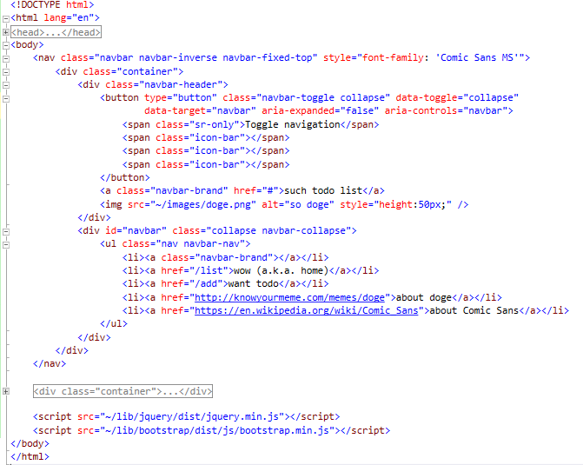
Common layout page

Slide 9
Future plans
Adding much more Bootstrap features
Registering the todos by different users
Adding custom sorting possibilities
Adding more attributes

Slide 10
Thanks for the attention!

