Slide 1
level++;
Review of the second week

Slide 2

C# basics
Different types, classes
Arrays, lists, dictionaries
Functions, methods
Debugging, clean coding
Etc.

Slide 3
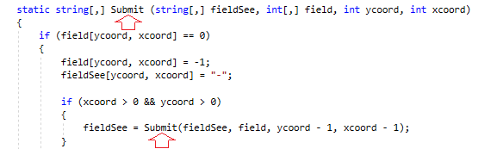
More: recursive functions
It is like all other functions, just being used in itself
Conditions here can be very useful
Fills the stack easier than you think

Slide 4
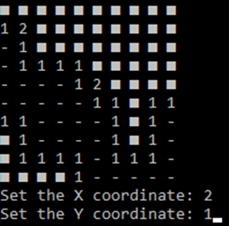
Minesweeper project
Original minesweeper from mentors
Why don’t we make our own version?
- made without looking at the original code
- lasted more than twice longer than the other

Slide 5
Minesweeper project
Some features:
- the player cannot start the game by revealing a mine
- all areas have at least two mineless places
- in case of death all mines become revealed
- some customized values are held in a specific range to prevent possible crashes

Slide 6
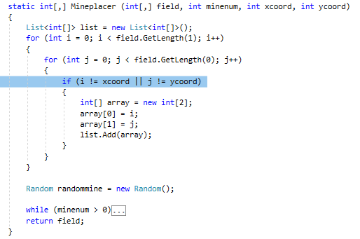
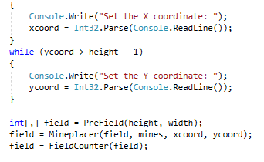
Minesweeper project
The first pair of coordinates are given before the mines are placed

Slide 7
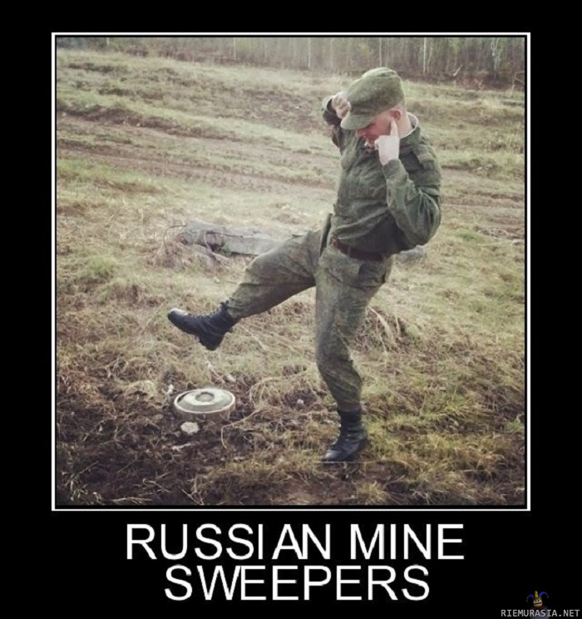
Minesweeper project
Further plans:
- making more features in the game, making it safer for (or from) users
- evolving the game in the next weeks with new methods

Slide 8
THE END
(No, just kidding. I will return next week.)

