Slide 1
Triangles, circles and other mind-blowing things
REVIEW OF THE THIRD WEEK

Slide 2
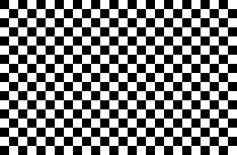
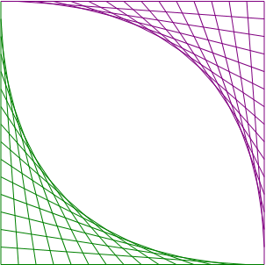
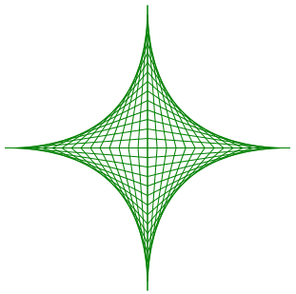

Drawing
Graphic display
WPF app
XAML files (remember CSS!)

Slide 3
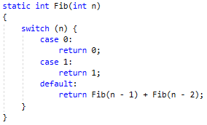
Recursion
Avoiding loops without making the function call itself
Conditions are necessary

Slide 4
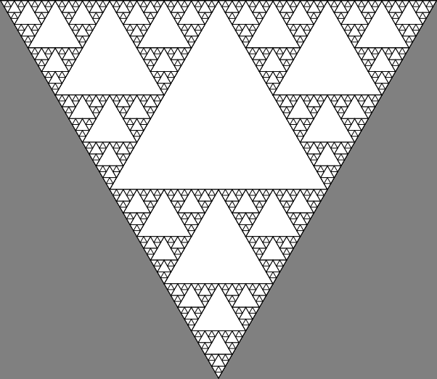
Fractals
Combination of graphic display and recursion
Can be funny and annoying
at the same time

Slide 5
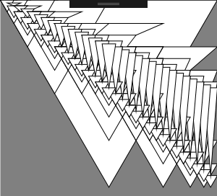

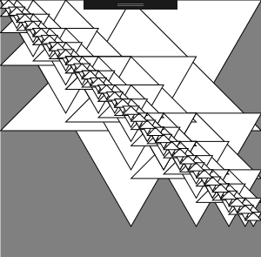
Fractals

Slide 6
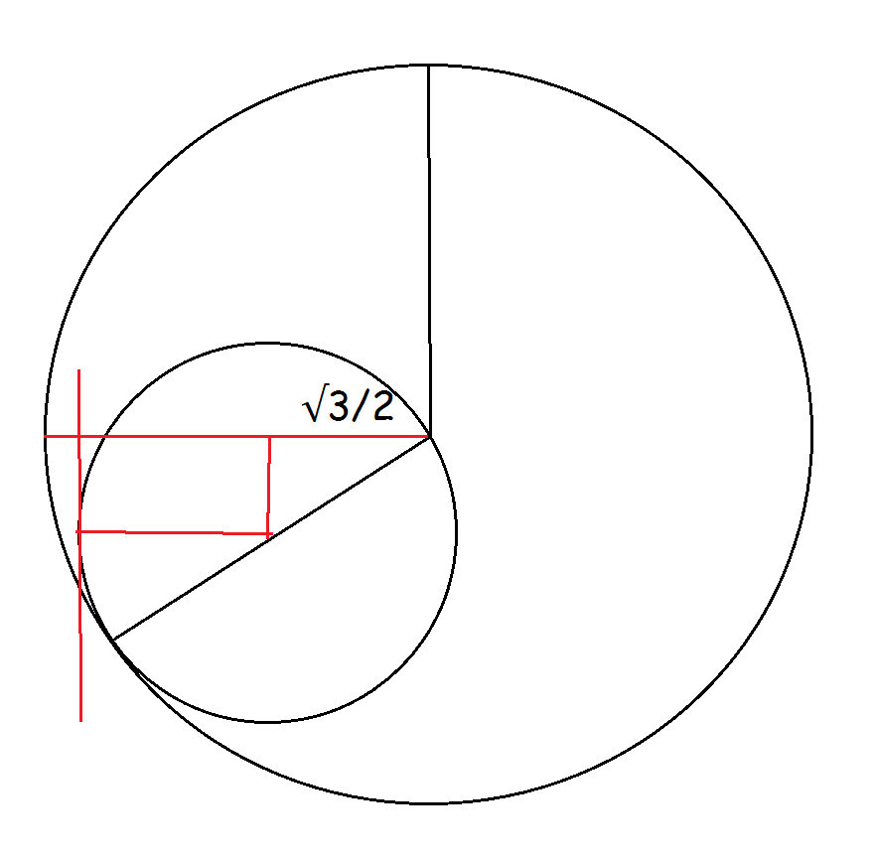
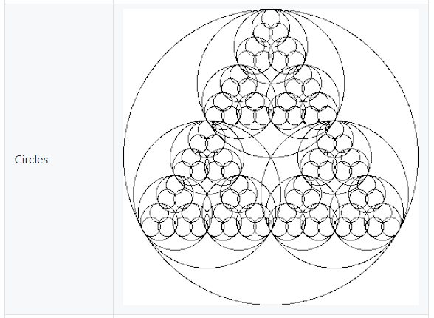

Fractals

Slide 7
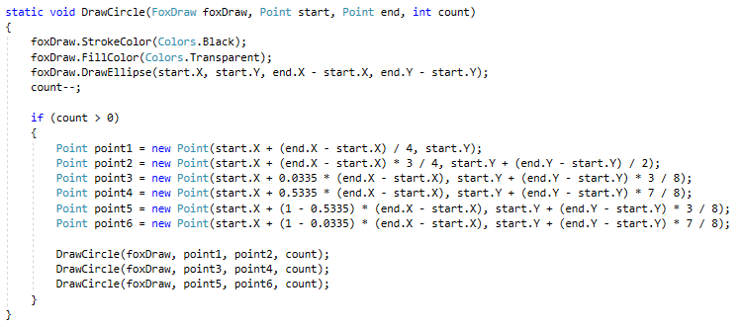
Fractals

Slide 8
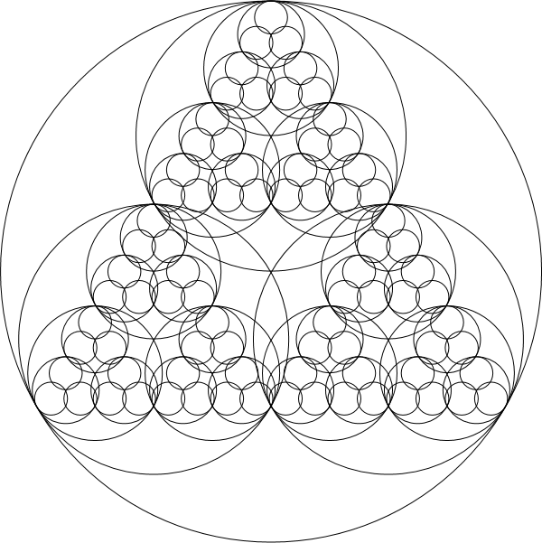

Slide 9
Thanks for watching!

