Slide 1
Poker by two players
BoldizSár Kiss

Slide 2
Poker task
Main target: writing a small program (by TDD) which can compare the values of two hands by basic poker rules
Status checks are made by unit tests, which represent two different hands and the comparison of them

Slide 3
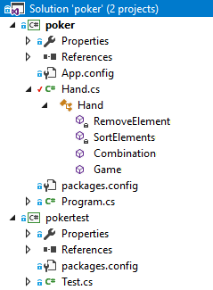
Program structure
A Hand class (not represents the exact hands, but handles them): it sorts the cards and mark them if they are parts of a combination
Another Test file (in another project) is responsible for unit tests

Slide 4
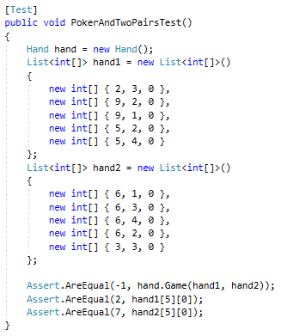
Tests
Checks the winner hand and the combination value
Input lists represent the hands, each number on the right place represents a value, a suit, and a combination check digit (later)

Slide 5
Poker methods
SortElements – sorts the list of the cards
Combination – gives the hand a combination value (also using SortElements) and marks the ones in the combination
RemoveElement – removes specific cards from the list (hand)
Game – uses all others, and returns which player won

Slide 6
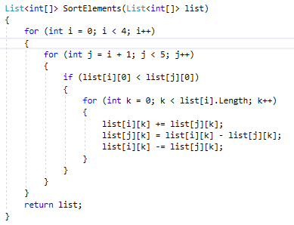
SortElements
Advantages of sorting:
in case of matching combinations, we only need to compare the cards in the middle

Slide 7
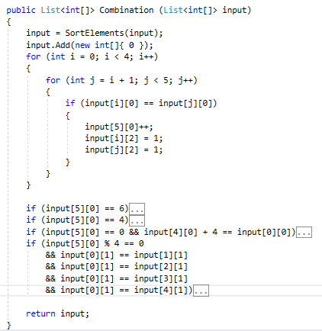
Combination
Gives a new element to the list (combination value)
It gets a value by counting the corresponding card values (with modifications to fit to the official combination order)

Slide 8
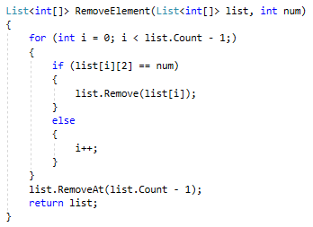
RemoveElement
Removes the elements of the list which are not part of the combination (or are, depending on a parameter)

Slide 9
Thanks for the attention!

