Slide 1
Random title just for fun

Slide 2
C# basics
Different types, classes
Arrays, lists, dictionaries
Functions, methods
Etc.

Slide 3
Recursion
Do something
{
Do something
}

Slide 4
Minesweeper project
Original minesweeper from mentors
Why don’t we make our own version?

Slide 5
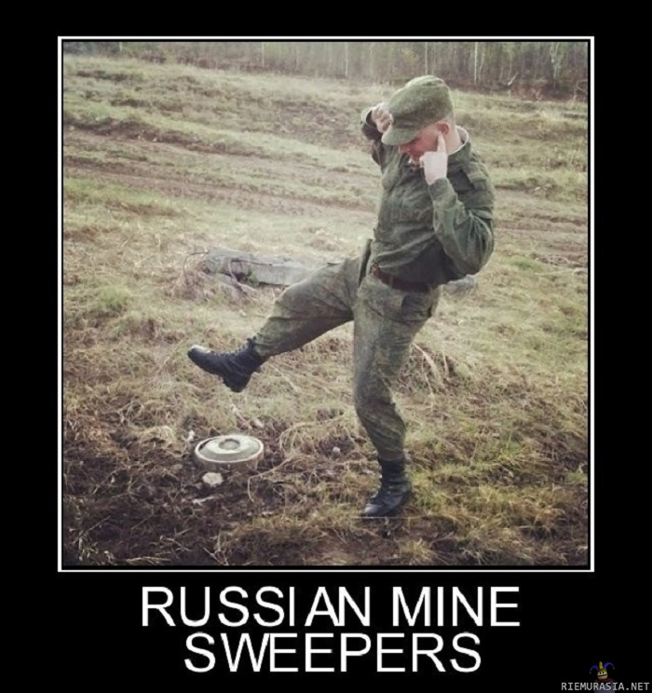
Minesweeper project

