Slide 1
[X] Get a title
REVIEW OF THE FOURTH WEEK

Slide 2
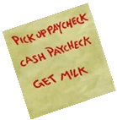
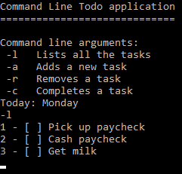
TODO App
2 days project
4 usable commands from console (or 5 – later…)
Listing, checking, removing tasks, or adding some new ones on 5 different days
Data input is from a chosen external file
File content is editable by the app

Slide 3
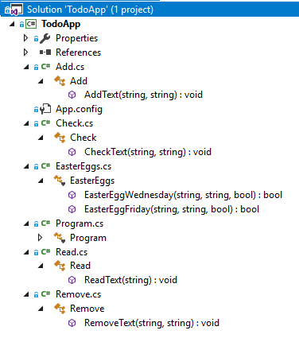
App structure
Different classes for each list modifying methods
An extra class (also later…)
Other small functions in the main program file (for error messages)

Slide 4
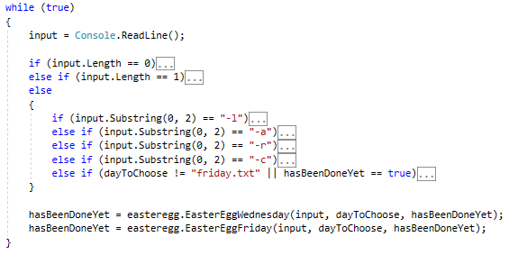
App structure

Slide 5
Other features, easter eggs
Based on a real game (the default themes too)
Newly generated other tasks:
- activated by completing a specific task or typing some (originally invalid) commands
- once doable, „normal” tasks like the others

Slide 6
What we learned
How a real project looks like
Previously gained experiences combined
Dealing with something more complex

Slide 7
Thanks for your attention!

