Slide 1
Playing with an AI
REVIEW OF THE SIXTH WEEK BOLDIZSÁR KISS

Slide 2
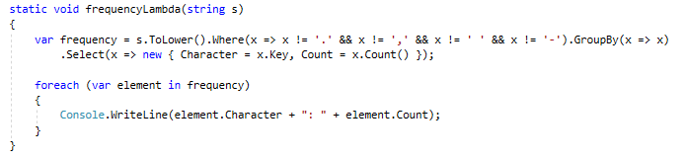
LINQ (/lɪŋk/)
Makes simple, but annoyingly long methods or other things more simple-looking (tl;dr huge refactoring)
New level of abstraction

Slide 3
Blackjack/Twenty and One
Seems to be an easy game with easy rules
Failed to implement the exact rules again and again, because of some lack of information (╯°□°）╯︵ ┻━┻
Program seems to be almost OK now (but Aces cannot have 1 value yet, and only one pulling method exists)

Slide 4
Blackjack/Twenty and One
Feature: making a simple dealer AI instead of some simple random generated numbers
The AI also pulls two cards from the deck, and also pulls more if it decides to
Often uses the same functions/methods as the player has to

Slide 5
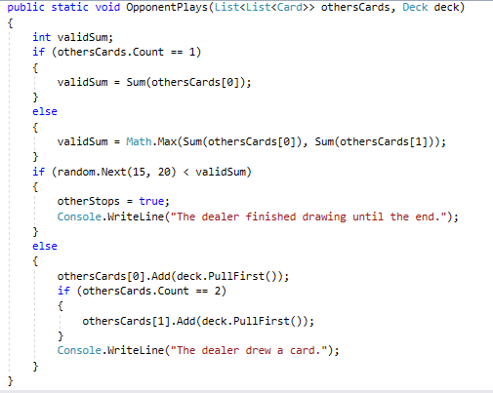
Blackjack/Twenty and One
Current version:
- the dealer can add new cards depending on the value of the hand(s)
- it also uses the same methods (sum, add, pull, etc.) as the player
- with higher values, the odds of pulling new cards are lower

Slide 6
Blackjack/Twenty and One
Further plans:
- making the rules more accurate
- making the console lines a bit more informative, adding the exact values to the written lines
- more refactoring

Slide 7
Thanks for your attention!
(Clap your hands or do something like this.)

