Slide 1
VODAFONE
2 YEARS
HUMAN CALCULATOR
GREEN FOX
4 MONTHS
AUTOMATE THE BORING STUFF
Vilmos Csibi
Notes:
Greeting / Introduction
I saw the opportunity in one of our exercises which I want to present you.

Slide 2
Cows
Game rules
Correct digit on a correct place = COW
Correct digit but wrong place = BULL
Random number: 3578
Your guess: 3769
Traditional game: “1 Cow and 1 Bull”
My version: “CowBull69”
Bulls
Notes:
What are the rules of this game?
Let me show you some snippets from the program.

Slide 3
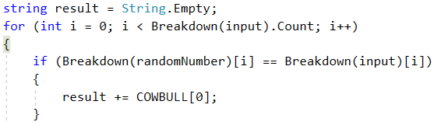
Notes:
BREAKDOWN
What does breakdown function do?
I check the Cows here

Slide 4
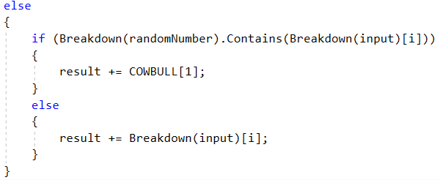
Notes:
If the digit is part of the random number the program replaces it with BULL
In any other case it will return with the original digit
Whole stuff in a do-while loop
Needed to censor numbers

Slide 5
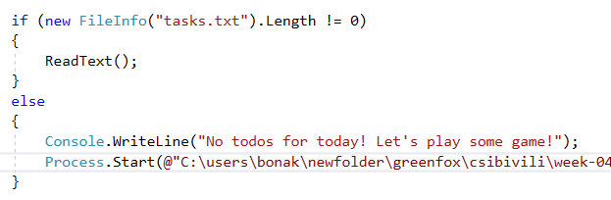
Notes:
- Be quick!

Slide 6
TEST-DRIVEN-DEVELOPMENT
STILL FOUND BUGS
Vilmos Csibi
Notes:
- I forced myself to complete this exercise with Test-Driven-Development process.
I wrote dozens of test but still found bugs.

