Slide 1
VODAFONE
2 YEARS
HUMAN CALCULATOR
GREEN FOX
4 MONTHS
AUTOMATE THE BORING STUFF
Vilmos Csibi
Notes:
Greeting / Introduction
I saw the opportunity in one of our exercises which I want to present you.

Slide 2
Cows
Game rules
Correct digit on a correct place = COW
Correct digit but wrong place = BULL
Random number: 3578
Your guess: 3769
Traditional game: “1 Cow and 1 Bull”
My version: “Cow5Bull8”
Bulls

Slide 3
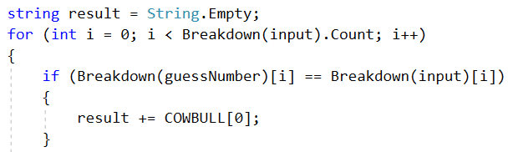
Notes:
What does breakdown function do?
I check the Cows here

Slide 4
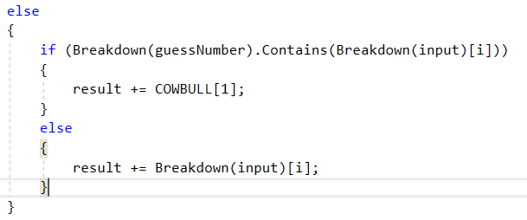
Notes:
Check the Bulls

Slide 5
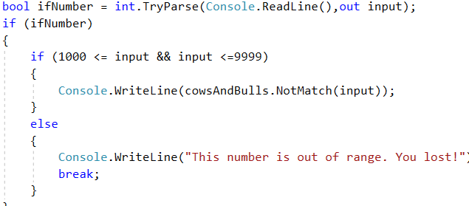
Notes:
Main program

Slide 6
TEST-DRIVEN-DEVELOPMENT
COULD HAVE USE
NEW FEATURE IN TODO APP
STILL FOUND BUGS
COULD HAVE USE
NEVER EMPTY TODO LIST
Vilmos Csibi

