Slide 1
8th week summary
Total Commits So Far
479
Target: 1K (end of the course)
Favourite Exercise – ToDo
Handling Users
2 days
Sean Walton – Youtube ToDo Tutorial
Web Application (MVC)
Different versions of VS, MSSQL vs PostgreSQL
Csibi Vili
Notes:
Okay with Model-View-Control approach
Also with simple tables
First: On my own
Suvi’s help
googlin
Login or connected tables

Slide 2
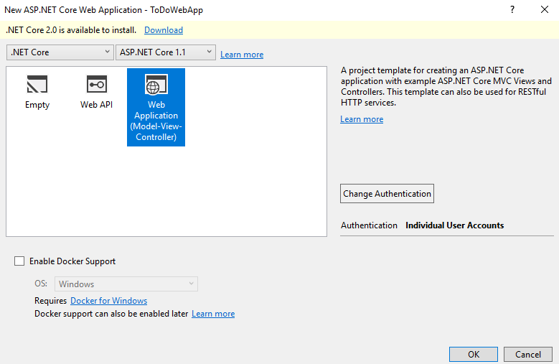
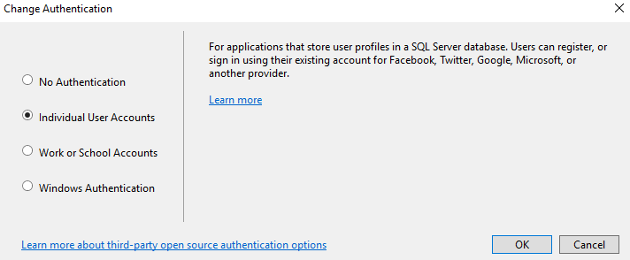

Slide 3
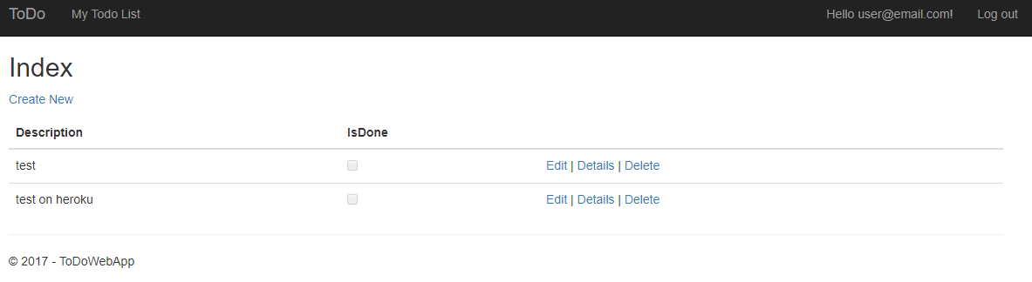
Notes:
Based on the first two videos

Slide 4
Steps
Change the connection string
Install the packages (Postgre)
Add ToDo Class
Add new migration
Add few lines of code based on the tutorial
Modify the view a little (deleting some stuff)

Slide 5
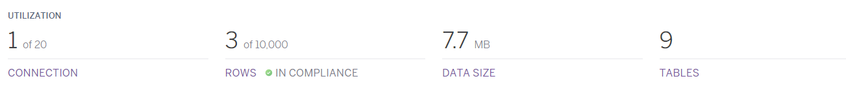
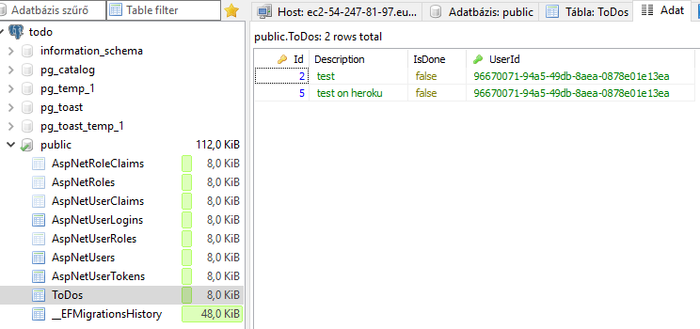
Notes:
Uniqe userIds which are connected to a user
Lot of tables and probably most of them are not necessary

Slide 6
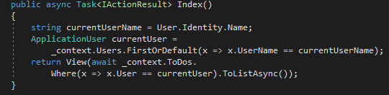
Code

Slide 7
Plans
Find the repository! Where are you, my old friend?
Build it without the tutorial
Get rid of unnecessary features
Views
Controllers
Properties
Understand what is left
Do it in an empty project

