Slide 1
6th week summary
Total Commits So Far
392
Target: 1K (end of the course)
Favourite Exercise – Black Jack
2 days
Max 100 lines / Class
TDD + UML
Time Saving
Why did I wait so long?
Csibi Vili

Slide 2
UML
Card
Which deck Suit Rank
Get info
Deck
Two decks List<Card>
Shuffle Pull First Last Random
Game

Slide 3
UML
Game
Players List<Player> Deck Value of Cards Dict<string,int[]>
Deal Value of hand Best possible value Compare hands Win or lose?
IRules
Deal
Player
Hand List<Card>
Pull a card
User
Comp

Slide 4
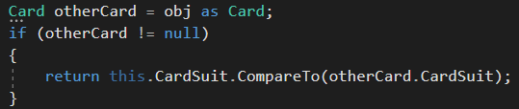
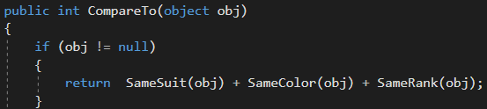
TDD – To make two reference values comparable

Slide 5
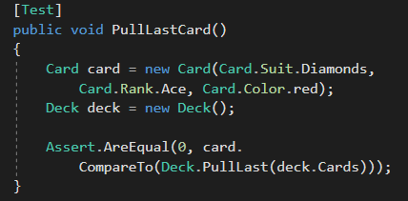
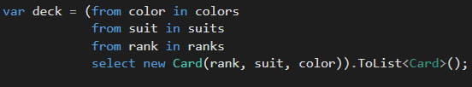

Slide 6
Summary
I will use more often UML & TDD
Black Jack is one of the most simple card games
Still hard to create the rules
Easy to figure out which is the best possible way to use an ace
Extra challenge for next week: create an other game by only modifying the game class

