Slide 1
8th week summary
Total Commits So Far
392
Target: 1K (end of the course)
Favourite Exercise – ToDo
4 days
Handling Users
Not empty MVC application
Sean Walton – Youtube video playlist
Different versions of VS, MSSQL vs PostgreSQL
Csibi Vili
Notes:
Sean Walton

Slide 2
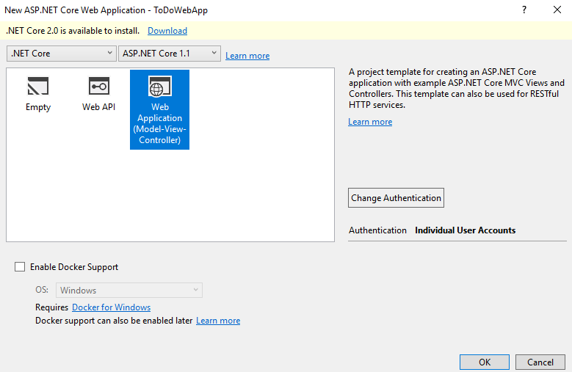
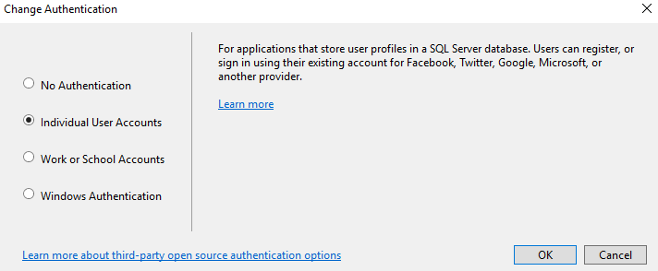

Slide 3
UML
Game
Players List<Player> Deck Value of Cards Dict<string,int[]>
Deal Value of hand Best possible value Compare hands Win or lose?
IRules
Deal
Player
Hand List<Card>
Pull a card
User
Comp

Slide 4
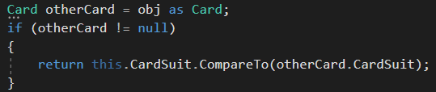
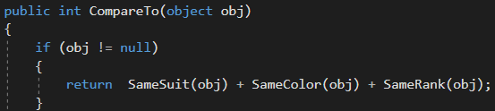
TDD – To make two reference values comparable

Slide 5
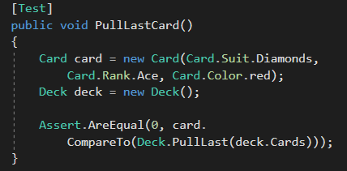
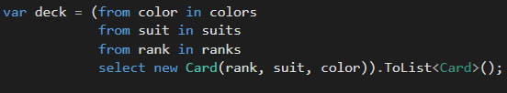

Slide 6
Summary
I will use more often UML & TDD
Black Jack is one of the most simple card games
Still hard to create the rules
Easy to figure out which is the best possible way to use an ace
Extra challenge for next week: create an other game by only modifying the game class

