Slide 1
VODAFONE
2 YEARS
HUMAN CALCULATOR
GREEN FOX
4 MONTHS
AUTOMATE THE BORING STUFF
Vilmos Csibi
Notes:
Greeting / Introduction
I saw the opportunity in one of our exercises which I want to present you.

Slide 2
7th week summary
Total Commits So Far
442
Target: 1K (end of the course)
Favourite Exercise – Black Jack
4 days
2-4 hours / day
MVC + DI
Challenging
However good feeling to deploy something online

Slide 3
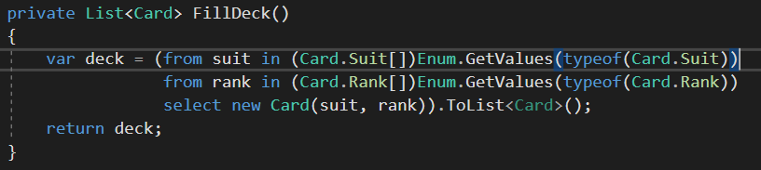
Deck
Card
Suit Rank
Deck
- List<Card>
Notes:
Enum & LINQ

Slide 4
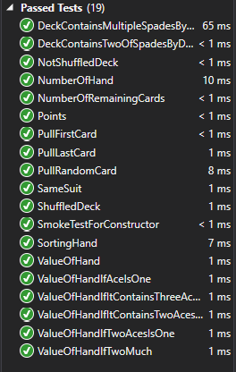
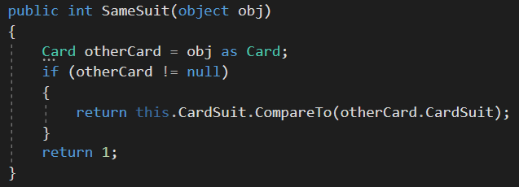
TDD
Notes:
To make cards comparable I needed to overwrite the Icomparable interface

Slide 5
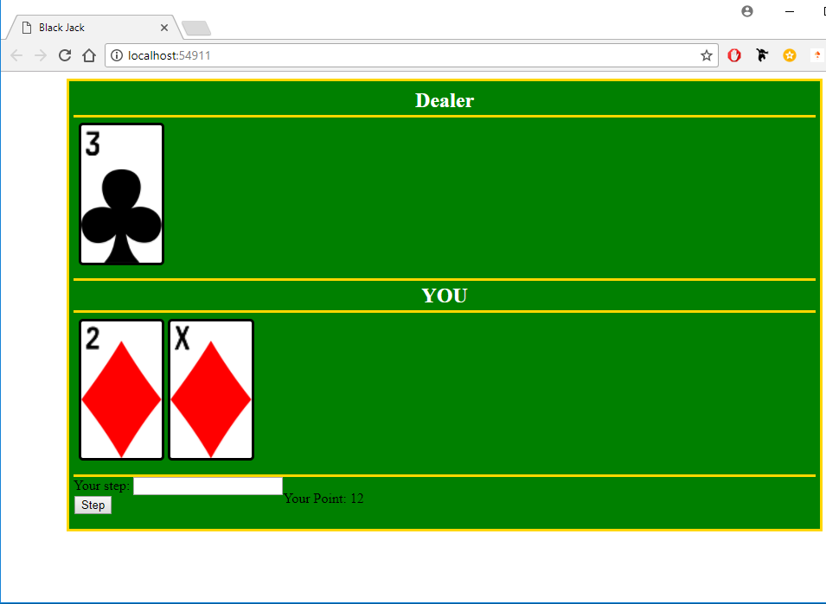
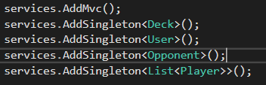
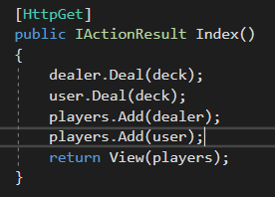

Notes:
HTML & CSS
Created a class for each suit – background image
Player: User or Opponent – Polymorphism
In BlackJack after dealing the dealer only shows his first card

Slide 6
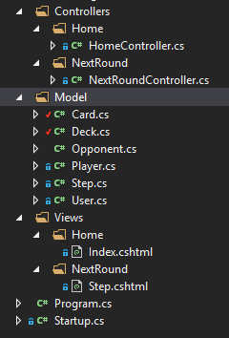
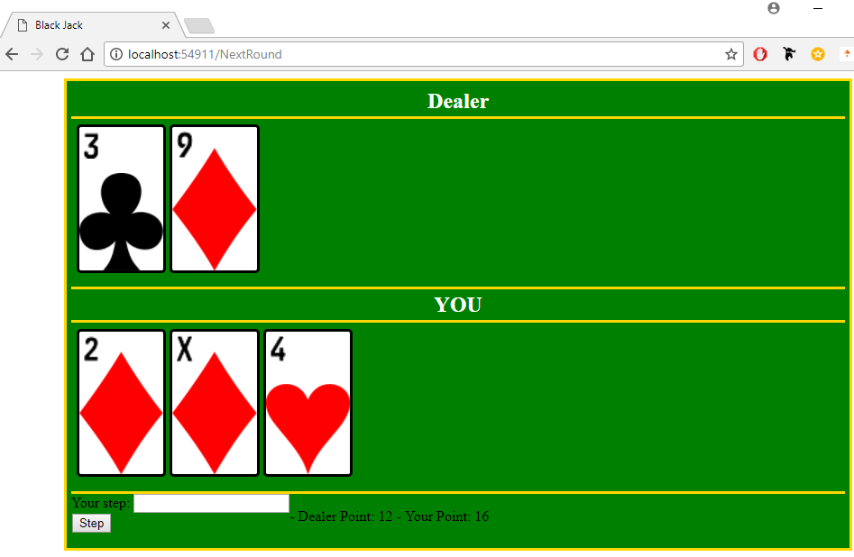

Slide 7
SOMETHING THAT I CAN SHOW TO MY FRIENDS
NOT WORKING YET
Vilmos Csibi
Notes:
- I forced myself to complete this exercise with Test-Driven-Development process.
I wrote dozens of test but still found bugs.

