Slide 1
3rd week summary
Commits
215
Target: 5K.
Finished Exercizes
Cca. 60%
-at least 25% drop
StackOverFlow
9999999999999999…
Why are you doing this to me?
Vili

Slide 2


Slide 3
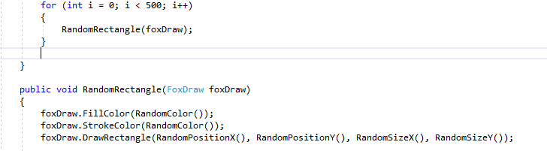
Rectangles

Slide 4
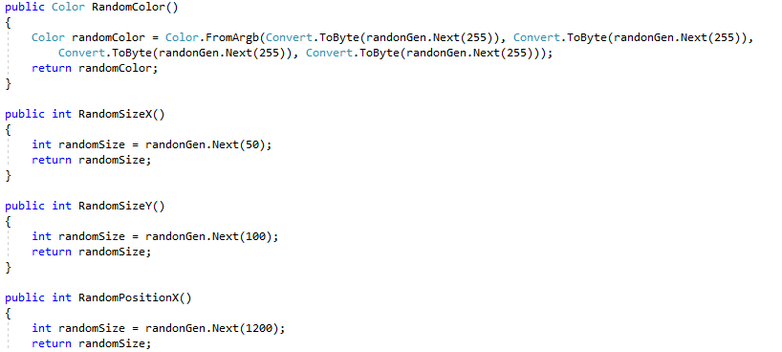

Slide 5
Random
Starts from a seed value which is time independent
Which means if you use a Random on function level the seed would repeat itself
Static Random random = new Random ();

Slide 6


