Slide 1
VODAFONE
2 YEARS
HUMAN CALCULATOR
GREEN FOX
4 MONTHS
AUTOMATE THE BORING STUFF
Vilmos Csibi
Notes:
Projects
Assigning feature

Slide 2
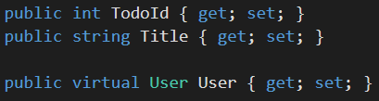
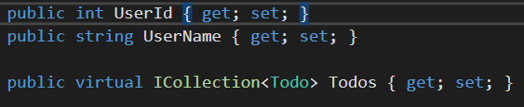
Tables
User
UserID (PK) UserName
ToDo
TodoID (PK) Title User (FK)
Notes:
Simple one-many relationship
In real life it would be many-many

Slide 3
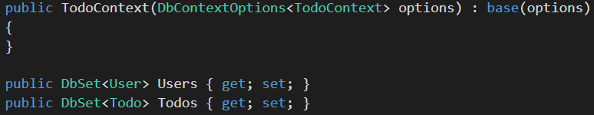
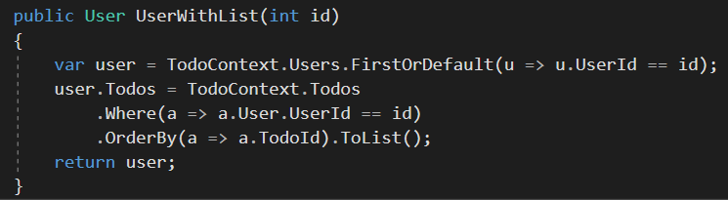
Relationship Problems
Notes:
I needed to fulfil the user todos property
At least this way the user gets his list in ordered format for sure

Slide 4
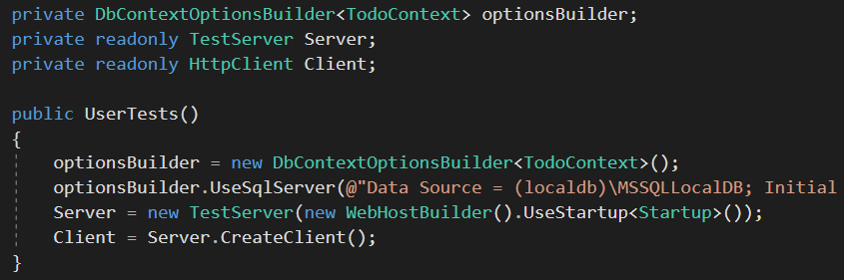
Testserver & local database
Notes:
If I could set up a test server which uses my own local database

Slide 5
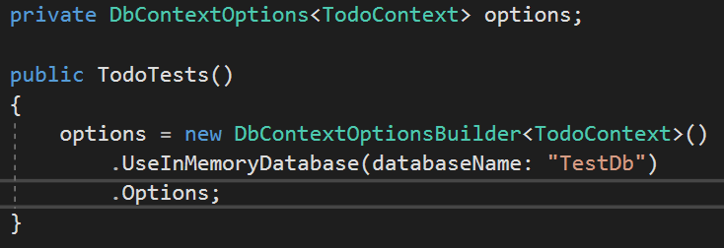
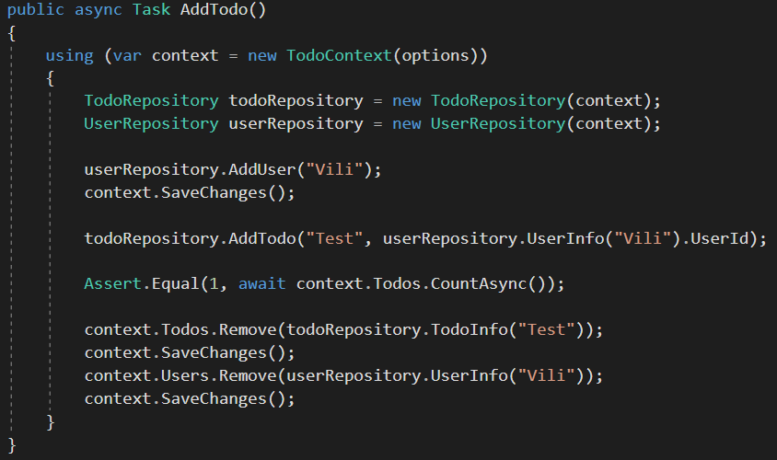
Test
Notes:
Repo – database communication
Why is hard to write good tests

Slide 6
MODELS
TABLES
REPOSITORIES
SERVICES
CONTROLLERS
FIX RELATIONSHIP
REAL TEST SERVER
VIEWS
BOOTSTRAP
Vilmos Csibi
Notes:
- I forced myself to complete this exercise with Test-Driven-Development process.
I wrote dozens of test but still found bugs.

