Slide 1
Demo - week one
Dóri

Slide 2
My first code
lots of new information
suprisingly quite easy
no difficulties
had more on the next day (box model)
by the next day I managed to make difference between the tags <span><div>

Slide 3
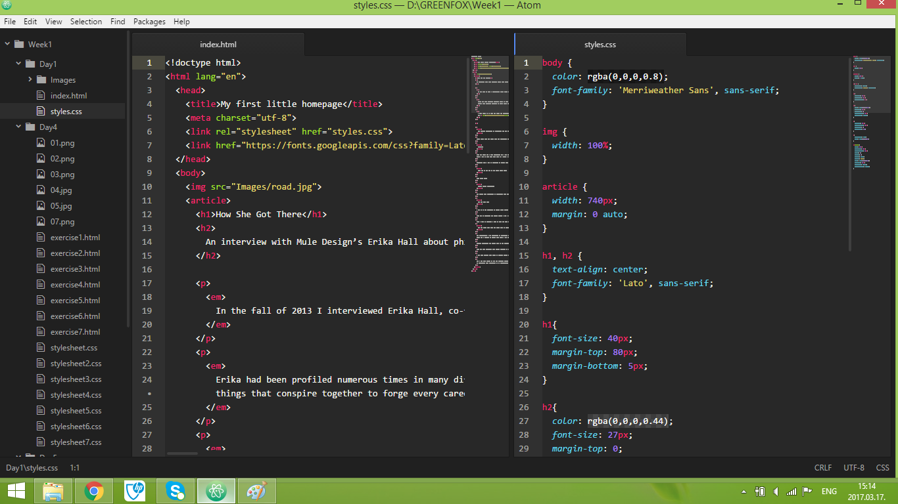
My first code

Slide 4
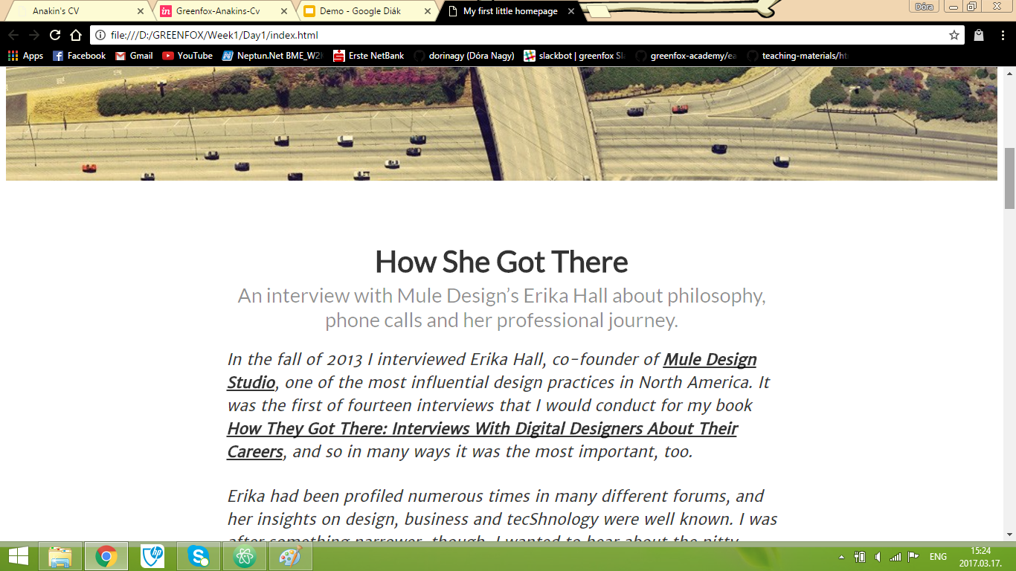

Slide 5

Friday’s project
had some problems with it : picture
managed to solve it
googled a lot - it was very useful
the “blockquote issue”
(two ,, upside down)

Slide 6
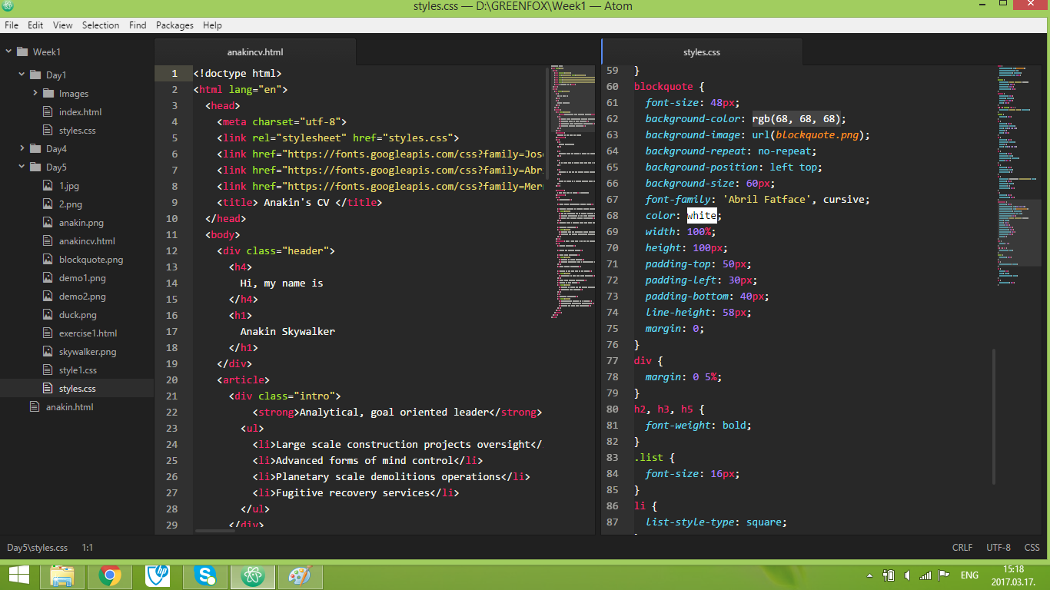

Slide 7
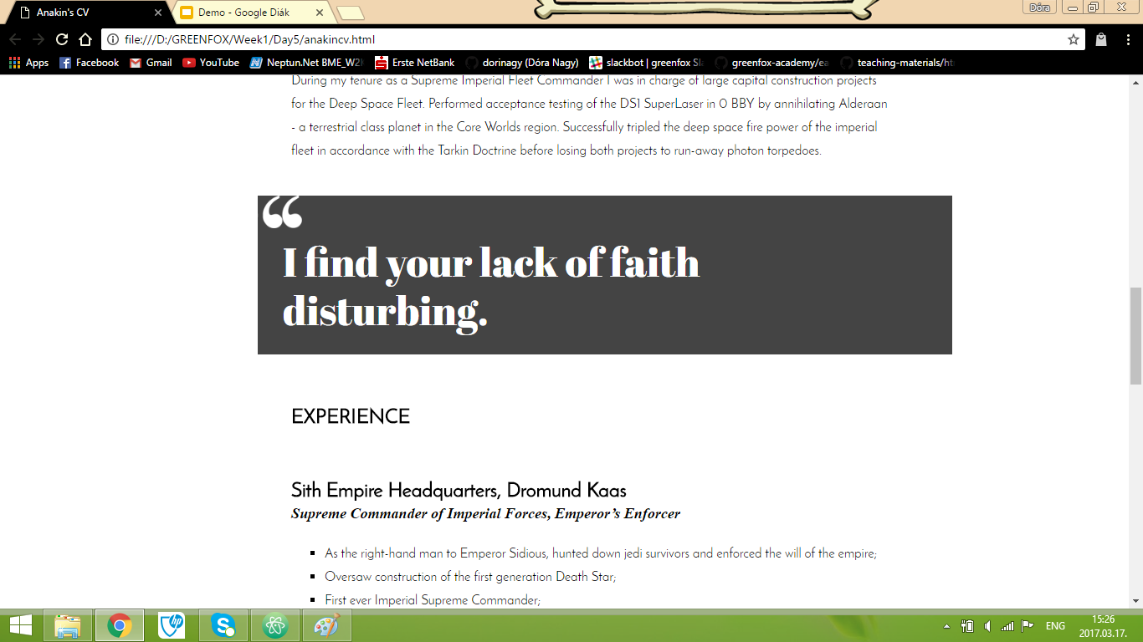

Slide 8

Thank you

