Slide 1

Weekly demo
What I learned so far
András Gerencsér • geriari • Week 01

Slide 2
Stuff I learned
but
I won’t talk about
boolean logic, logic gates, binary, ALU, registers, RAM, CPU, internet, wires, packets, routers, IP address, DNS, encryption, public keys, security protocols, CLI, blind typing, github, stage, commit, push, pull, fork, ...

Slide 3
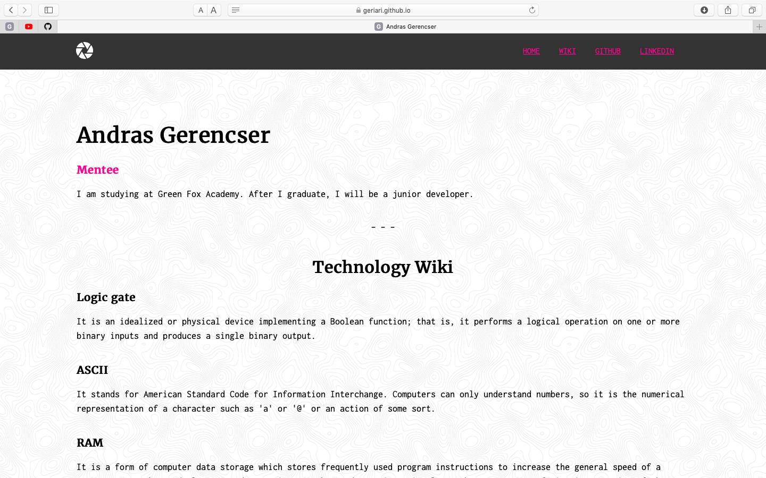
My First Webpage

Slide 4
My First Webpage
1 Understanding vs. doing
2 RTFM
3 Collaboration

Slide 5
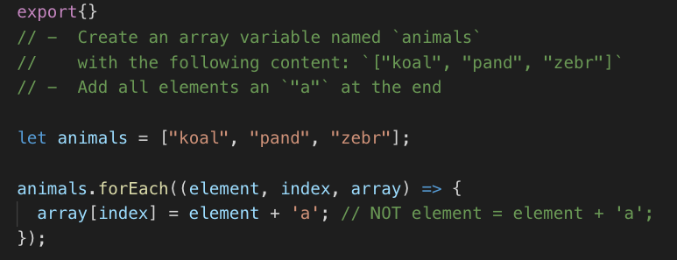
Javascript
method arguments vs variables

Slide 7
Thank you

