Slide 1
Sorting algorithms
András Gerencsér github.com/geriari
Notes:
Why is it important?

Slide 2
What is sorting?
Arranging the elements in a list* in increasing or decreasing order of some property.
*Condition: the list should be homogeneous.

Slide 3
Why sort data?
improve readability

Slide 4
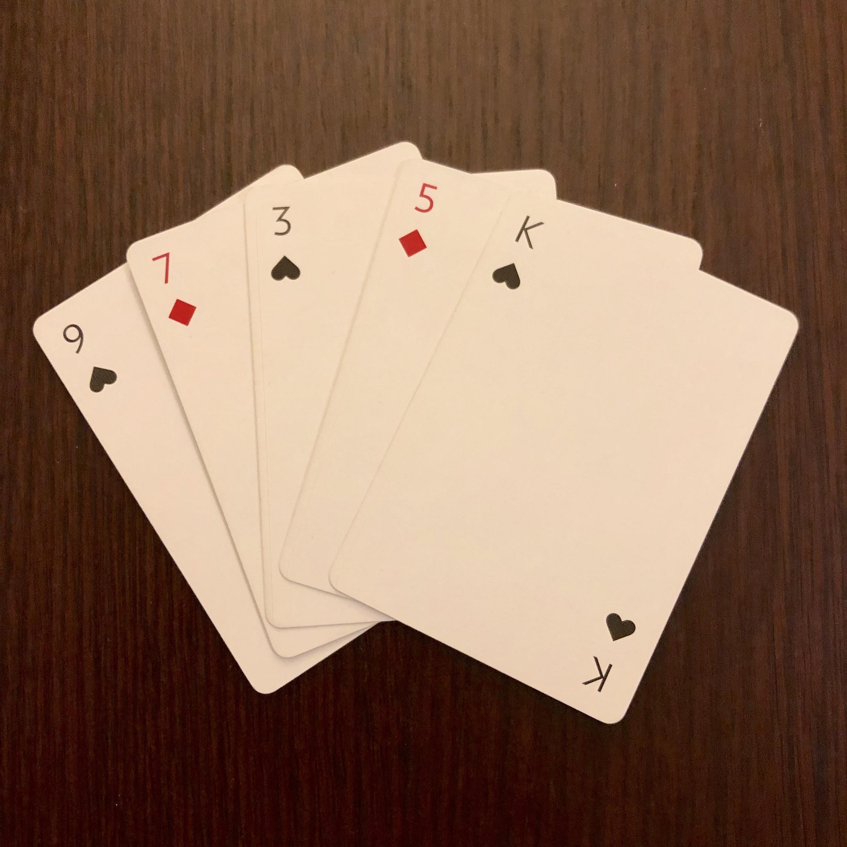
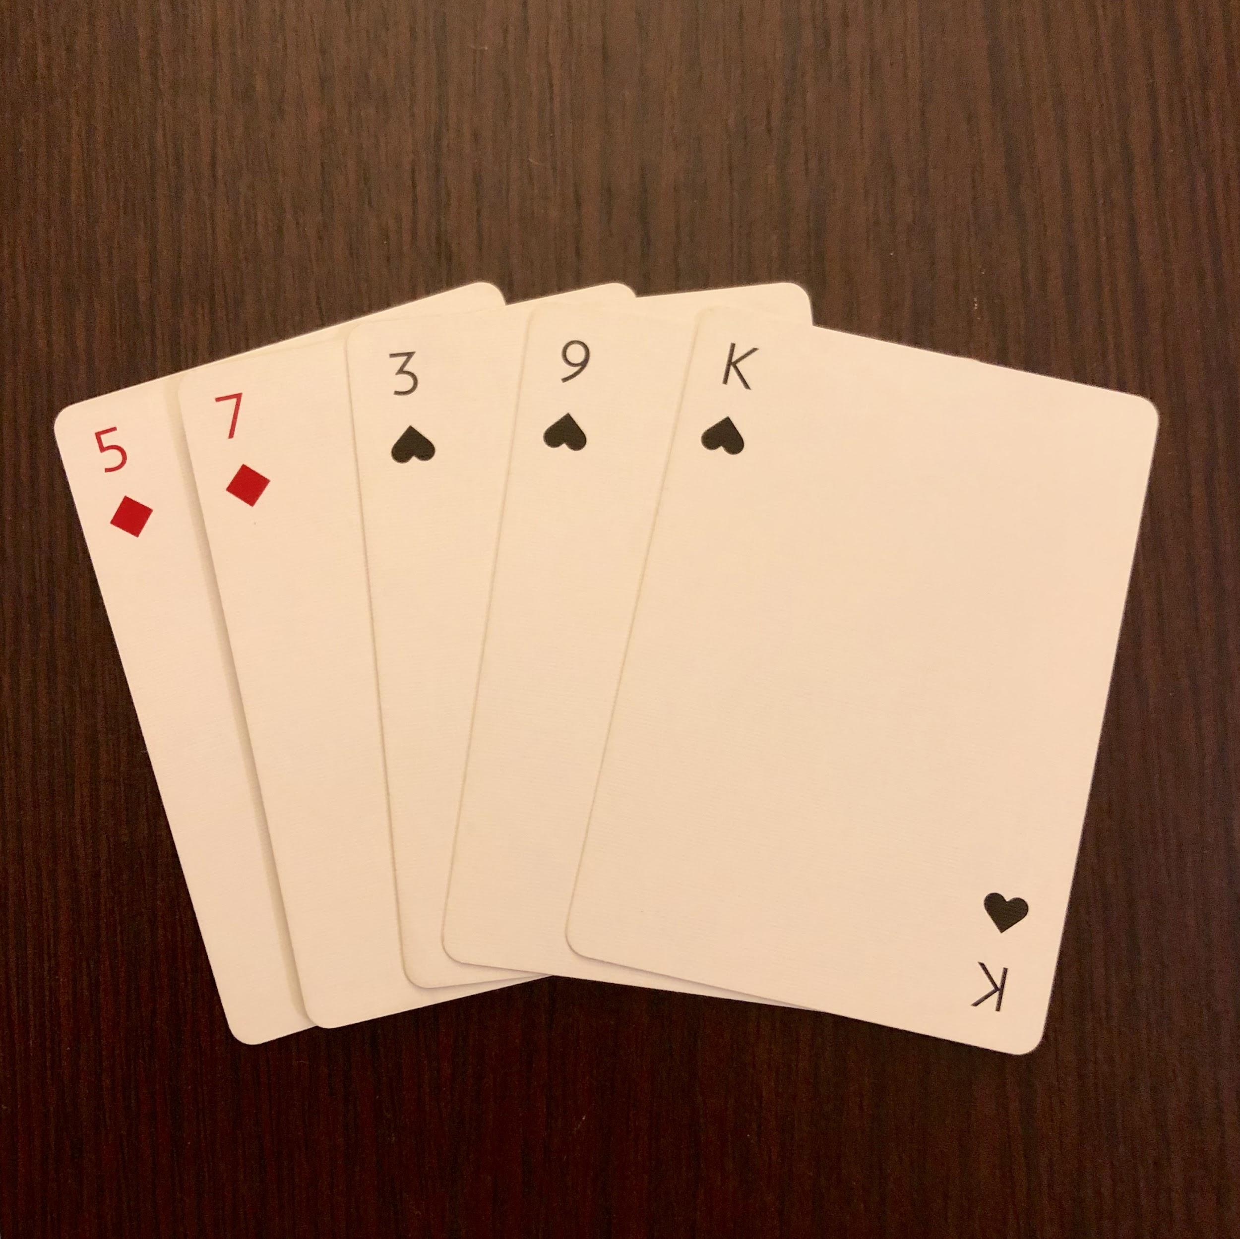
unsorted
sorted

Slide 5
Why sort data?
improve readability
make search easier
unsorted list ⇒ linear search
sorted list ⇒ binary search

Slide 7
Some sorting algorithms

Slide 9
Classification of sorting algorithms
computational complexity (speed)
recursive / non-recursive
stability

Slide 10
Stability - example
Original list
France 12
USA 21
UK 12
Germany 14
Sorted 1 (stable)
USA 21
Germany 14
France 12
UK 12
Sorted 2 (non-stable)
USA 21
Germany 14
UK 12
France 12

Slide 11
Selection sort
simplest
we would intuitively sort this way
scan the list, find the smallest one, put it in the beginning of the list, repeat

Slide 12
Selection sort

Slide 13
Selection sort

Slide 14
Classification of selection sort
fast on small lists, slow on large lists
non-recursive
non-stable (but can be implemented as stable)

Slide 15
2. Bubble sort
simple
often used to introduce the concept of sorting algorithms
compare two adjacent elements, change if necessary, move on

Slide 16
Bubble sort

Slide 17
Bubble sort

Slide 18
Classification of bubble sort
slooooow ⇒ not used
non-recursive
stable

Slide 19
3. Quick sort
a divide and conquer algorithm
very efficient
widely used

Slide 20

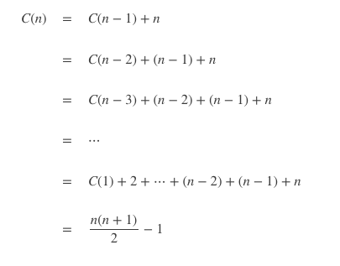

Quick sort - mathematical model

Slide 21
Quick sort - mathematical model

Slide 22
Quick sort
Select a pivot element.
Put smaller elements to the left, bigger element to the right of the pivot in the list.
Repeat recursively on the two halves. (Base case: number of elements <= 1.)

Slide 23
| 6 5 1 3 8 2 7 9 4 Step 0: declare wall index and pivot
| 6 5 1 3 8 2 7 9 4 Step 1: 6 > 4
| 6 5 1 3 8 2 7 9 4 Step 2: 5 > 4
| 6 5 1 3 8 2 7 9 4 Step 3: 1 < 4, change + move wall
1 | 5 6 3 8 2 7 9 4 Step 4: 3 < 4, change + move wall
1 3 | 6 5 8 2 7 9 4 Step 5: 8 > 4
Pivot | Wall Current element
Notes:
Look at all the elements other than the pivot.
Put smaller elements on left of the wall, bigger elements on right of the wall.
In the end we put the pivot element to its place: just right of the wall.

Slide 24
1 3 | 6 5 8 2 7 9 4 Step 6: 2 < 4, change + move wall
1 3 2 | 5 8 6 7 9 4 Step 7: 7 > 4
1 3 2 | 5 8 6 7 9 4 Step 8: 9 > 4
1 3 2 | 4 8 6 7 9 5 Step 9: put 4 to the right of the wall
1 3 2 Repeat the process with these
4 8 6 7 9 5 two subarrays (recursion).
Pivot | Wall Current element
Notes:
Look at all the elements other than the pivot.
Put smaller elements on left of the wall, bigger elements on right of the wall.
In the end we put the pivot element to its place: just right of the wall.

Slide 25
Quick sort

Slide 26
Classification of quick sort
quick, especially on long lists
recursive
non-stable

Slide 27
Summary
 | Selection | Bubble | Quick
Speed | ❌ | ❌ | ✅
Recursive | ❌ | ❌ | ✅
Stable | ❌ | ✅ | ❌

Slide 28
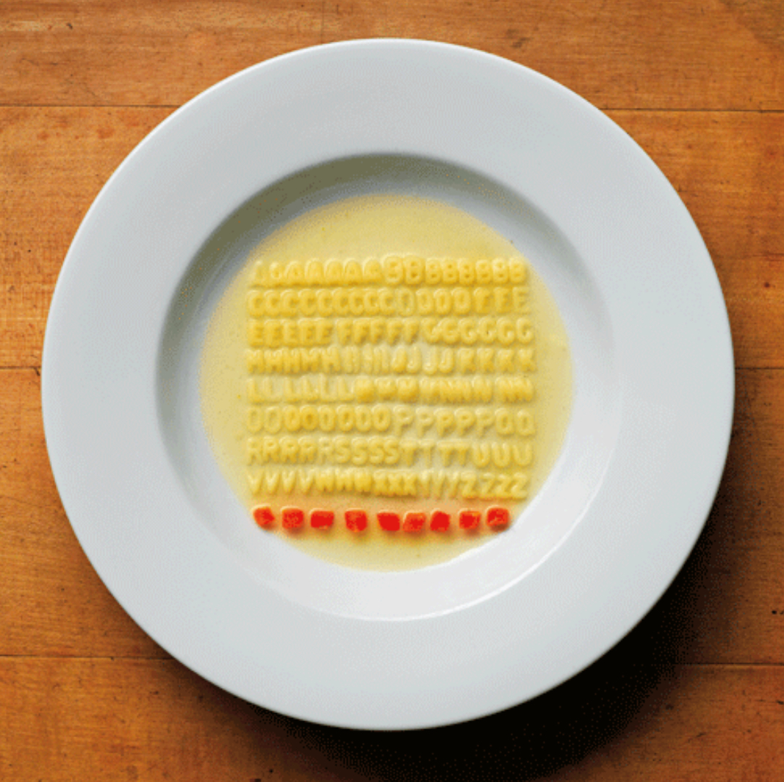
Sorting is your friend!

Slide 29
Thank you for your attention!

