Slide 1

Weekly demo
András Gerencsér • geriari • Week 02

Slide 2
Two tidbits from this week
1 Working with objects in arrays
2 Dynamically access object properties
Notes:
I have two tidbits from this week. Both are related to the object properties.

Slide 3
Working with objects in arrays
- We have objects in an array
- We have a property value to look for
- How do we filter elements, that have
this property value
Notes:
Let’s see an example.
We have objects in an array.
We have a property value to look for.
How do we filter elements, that have this property value. It’s easy, right?

Slide 4
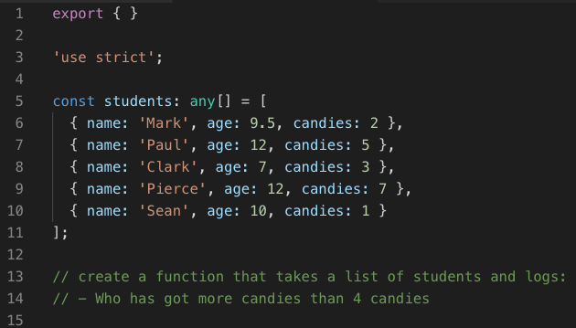

Slide 5
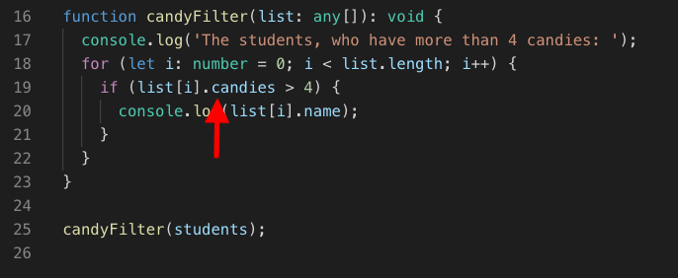
Easy: make a ‘for loop’

Slide 6
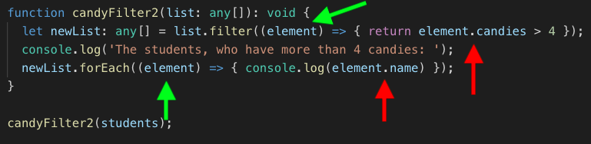
Tricky: use methods
Notes:
You specify the candies property in the callback function.
In the method’s argument you just put the elements.
I did the same thing two rows later, when I logged the filtered students.
So. That was the way to use methods on arrays of objects.

Slide 7
2. Dynamically access object
properties
Notes:
Next: Dynamically access object properties. What the heck is that?

Slide 8
Two ways to access properties of an object
Hard coded: dot notation
Object.property
Notes:
So. Let’s see two ways to access the property of an object.
One is the one we know.
It means, you hard-code the property name of the object in your code. E.g. student.name.
But what if you want your property to be a variable?

Slide 9
Two ways to access properties of an object
Hard coded: dot notation
Object.property
Dynamically: bracket notation
Object[variable]
Notes:
This is what we call dynamically accessed property.
And we must use a different syntax for this.
Let’s see an example: the Rick Astley exercise.

Slide 10
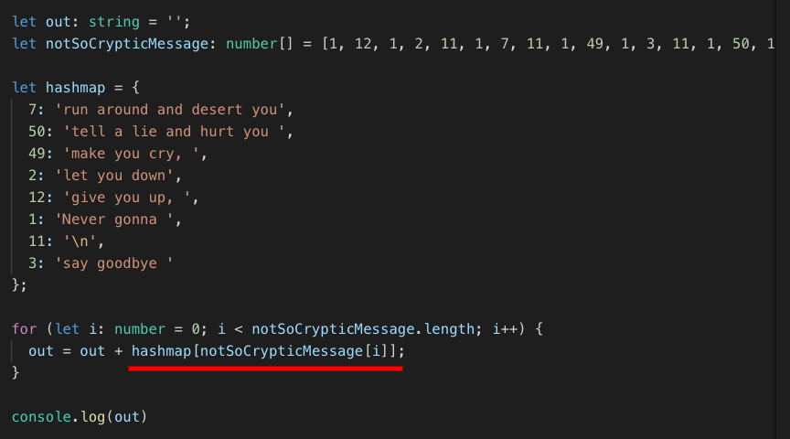
Notes:
We have an array with numbers and we have one object with lots of properties.
And the elements of the objects are references to the object’s properties.
So what we do: we run through the array, and use the array elements as references to the object’s property. As you can see underlined.

Slide 11
It’ not over, yet.
Notes:
But it’s not over yet.
Let’s make our code more compact!
Let’s combine the two things I was talking about.

Slide 12
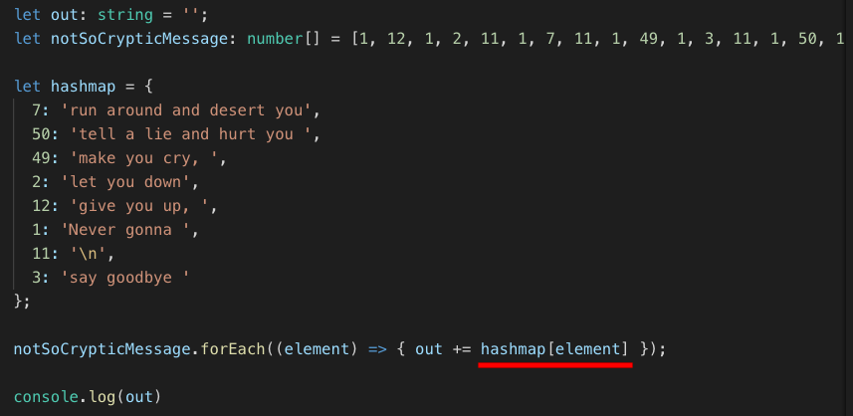
Notes:
In the end we have only 1 line of code that does the job.
Here I used a forEach method
and the dynamic reference to the object property is inside the callback function of the method.

Slide 13
Notes:
I know, it was a bit too much for Friday evening, but anyway:

Slide 14
Thank you
for your attention.

