Slide 1
The 6th Week…
Peter Horgas

Slide 2
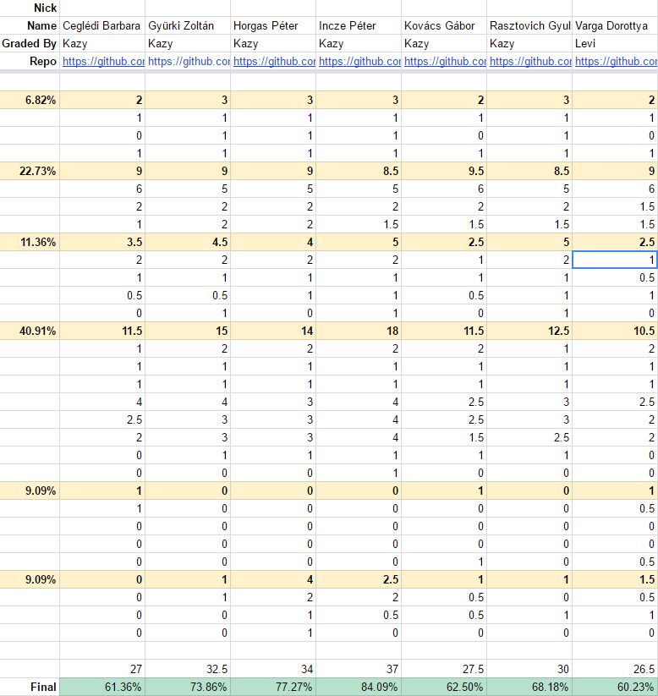
Exam: fear, shivering
& success

Slide 3
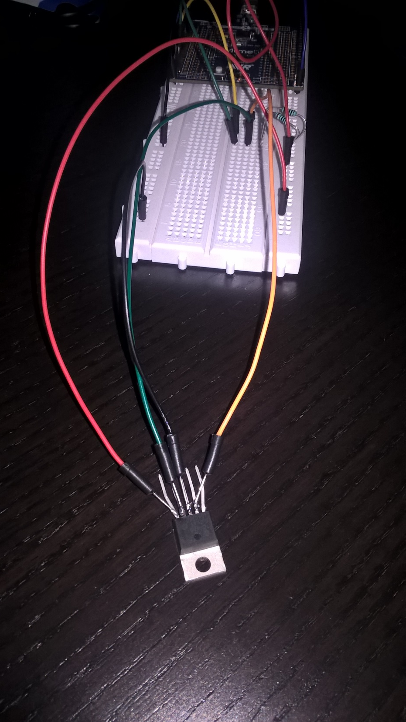
Extended temperature sensor

Slide 4
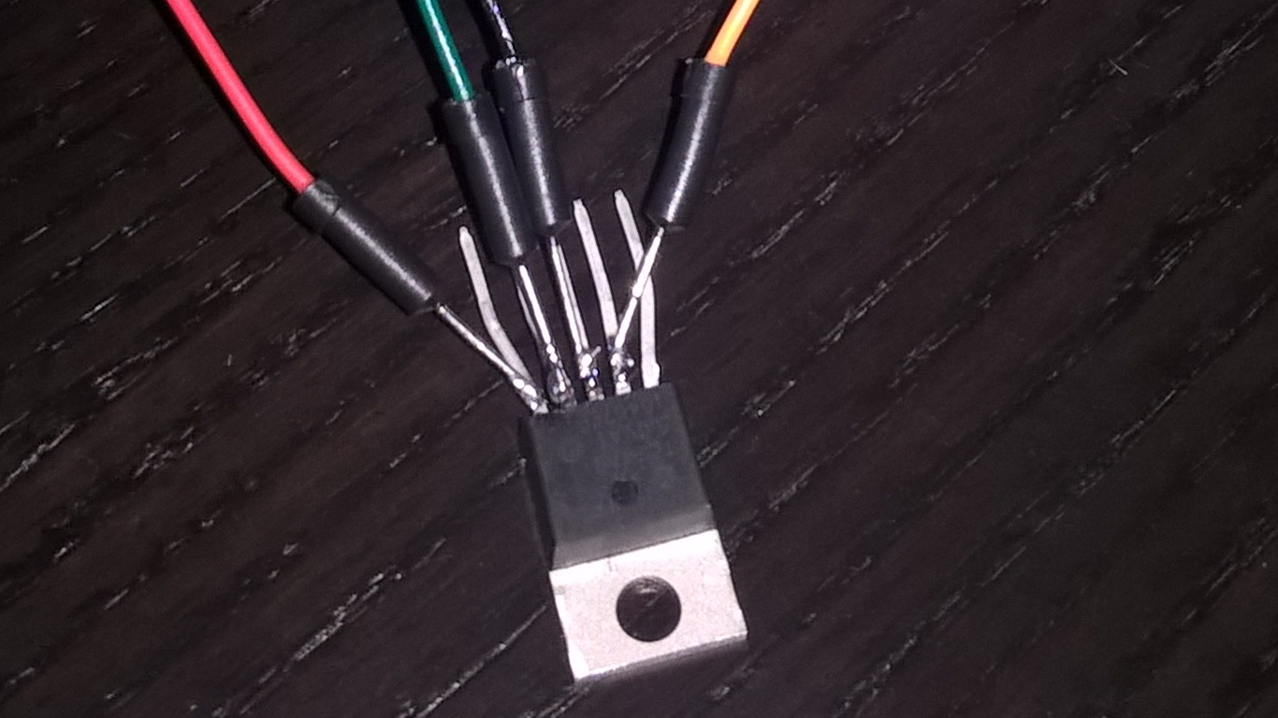
Soldering of the week :)

Slide 5
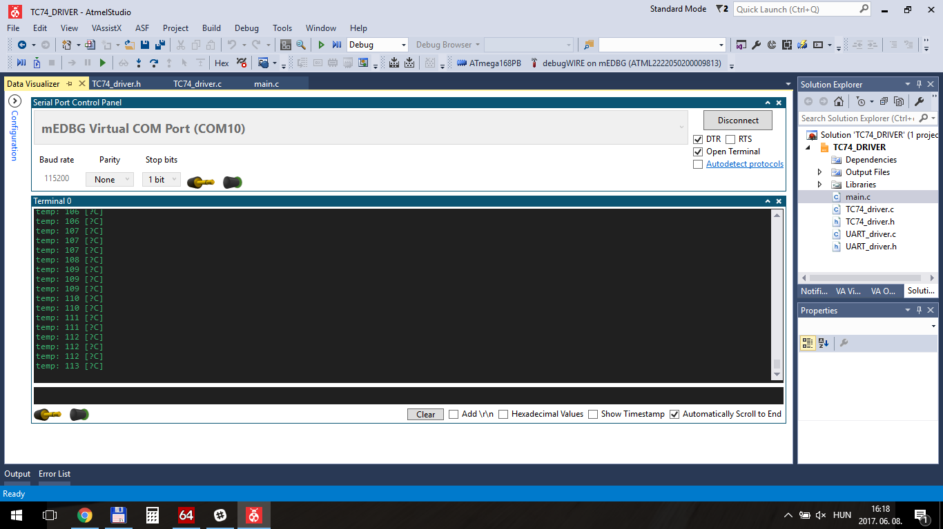
Temp of the Soldering Station

Slide 6
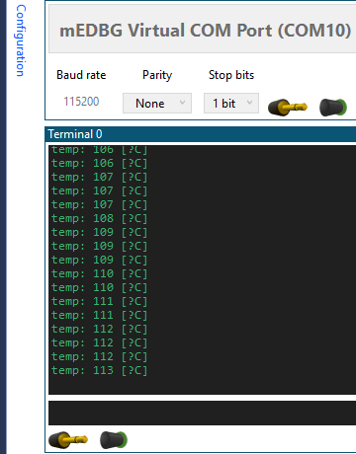
Temp of the Soldering Station
:)

