Slide 1
The 9th week…
Peter Horgas

Slide 2


Slide 3
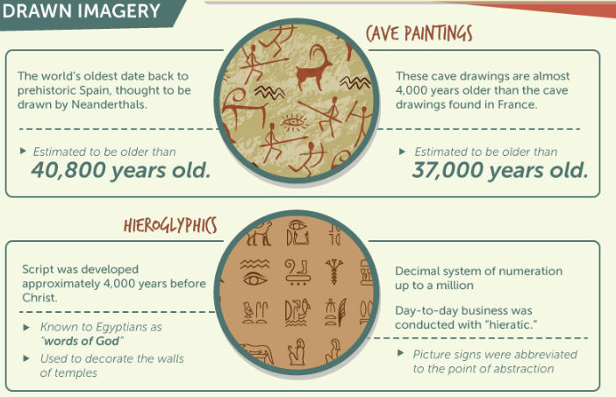

Slide 4

Instant Messaging (IM)
First used in the 1960s, but didn’t enter the mainstream until the 1990s.

Slide 5
1961 – MIT: First network real-time chat
1971 – First network e-mail sent
1991 – Internet access available
1991 – First e-mail sent from space
1992 – First SMS sent

Slide 6
1988 – Internet Relay Chat (IRC)
1996 – ICQ
1997 – AOL Instant Massenger
1998 – Yahoo Massenger
1999 – Microsoft’s MSN

Slide 7
2003 – Skype
2005 – Google Talk
2006 – MySpace
2008 – Facebook Chat
2009 – WhatsApp

Slide 8
2010 – Viber
2011 – SnapChat
2013 – Slack
…

Slide 9



