Slide 1
The 4 Week…
Peter Horgas

Slide 2

1. week: Micro:bit

Slide 3
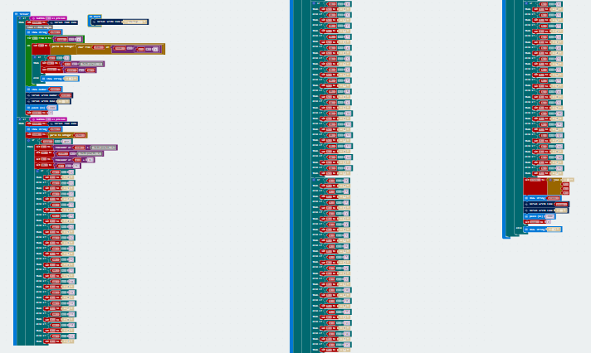
BIN2DEC
DEC2HEX

Slide 4
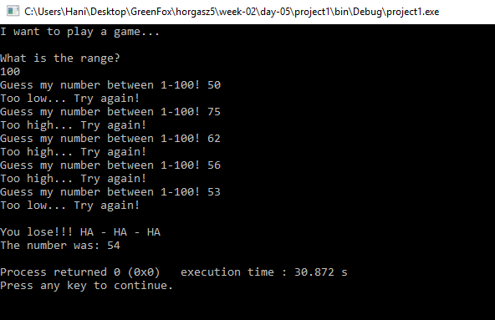
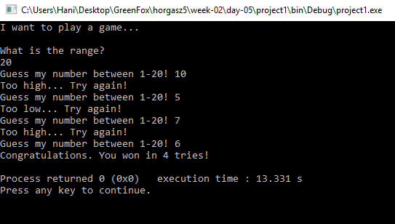
2. week: Guess the number!

Slide 5
3. week: Blinking…

Slide 6
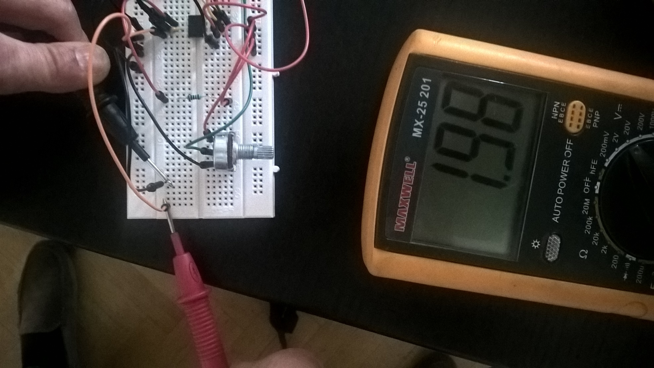
DC Function generator

Slide 7
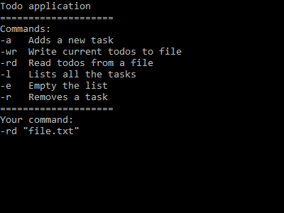
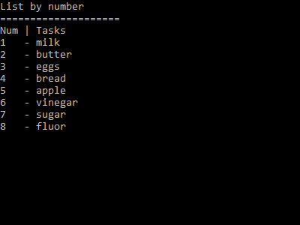
4. week: ToDO Application

Slide 8



