Slide 1


Slide 2
What motivates us?
If you REWARD something do you get MORE of the BEHAVIOUR you want?
If you PUNISH something do you get LESS of the BEHAVIOUR you want?

Slide 3
MIT study
Whole group of students
Challenges:
Memorizing strings of digits
Solving puzzles
Physical task like (throwing a ball through a hoop)

Slide 4
MIT study
To incentivise their performance they gave them 3 levels of reward
If they did:
Pretty well: Small ammount of prize
Medium well: Medium ammount of prize
Really well: $$$ they made it rain for them
We’ve seen this before this is the typical motivation sceem
Reward top performers
Ignore low performers

Slide 5
What happens???

Slide 6
MIT study
As long as the task involved only MECHANICAL SKILL
It worked
Higher pay leads to better performance

Slide 7
MIT study
Once the task calles for rudimentary COGNITIVE skill
Higher reward lead to poorer performance
WTF?
Once you get abouve tudimentary cognitive skill it works the other way around.

Slide 8
MIT study
For simple tasks → if you do THIS then you get THAT works fine.
Complicated tasks → This motivator won’t work

Slide 9
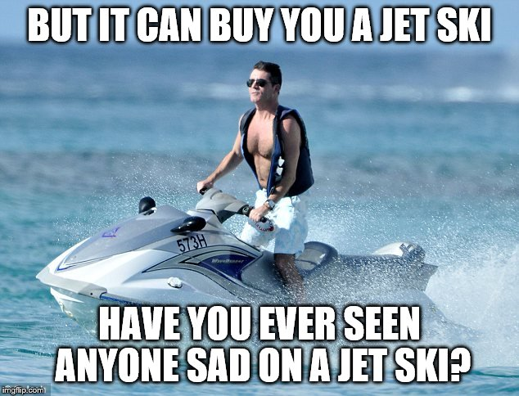
FACTS
Money can’t buy happiness
MONEY IS A MOTIVATOR
If you don’t pay people enaugh, they won’t be motivated
What do you do?
Pay people enaugh so they’re not thinking about money → they are thinking about the work

Slide 10
So what leads to better performace?
3 factors:
Autonomy
Mastery
Purpose

Slide 11
Autonomy
Desire to be self directed
Let the people go the way they want
Traditional Management:
Go this way
Do that
Do it this way etc…
If you want ENGAGEMENT
Self direction is better
Let them do it their way

Slide 12
Mastery
Is the urge to get better at stuff
This is why i play the guitar…
But why do i do that?
Economically it makes no sense it wont get me a raise or through te RERE EXAM
It’s Fun, Satisfying etc..
We like to get better at stuff

Slide 13
Purpose
The reason for wich something is done or created.
Why you do what you do:
https://www.youtube.com/watch?v=Cpc-t-Uwv1I
When you think PROFIT
If only money drives you: BAD THINGS HAPPEN like…
When you think ABOVE PROFIT
Eg.: I wanna make the world a better place…: COOL THINGS HAPPEN

Slide 14
Thank you for your Attention!

