Slide 1
SASS
Syntactically Awesome Style Sheets

Slide 2
What is Sass and Scss?
Scss:
More developed css format
Lets you use features that doesent exist in css.
Sass:
Compiler.
Name of thecnology.

Slide 3

Install and usage of Sass
You can download in all operating system.
Running in command line
Compile in scss
In my application i use Koala

Slide 4
New features in Scss

Slide 5
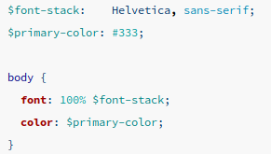
Variables:
We have an option to make variables.

Slide 6
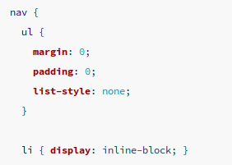
Nesting
We have an option to make hierarchy beetween items like html.

Slide 7
Partials:
You can create partial sass files that contains little snippets of css that you can include in other sass files.
For example:
Buttons.scss
Globals.scss
Variables.scss

Slide 8
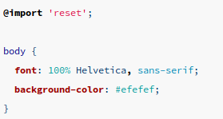
Import:
Sass will take the file that you want to import and combine it with the file you are importing into.

Slide 9
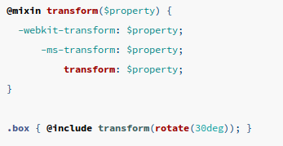
Mixins:
A mixin lets you make groups of css declarations that you want to reuse throughout your site.

Slide 10
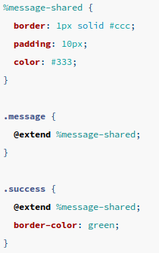
Extend/inheritance:
Lets you share a set of css properties from one selector to another.

Slide 11
Operators:
You can use math operators.

Slide 12
When is it good?

Slide 13
When we have company standard style.
When we want clear css code.
When we need features like mixins and inheritance.
When the technology works with Sass.

Slide 14
Lets see it in our gallery project

