Slide 1

My demo
Made by Kapéter Ákos

Slide 2
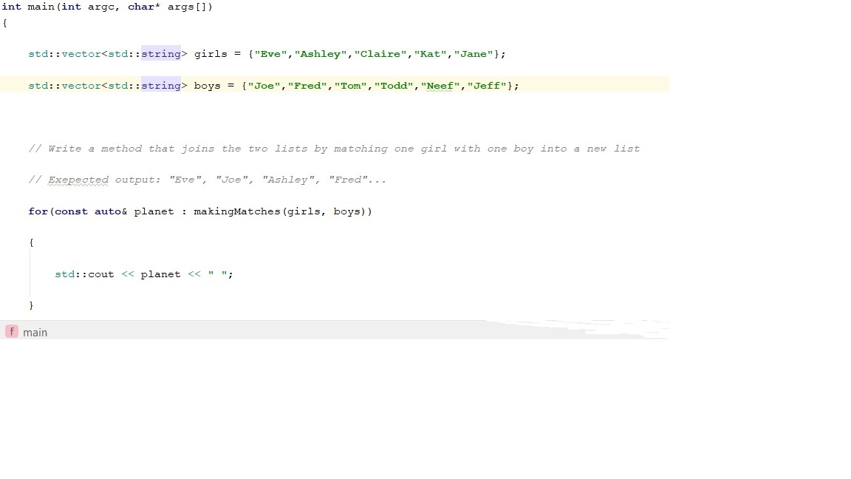
Topic

Slide 3
The Problem
Using the "Insert" function without knowing the correct position of every person
The simple solution would be inserting a girl next to a boy but
thats the GAY solution

Slide 4
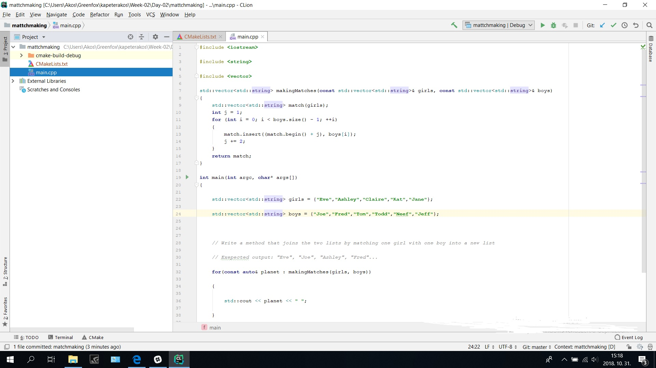

Slide 5
The correct solution
Creating a new vector (ie. match) :
std::vector<std::string> match(girls);
Using a "for" loop .
Using the "insert" function the correct way:
match.insert((match.begin() + j), boys[i]); j += 2;
(Return the "match" vector)

