Slide 1
Week 3 demo
Made by Kapéter Ákos

Slide 2
About this week
Pointers
Drawing

Slide 3
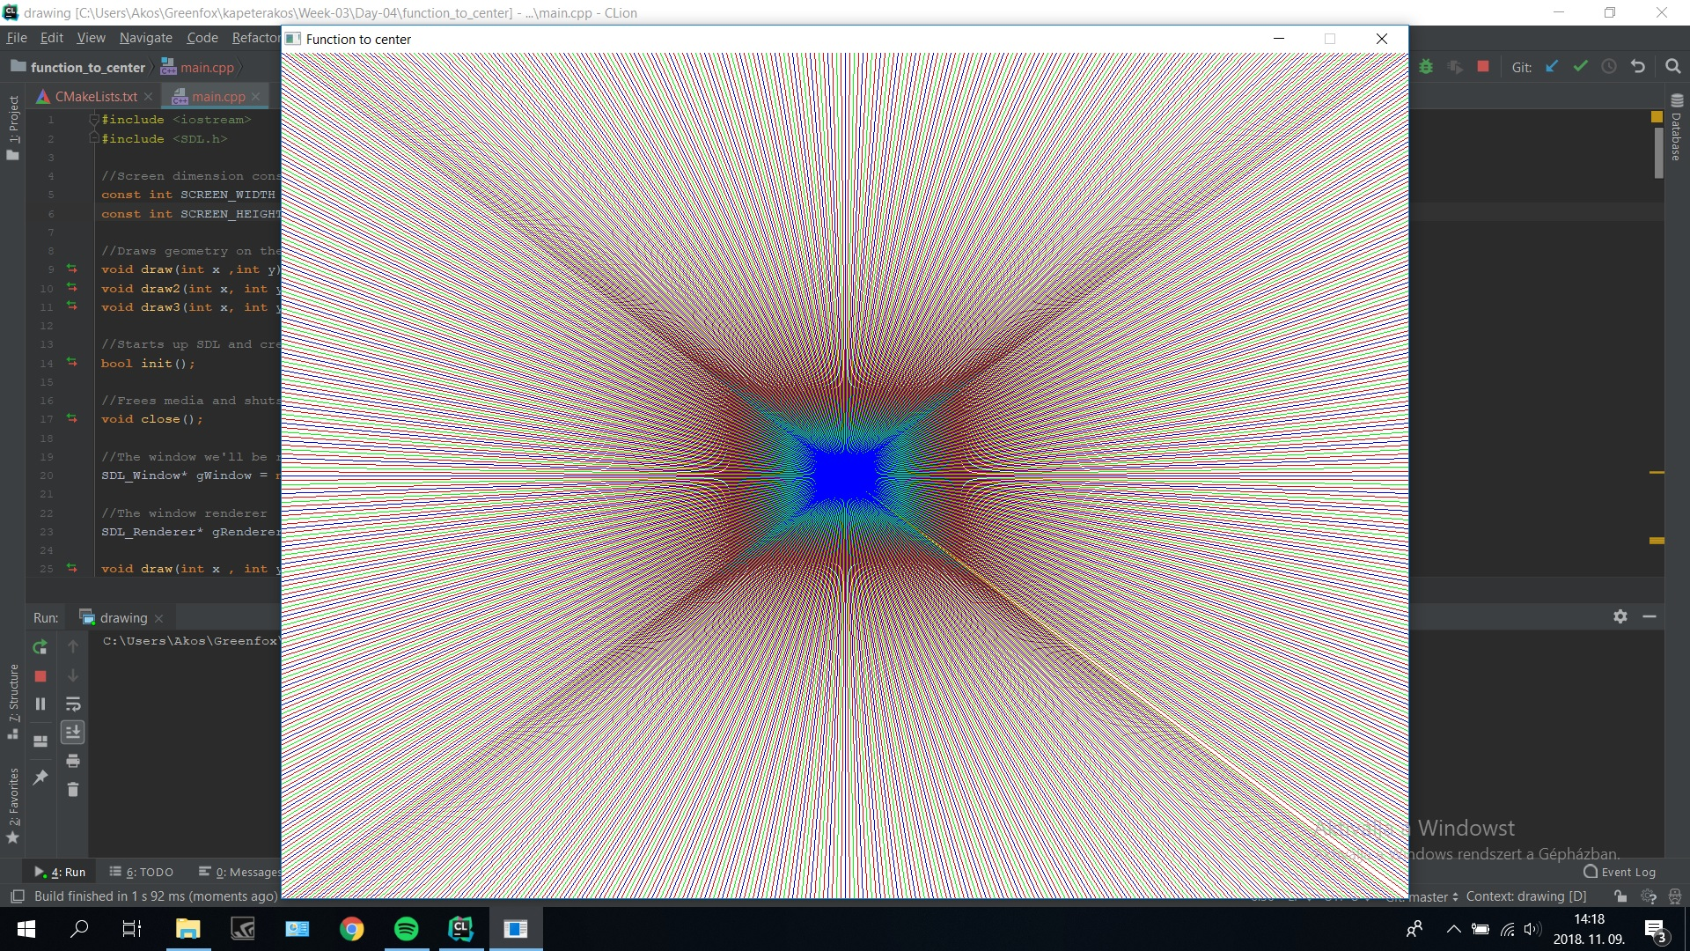
What i enjoyed the most

Slide 4






