Slide 1
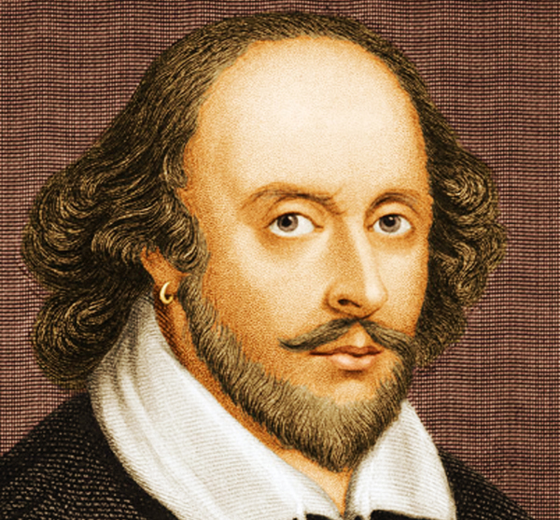
Let’s Rather Talk about Shakespeare
Norbert Kovács, #ALPAGA
25 October 2017

Slide 2
Act I: Hamlet's insults and flattery.
Scene I: The insulting of Romeo.
[Enter Hamlet and Romeo]
Hamlet:
You lying stupid fatherless big smelly half-witted coward! You are as stupid as the difference between a handsome rich brave hero and thyself! Speak your mind!
You are as brave as the sum of your fat little stuffed misused dusty old rotten codpiece and a beautiful fair warm peaceful sunny summer’s day. You are as healthy as the difference between the sum of the sweetest reddest rose and my father and yourself! Speak your mind!
You are as cowardly as the sum of yourself and the difference between a big mighty proud kingdom and a horse. Speak your mind. Speak your mind!
[Exit Romeo]
Act I: Hamlet's insults and flattery.
Scene I: The insulting of Romeo.
[Enter Hamlet and Romeo]
Hamlet:
You lying stupid fatherless big smelly half-witted coward! You are as stupid as the difference between a handsome rich brave hero and thyself! Speak your mind!
You are as brave as the sum of your fat little stuffed misused dusty old rotten codpiece and a beautiful fair warm peaceful sunny summer’s day. You are as healthy as the difference between the sum of the sweetest reddest rose and my father and yourself! Speak your mind!
You are as cowardly as the sum of yourself and the difference between a big mighty proud kingdom and a horse. Speak your mind. Speak your mind!
[Exit Romeo]
Act I: Hamlet's insults and flattery.
Scene I: The insulting of Romeo.
[Enter Hamlet and Romeo]
Hamlet:
You lying stupid fatherless big smelly half-witted coward! You are as stupid as the difference between a handsome rich brave hero and thyself! Speak your mind!
You are as brave as the sum of your fat little stuffed misused dusty old rotten codpiece and a beautiful fair warm peaceful sunny summer’s day. You are as healthy as the difference between the sum of the sweetest reddest rose and my father and yourself! Speak your mind!
You are as cowardly as the sum of yourself and the difference between a big mighty proud kingdom and a horse. Speak your mind. Speak your mind!
[Exit Romeo]
Act I: Hamlet's insults and flattery.
Scene I: The insulting of Romeo.
[Enter Hamlet and Romeo]
Hamlet:
You lying stupid fatherless big smelly half-witted coward! You are as stupid as the difference between a handsome rich brave hero and thyself! Speak your mind!
You are as brave as the sum of your fat little stuffed misused dusty old rotten codpiece and a beautiful fair warm peaceful sunny summer’s day. You are as healthy as the difference between the sum of the sweetest reddest rose and my father and yourself! Speak your mind!
You are as cowardly as the sum of yourself and the difference between a big mighty proud kingdom and a horse. Speak your mind. Speak your mind!
[Exit Romeo]
Act I: Hamlet's insults and flattery.
Scene I: The insulting of Romeo.
[Enter Hamlet and Romeo]
Hamlet:
You lying stupid fatherless big smelly half-witted coward! You are as stupid as the difference between a handsome rich brave hero and thyself! Speak your mind!
You are as brave as the sum of your fat little stuffed misused dusty old rotten codpiece and a beautiful fair warm peaceful sunny summer’s day. You are as healthy as the difference between the sum of the sweetest reddest rose and my father and yourself! Speak your mind!
You are as cowardly as the sum of yourself and the difference between a big mighty proud kingdom and a horse. Speak your mind. Speak your mind!
[Exit Romeo]
Act I: Hamlet's insults and flattery.
Scene I: The insulting of Romeo.
[Enter Hamlet and Romeo]
Hamlet:
You lying stupid fatherless big smelly half-witted coward! You are as stupid as the difference between a handsome rich brave hero and thyself! Speak your mind!
You are as brave as the sum of your fat little stuffed misused dusty old rotten codpiece and a beautiful fair warm peaceful sunny summer’s day. You are as healthy as the difference between the sum of the sweetest reddest rose and my father and yourself! Speak your mind!
You are as cowardly as the sum of yourself and the difference between a big mighty proud kingdom and a horse. Speak your mind. Speak your mind!
[Exit Romeo]
Act I: Hamlet's insults and flattery.
Scene I: The insulting of Romeo.
[Enter Hamlet and Romeo]
Hamlet:
You lying stupid fatherless big smelly half-witted coward! You are as stupid as the difference between a handsome rich brave hero and thyself! Speak your mind!
You are as brave as the sum of your fat little stuffed misused dusty old rotten codpiece and a beautiful fair warm peaceful sunny summer’s day. You are as healthy as the difference between the sum of the sweetest reddest rose and my father and yourself! Speak your mind!
You are as cowardly as the sum of yourself and the difference between a big mighty proud kingdom and a horse. Speak your mind. Speak your mind!
[Exit Romeo]
Act I: Hamlet's insults and flattery.
Scene I: The insulting of Romeo.
[Enter Hamlet and Romeo]
Hamlet:
You lying stupid fatherless big smelly half-witted coward! You are as stupid as the difference between a handsome rich brave hero and thyself! Speak your mind!
You are as brave as the sum of your fat little stuffed misused dusty old rotten codpiece and a beautiful fair warm peaceful sunny summer’s day. You are as healthy as the difference between the sum of the sweetest reddest rose and my father and yourself! Speak your mind!
You are as cowardly as the sum of yourself and the difference between a big mighty proud kingdom and a horse. Speak your mind. Speak your mind!
[Exit Romeo]
Act I: Hamlet's insults and flattery.
Scene I: The insulting of Romeo.
[Enter Hamlet and Romeo]
Hamlet:
You lying stupid fatherless big smelly half-witted coward! You are as stupid as the difference between a handsome rich brave hero and thyself! Speak your mind!
You are as brave as the sum of your fat little stuffed misused dusty old rotten codpiece and a beautiful fair warm peaceful sunny summer’s day. You are as healthy as the difference between the sum of the sweetest reddest rose and my father and yourself! Speak your mind!
You are as cowardly as the sum of yourself and the difference between a big mighty proud kingdom and a horse. Speak your mind. Speak your mind!
[Exit Romeo]
Act I: Hamlet's insults and flattery.
Scene I: The insulting of Romeo.
[Enter Hamlet and Romeo]
Hamlet:
You lying stupid fatherless big smelly half-witted coward! You are as stupid as the difference between a handsome rich brave hero and thyself! Speak your mind!
You are as brave as the sum of your fat little stuffed misused dusty old rotten codpiece and a beautiful fair warm peaceful sunny summer’s day. You are as healthy as the difference between the sum of the sweetest reddest rose and my father and yourself! Speak your mind!
You are as cowardly as the sum of yourself and the difference between a big mighty proud kingdom and a horse. Speak your mind. Speak your mind!
[Exit Romeo]
Act I: Hamlet's insults and flattery.
Scene I: The insulting of Romeo.
[Enter Hamlet and Romeo]
Hamlet:
You lying stupid fatherless big smelly half-witted coward! You are as stupid as the difference between a handsome rich brave hero and thyself! Speak your mind!
You are as brave as the sum of your fat little stuffed misused dusty old rotten codpiece and a beautiful fair warm peaceful sunny summer’s day. You are as healthy as the difference between the sum of the sweetest reddest rose and my father and yourself! Speak your mind!
You are as cowardly as the sum of yourself and the difference between a big mighty proud kingdom and a horse. Speak your mind. Speak your mind!
[Exit Romeo]

Slide 3
SPL – Shakespeare Programming Language
Esoteric programming language
Designed to test the boundaries of computer programming language design
…or as a joke
Not used for mainstream programming
Usability is rarely a goal

Slide 4
SPL – Shakespeare Programming Language
Esoteric programming language
Designed by Jon Åslund and Karl Hasselström
It is designed to make programs appear to be something other than programs; in this case, Shakespearean plays
Created in 2001

Slide 5
SPL – The Title
The first line of the program is the title (everything up until the first period)
Title is just a comment from the parser’s point of view

Slide 6
SPL – Main Characters
A list of all characters in the play.
They are variables holding an integer value.
It should be a real Shakespeare character.

Slide 7
SPL – Acts and Scenes
Acts and scenes are numbered with roman numbers
They also serve as labels, which can be jumped to using goto statements.

Slide 8
SPL – Enter, Exit and Exeunt
Characters (“variables”) must be on stage.
The character addressed as “you” (or “thou”) must also be on stage.
Enter, Exit and Exeunt words cause characters to get on and off stage.

Slide 9
SPL – Constant
Any noun is a constant with the value 1 or -1, depending on whether the noun is nice or not.
If the noun has an adjective, we multiply it by two (n^{th} power of 2).
Possessive pronouns (my, your,…) are ignored
Your nice red flower → 2^2 *(1) = 4
A pig → 2^0 *(-1) = -1

Slide 10
SPL – Assignment of values
Simple: “You lying coward!” → X = -2
Complex: “You are as stupid as the difference between a hero and thyself!” → X = 1 – (-2) = 3
“as something as” → equal (=)

Slide 11
SPL – Comparison
“is X as good as Y” | X = Y
“is X better than Y” | X > Y
“is X worse than Y” | X < Y
“is X not as good as Y” | X ≠ Y
“is X not better than Y” | X ≤ Y
“is X not worse than Y” | X ≥ Y

Slide 12
SPL – Arithmetic operations
Sum | +
Difference | -
Product | x
Quotient | /
Square | ^2
Cube | ^3

Slide 13
SPL – Input / Output
 | Input | Output
Number | Listen to your heart. | Open your heart.
Letter | Open your mind. | Speak your mind.

Slide 14
SPL – Conditional statements (“If”)
Juliet:
Am I better than you?
Hamlet:
If so, let us proceed to scene III.

Slide 15
SPL – Let’s see our actual code
https://en.wikipedia.org/wiki/Shakespeare_Programming_Language#Example_code
Variables:
Romeo
Juliet
Ophelia
Hamlet

Slide 16
Act I, Scene I:
Hamlet (to Romeo):
You lying stupid fatherless big smelly half-witted coward! You are as stupid as the difference between a handsome rich brave hero and thyself! Speak your mind!
Romeo = (2^6)*(-1) = -64
Romeo = (2^3)*1 – Romeo = 8 – (-64) = 72
Output[1] = 72

Slide 17
Act I, Scene I:
Hamlet (to Romeo):
You are as brave as the sum of your fat little stuffed misused dusty old rotten codpiece and a beautiful fair warm peaceful sunny summer’s day. You are as healthy as the difference between the sum of the sweetest reddest rose and my father and yourself! Speak your mind!
Romeo = (2^7)*(-1) + (2^5)*1 = -128+32 = -96
Romeo = [(2^2)*1 + (2^0)*1] – (-96) =
(4 + 1) + 96 = 101
Output[2]= 101

Slide 18
Act I, Scene I:
Hamlet (to Romeo):
You are as cowardly as the sum of yourself and the difference between a big mighty proud kingdom and a horse. Speak your mind. Speak your mind!
Romeo = Romeo + [(2^3)*1 – 1] = 101 + 7 = 108
Output[3]= 108
Output[4]= 108

Slide 19
Act I, Scene II:
Hamlet (to Juliet):
Thou art as sweet as the sum of the sum of Romeo and his horse and his black cat! Speak thy mind!
Juliet = [Romeo + (2^0)*1] + (2^1)*1 = 108 + 1 + 2 = 111
Output[5]= 111

Slide 20
Act I, Scene III:
Hamlet (to Ophelia):
Thou art as lovely as the product of a large rural town and my amazing bottomless embroidered purse. Speak thy mind!
Ophelia = [(2^2)*1] * [(2^3)*1] = 4 * 8 = 32
Output[6]= 32

Slide 21
Act I, Scene III:
Hamlet (to Ophelia):
Thou art as loving as the product of the bluest clearest sweetest sky and the sum of a squirrel and a white horse. Thou art as beautiful as the difference between Juliet and thyself. Speak thy mind!
Ophelia = [(2^3)*1] * [(2^0)*1 + (2^1)*1] = 8 * (2 + 1) = 8*3 = 24
Ophelia = Julia – Ophelia = 111 – 24 = 87
Output[7]= 87

Slide 22
Act II, Scene I:
Romeo (to Juliet):
Speak your mind.
Juliet = 111
Output[8]= 111

Slide 23
Act II, Scene I:
Romeo (to Juliet):
You are as worried as the sum of yourself and the difference between my small smooth hamster and my nose.
Juliet = Juliet + [(2^2)*1 - (2^0)*1)] =
111 + (4 – 1) = 114
Output[9]= 114

Slide 24
Act II, Scene I:
Juliet (to Romeo):
Speak YOUR mind!
Romeo = 108
Output[10]= 108

Slide 25
Act II, Scene I:
Juliet (to Romeo):
You are as bad as Hamlet! You are as small as the difference between the square of the difference between my little pony and your big hairy hound and the cube of your sorry little codpiece. Speak your mind!
Romeo = 0
Romeo = {[(2^1)*1] – [(2^2)*(-1)]}^2 –
[(2^2)*(-1)]^3 = [2 – (-4)]^2 – (-4)^3 =
6^2 – (-4)^3 = 36 – (-64) = 36 + 64 = 100
Output[11]= 100

Slide 26
Act II, Scene II:
Juliet (to Ophelia):
Thou art as good as the quotient between Romeo and the sum of a small furry animal and a leech. Speak your mind!
Ophelia = Romeo / [(2^2)*1 + (2^0)*(-1)] =
100 / (4 – 1) = 100 / 3 = 33
Output[12]= 33

Slide 27
Act II, Scene II:
Ophelia (to Juliet):
Thou art as disgusting as the quotient between Romeo and twice the difference between a mistletoe and an oozing infected blister!
Juliet = Romeo / {2 * [(2^0)*1 – (2^2)*(-1)]} = 100 / [2 * (1 –(-4))] = 100 / [2 * 5] =
100 / 10 = 10
Output[13]= 10

Slide 28
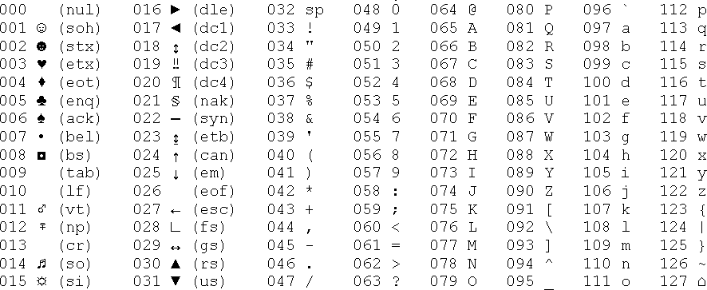
Sum the output
[1] | [2] | [3] | [4] | [5] | [6] | [7] | [8] | [9] | [10] | [11] | [12] | [13]
72 | 101 | 108 | 108 | 111 | 32 | 87 | 111 | 114 | 108 | 100 | 33 | 10
H | e | l | l | o | sp | W | o | r | l | d | ! | lf
The key is the ASCII Table

Slide 29


