Slide 1
Martin Smitnya Demo week-02
Purple Steps 3D
gitHub:martinsmitnya 2020.11.27

Slide 2
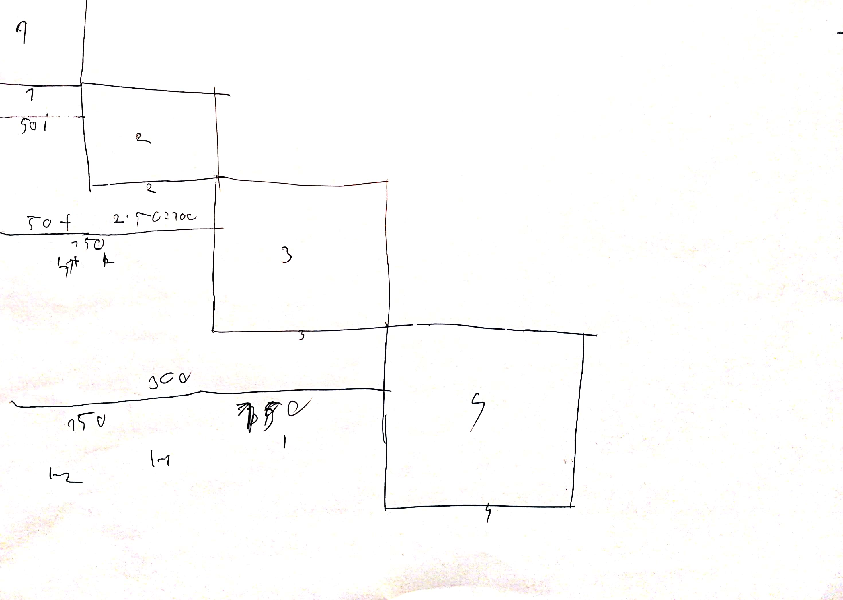
The problem:
How to resize the square AND take into acount the previous sqare’s size?

Slide 3
My attempts to solve the problem
Implement everything in ONE loop
Drawing the problem on paper (in IRL)
Figuring out how I would hard code it manually
TLDR: I tried to do everything in one go

Slide 4
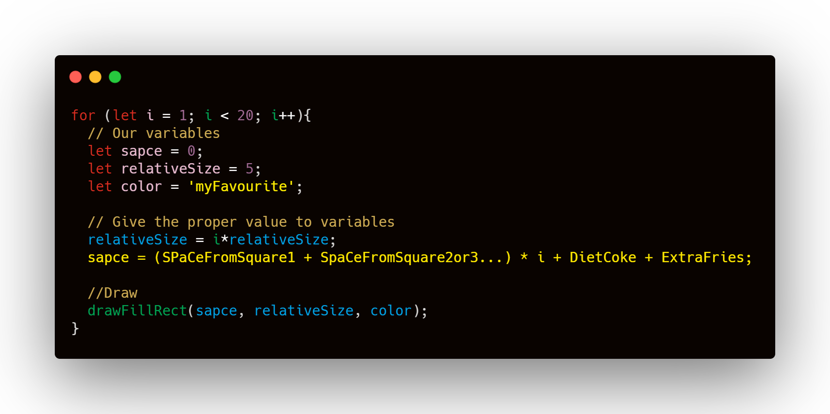
TLDR: I tried to do everything in one go

Slide 5
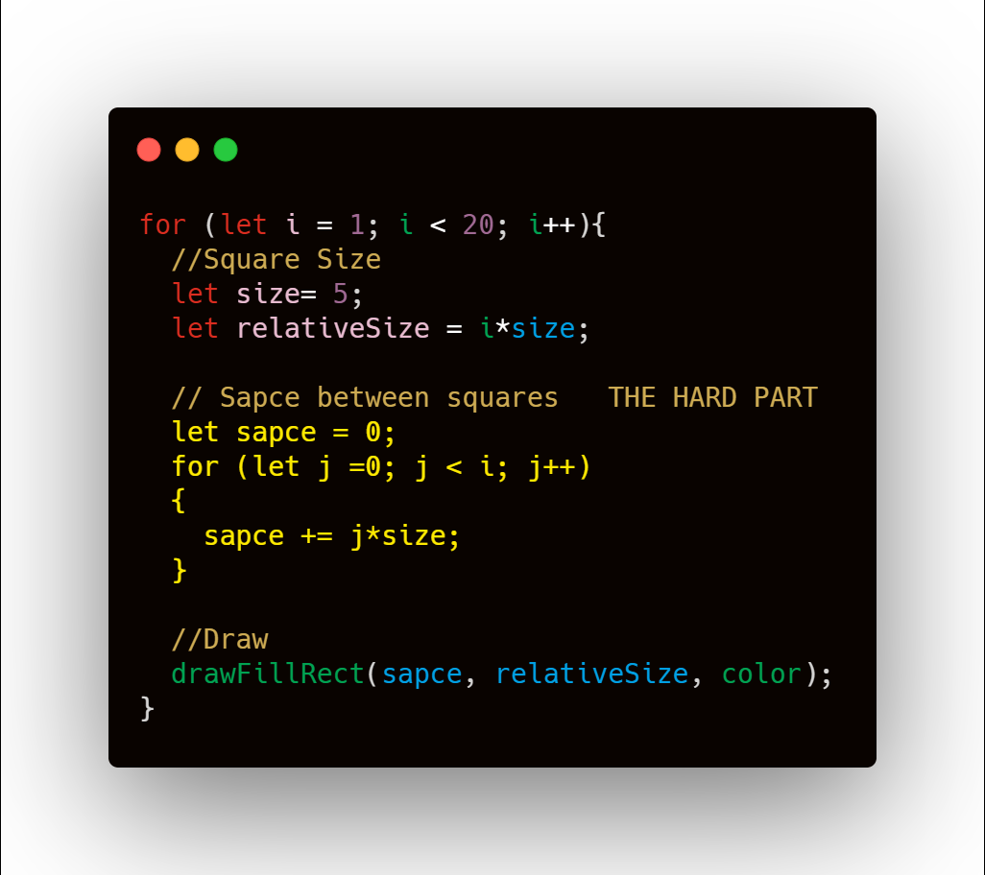
The solution
Implementing the hardcode solution to dynamic function
Testing the results

Slide 6
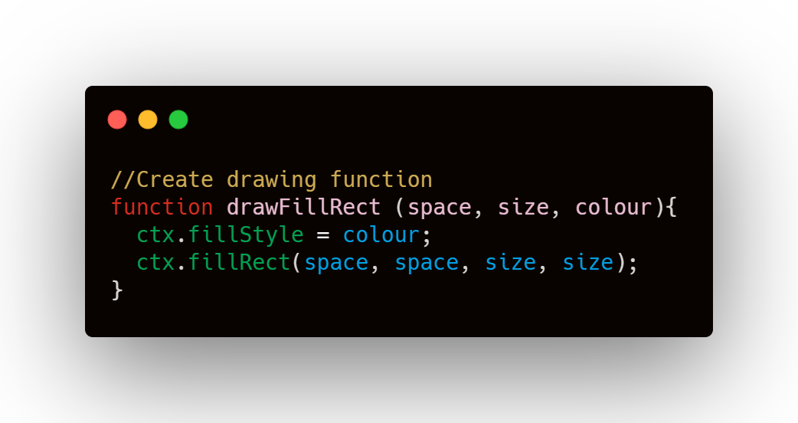
What did I learn
Think in pseudo code first!
Looking at the problem on diferent tools (drawing, visualising)
Breaking down the problem into smaller parts
Implementing existing code for smaller parts -> Not just copy pasting!
Try to organise into functions

