Slide 1
WEEK 3 - DEMO
ANNIE NGUYEN
December 8, 2017

Slide 2


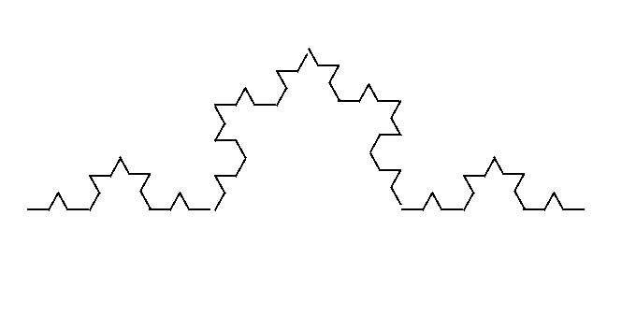

KOCH CURVE

Slide 4
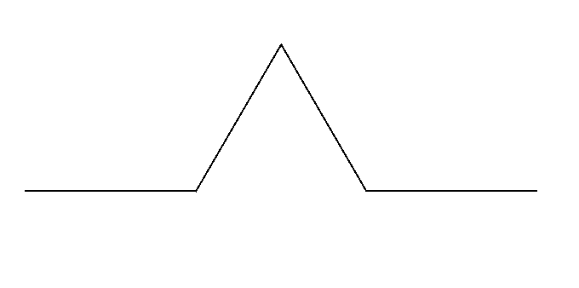

Slide 5
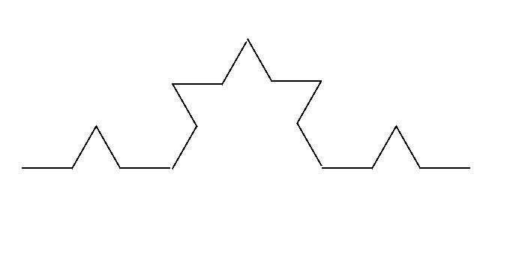

Slide 7
KOCH CURVE

Slide 8
FIRST ATTEMPTS

Slide 9
public static void drawKochLine(Graphics g, int x, int y, int size) {
int height = (int)(Math.sqrt(3.0)/6* size); int x0 = x - size/2; int y0 = y + height; int x1 = x - size/6; int y1 = y + height; int x2 = x + size/6; int y2 = y + height; int x3 = x + size/2; int y3 = y + height; g.drawLine(x0,y0,x1,y1); g.drawLine(x1,y1,x,y); g.drawLine(x,y,x2,y2); g.drawLine(x2,y2,x3,y3); }
CALCULATIONS
DRAWING

Slide 10
public static void recursiveKochLines(Graphics g, int x, int y, int size, int n){ if(n == 0) return;
drawKochLine(g,x,y,size);
double x0 = x- 7 * size/18;
double y0 = y + 2 * height/3;
double x1 = x - size/6;
double y1 = y + height/3;
double x2 = x + size/6;
double y2 = y + height/3;
double x3 = x + 7 * size/18;
double y3 = y + 2 * height/3; recursiveKochLines(g,(int)x0,(int)y0,size/3, n -1); recursiveKochLines(g,(int)x1,(int)y1,size/3, n -1); recursiveKochLines(g,(int)x2,(int)y2,size/3, n -1); recursiveKochLines(g,(int)x3,(int)y3,size/3, n -1 );
}
TERMINATING CONDITION
CALCULATIONS
RECURSION

Slide 11
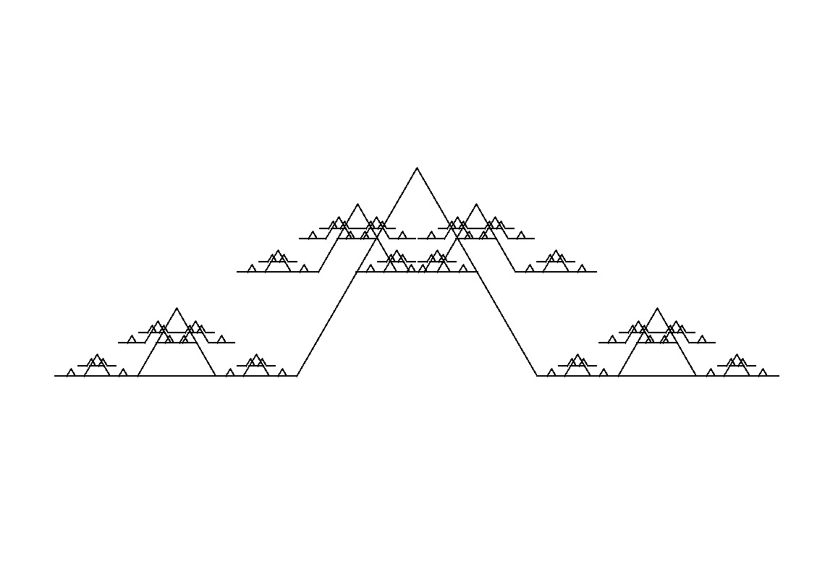

Slide 13
int height = (int)(Math.sqrt(3.0)/6* size); double[] angles = {-Math.PI/2, -5/6 * Math.PI,-1/6 * Math.PI, -Math.PI/2}; double x0 = x- 7*size/18 + height/3*Math.cos(angles[0]); double y0 = y + 2*height/3 + height/3 * Math.sin(angles[0]); double x1 = x - size/6 + height/3 * Math.cos(angles[1]); double y1 = y + height/3 + height/3 * Math.sin(angles[1]); double x2 = x + size/6 + height/3*Math.cos(angles[2]); double y2 = y + height/3 + height/3*Math.sin(angles[2]); double x3 = x + 7 * size/18 + height/3*Math.cos(angles[3]); double y3 = y + 2 * height/3 + height/3*Math.sin(angles[3]);
RE-CALCULATIONS

Slide 14
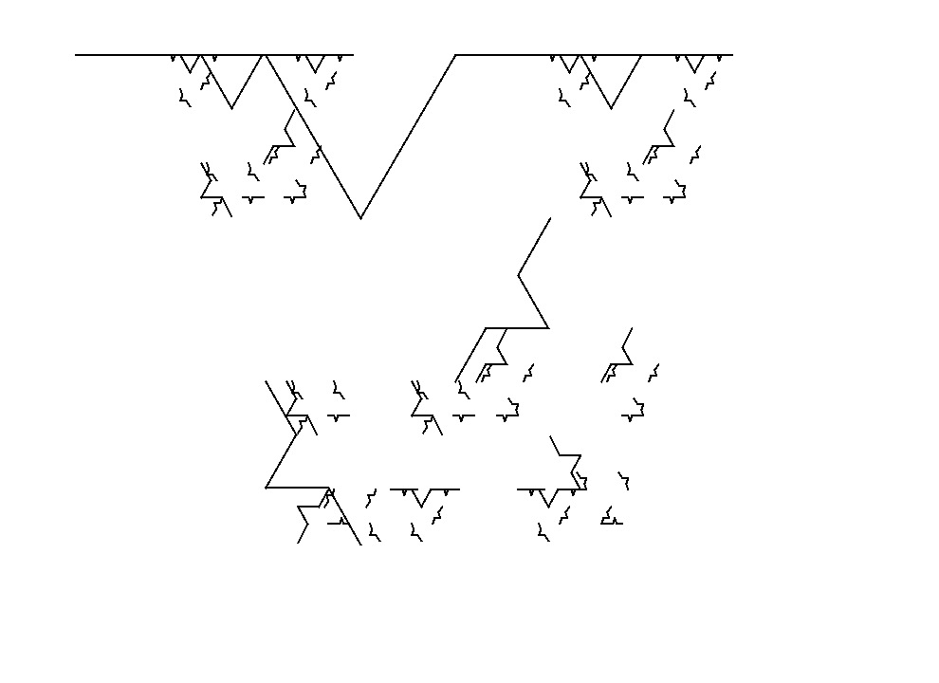

Slide 15
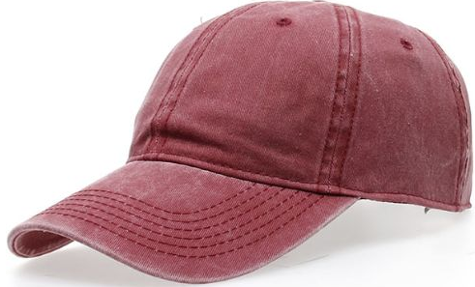

Slide 16
FIRST ATTEMPTS

Slide 17
public static void kochLine(Graphics g, int x, int y, int size, double angle) { int x1 = x + (int)(Math.cos(angle) * size/3 ) ; int y1 = y + (int)(Math.sin(angle) * size/3 ) ; int x2 = x1 + (int)(Math.cos(angle - Math.PI/3) * size / 3); int y2= y1 + (int)(Math.sin(angle - Math.PI/3) * size/3); int x3 = x2 + (int)(Math.cos(angle + Math.PI/3) * size/3); int y3 = y2 + (int)(Math.sin(angle + Math.PI/3) * size/3); int x4 = x + (int)(Math.cos(angle)* size); int y4 = y + (int)(Math.sin(angle) * size ); g.drawLine(x,y,x1,y1) ; g.drawLine(x1,y1,x2,y2) ; g.drawLine(x2,y2,x3,y3) ; g.drawLine(x3,y3,x4,y4); }

