Slide 1
WEEK 3 - DEMO
ANNIE NGUYEN
December 8, 2017

Slide 2


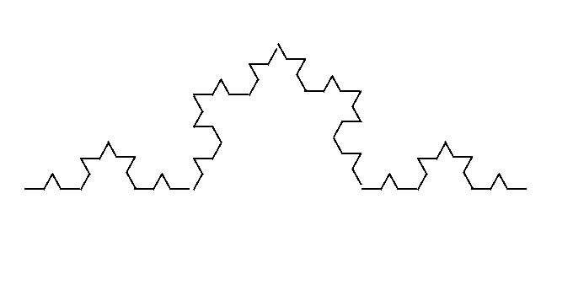

KOCH CURVE

Slide 3
N = 0

Slide 4
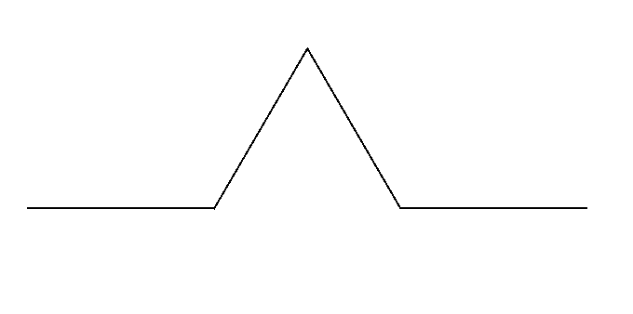
N = 1

Slide 5
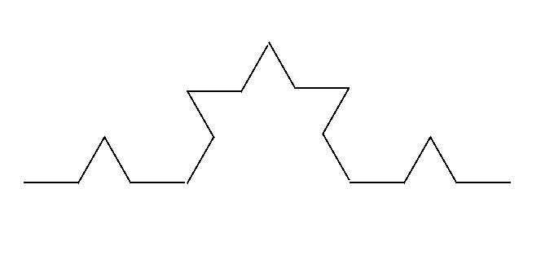
N = 2

Slide 6
N = 3

Slide 7
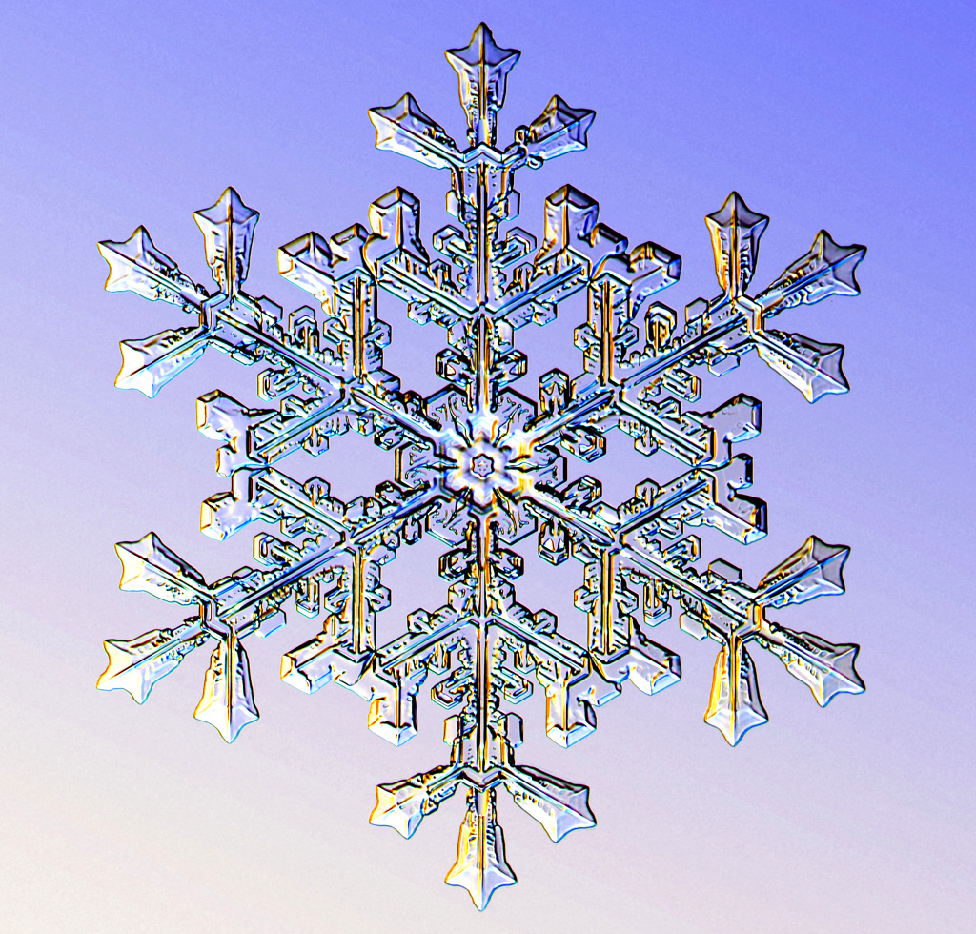
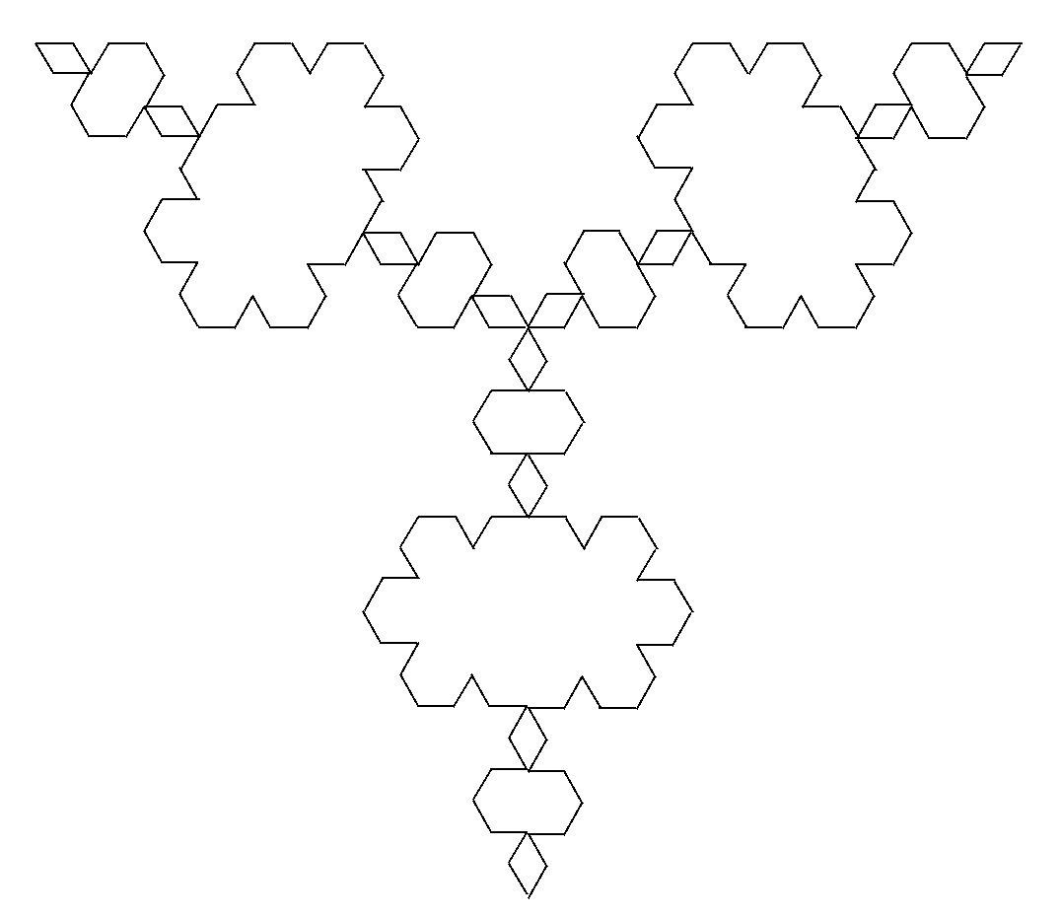
KOCH CURVE

Slide 8
FIRST ATTEMPTS

Slide 9
public static void kochBasicPattern(Graphics g, int x, int y, int size) {
int height = (int)(Math.sqrt(3.0)/6* size); int x1 = x - size/2; int y1 = y + height; int x2 = x - size/6; int y2 = y + height; int x3 = x + size/6; int y3 = y + height; int x4 = x + size/2; int y4 = y + height; g.drawLine(x1,y1,x2,y2); g.drawLine(x2,y2,x,y); g.drawLine(x,y,x3,y3); g.drawLine(x3,y3,x4,y4); }
CALCULATIONS
DRAWING

Slide 10
N = 1
x,y
x1,y1
x2,y2
x3,y3
x4,y4

Slide 11
public static void recursiveKochLines(Graphics g, int x, int y, int size, int n){ if(n == 0) return;
kochBasicPattern(g,x,y,size);
double x1 = x- 7 * size/18;
double y1 = y + 2 * height/3;
double x2 = x - size/6;
double y2 = y + height/3;
double x3 = x + size/6;
double y3 = y + height/3;
double x4 = x + 7 * size/18;
double y4 = y + 2 * height/3; recursiveKochLines(g,(int)x1,(int)y1,size/3, n -1); recursiveKochLines(g,(int)x2,(int)y2,size/3, n -1); recursiveKochLines(g,(int)x3,(int)y3,size/3, n -1); recursiveKochLines(g,(int)x4,(int)y4,size/3, n -1 );
}
TERMINATING CONDITION
DRAWING
CALCULATIONS
RECURSION

Slide 12
N = 2
x,y
x2,y2
x3,y3
x1,y1
x4,y4

Slide 13
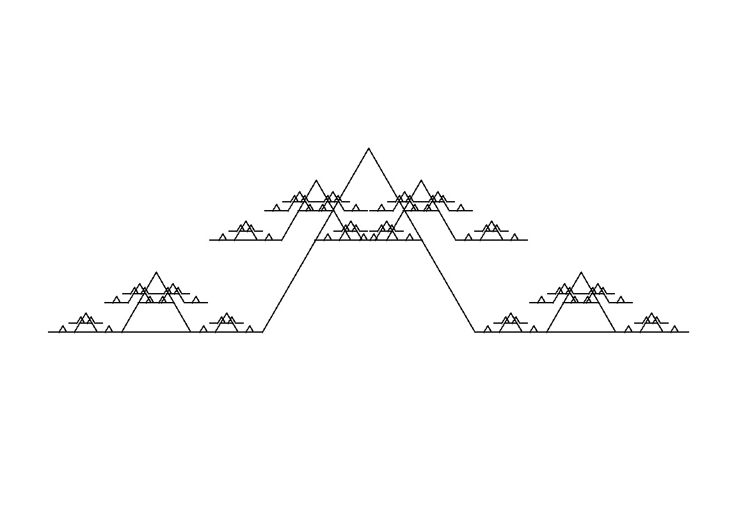

Slide 15
int height = (int)(Math.sqrt(3.0)/6* size); double[] angles = {-Math.PI/2, -5/6 * Math.PI,-1/6 * Math.PI, -Math.PI/2}; double x0 = x- 7*size/18 + height/3*Math.cos(angles[0]); double y0 = y + 2*height/3 + height/3 * Math.sin(angles[0]); double x1 = x - size/6 + height/3 * Math.cos(angles[1]); double y1 = y + height/3 + height/3 * Math.sin(angles[1]); double x2 = x + size/6 + height/3*Math.cos(angles[2]); double y2 = y + height/3 + height/3*Math.sin(angles[2]); double x3 = x + 7 * size/18 + height/3*Math.cos(angles[3]); double y3 = y + 2 * height/3 + height/3*Math.sin(angles[3]);
RE-CALCULATIONS
WITH ANGLES

Slide 16
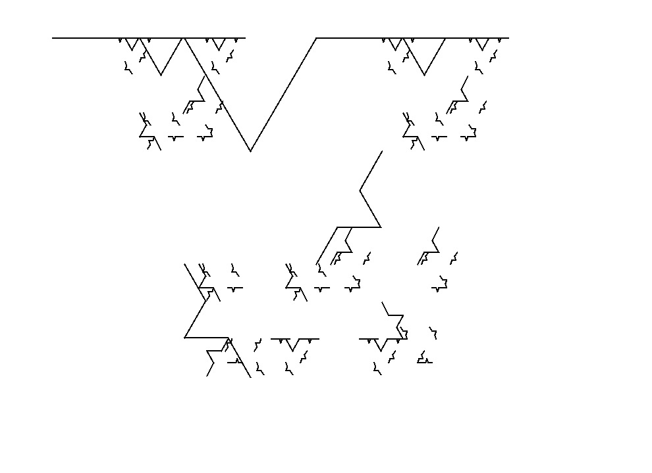

Slide 17


Slide 18
5 HOURS LATER …

Slide 19
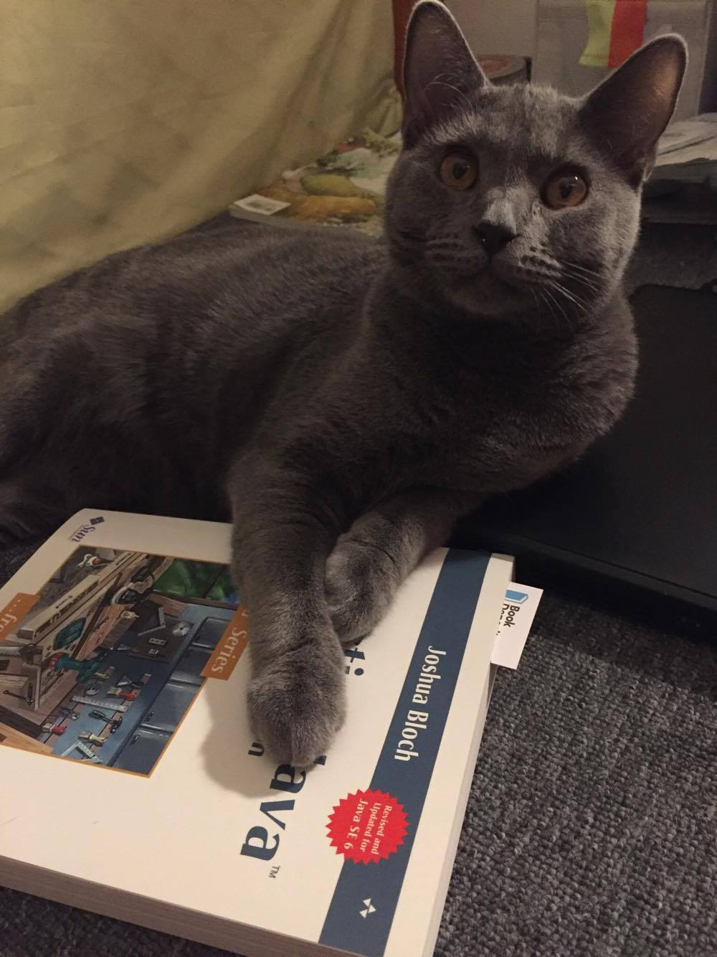
WAIT A MINUTE!!!!

Slide 20

OMG! I WAS WRONG FROM THE FIRST STEP

Slide 21
public static void recursiveKochLines(Graphics g, double x, double y, int size, double angle, int n) {
double x1 = x + (Math.cos(angle) * size/3); double y1 = y + (Math.sin(angle) * size/3);
double x2 = x1 + (Math.cos(angle - Math.PI/3) * size / 3); double y2= y1 + (Math.sin(angle - Math.PI/3) * size/3);
CALCULATING
double x3 = x2 + (Math.cos(angle + Math.PI/3) * size/3); double y3 = y2 + (Math.sin(angle + Math.PI/3) * size/3);
double x4 = x + (Math.cos(angle) * size;
double y4 = y + (Math.sin(angle) * size);
if (n == 0) {
g.drawLine((int)x, (int) y, (int) x4, (int)y4}; return; }
TERMINATING CONDITION

Slide 22
N = 1
0,0
x2,y2
-60⁰
0⁰
0⁰
60⁰
x,y
x1,y1
x3,y3
x4,y4

Slide 23
recursiveKochLines(g,x,y,size/3,angle,n-1); recursiveKochLines(g,x1,y1,size/3,angle - Math.PI/3,n-1); recursiveKochLines(g,x2,y2,size/3,angle + Math.PI/3,n-1); recursiveKochLines(g,x3,y3,size/3,angle,n-1);
RECURSION
public static void mainDraw(Graphics g){ g.setColor(Color.WHITE); g.fillRect(0,0,WIDTH,HEIGHT); g.setColor(Color.BLACK); recursiveKochLines(g,150,300,300,0,4);
DRAWING

Slide 24
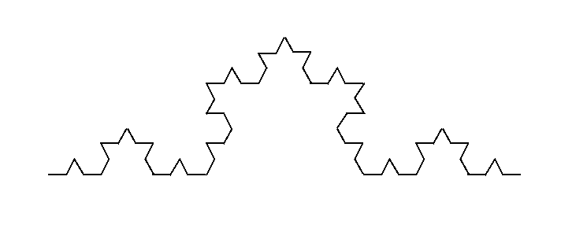
N = 3

Slide 25
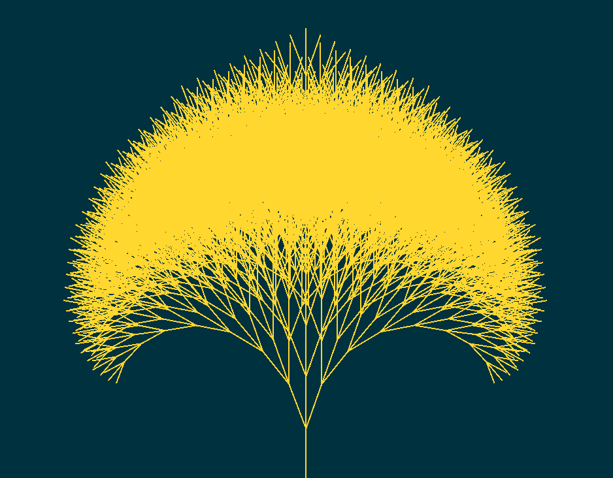
ANOTHER SOLUTION:
Turtle Graphics
https://turtleacademy.com/

Slide 26

RUBBLE THE CAT ☺

