Slide 1

Few words about the first week
András Pásztor
06.10.2017

Slide 2
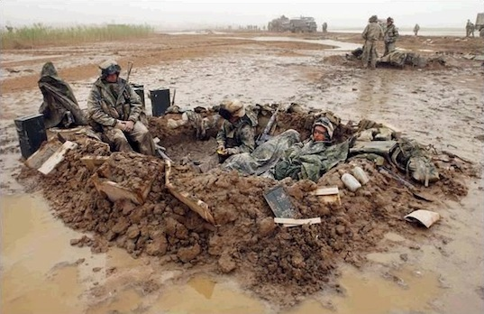
Few words about the first week
This is how I feel after the first week

Slide 3


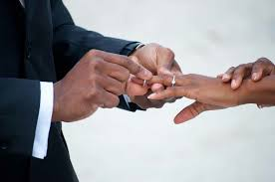
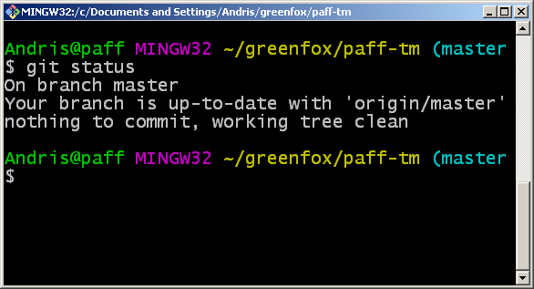

GitHub Monster
Committed to use commit
Beated the GitHub monster

Slide 4
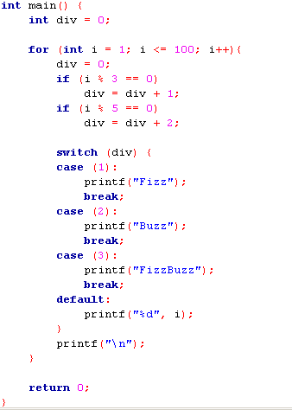
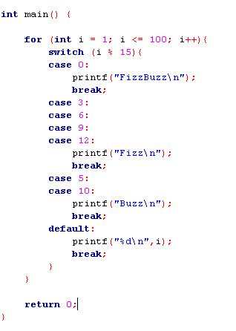
FizzBuzz

Slide 5
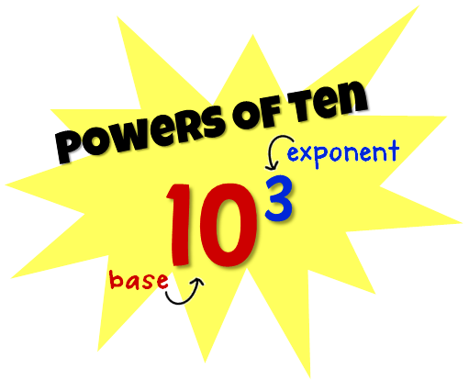


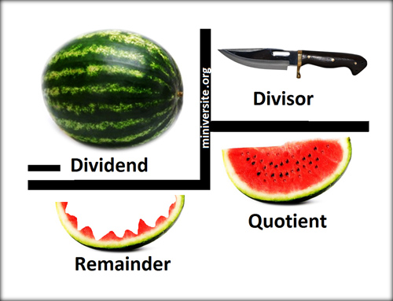
Mathematic Expressions

Slide 6
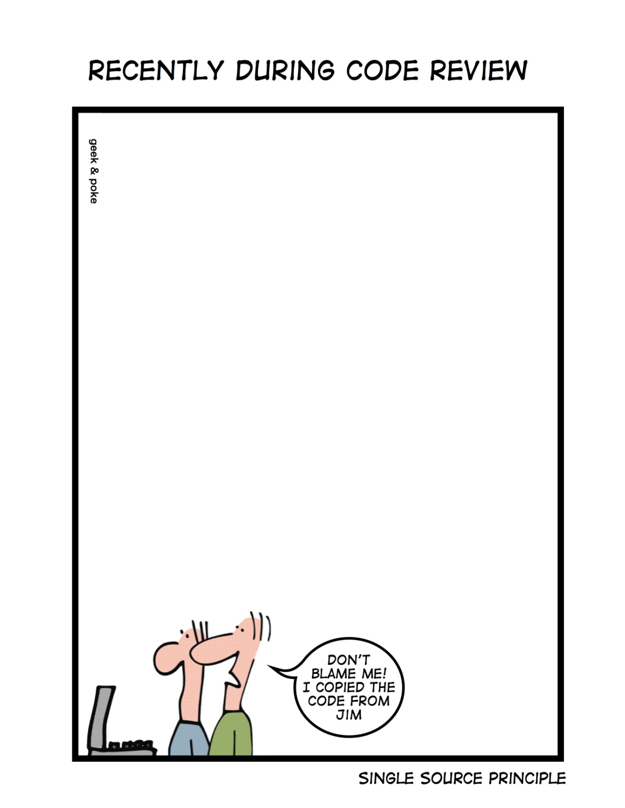

Code Review

Slide 7
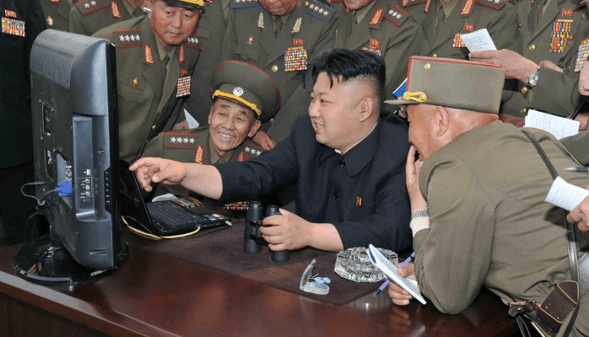
Code Review

Slide 8
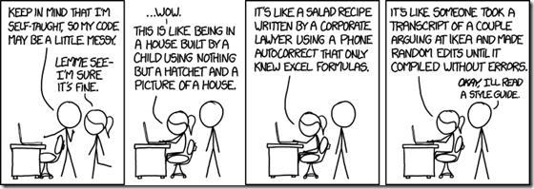
Importance of Styleguide

