Slide 1
Demo – week 3
András Pásztor
20.10.2017
Pallida Cohort
Static class

Slide 2
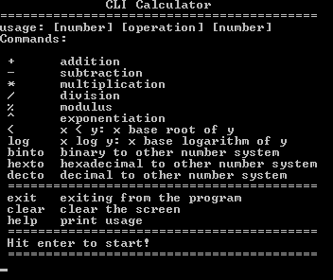
CLI Calculator

Slide 3
Command Line Evaulation
Input String
13 + 17
10 binto 10
B4 hexto 2
help
10 binto 10
operand a operand b
operator
1

Slide 4
Command Line Evaulation
Input String
10 binto 10
1+2
eliminate all spaces from input string
10 binto 10
operand a operand b
operator
2

Slide 5
Command Line Evaulation
Input String
10 binto 10
1+2
eliminate all spaces from input string
10binto10
operand a operand b
operator
2

Slide 6
Command Line Evaulation
Operands
13+17
D3hexto10
10binto10
-1.3+-1.7
dec
hex
bin
0 5
1 6
2 7
3 8
4 9
0 5 A
1 6 B
2 7 C
3 8 D
4 9 E
F
0
1
. -
3

Slide 7

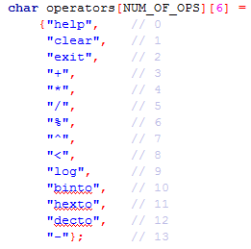


Command Line Evaulation
Operator
… more code
1+yhelp42
-1.3+-1.7
4

Slide 8
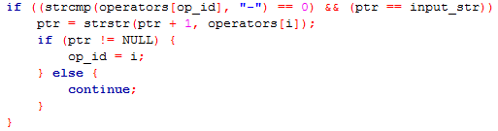
Command Line Evaulation
Operator
Is it a ’-’ character?, and
Is it the first character in the string?
then skip it!
-1.3--1.7
5

Slide 9

Take Home Message
Plan before start programming
Change the plan
DFTCTP

Slide 10
Thank you for your attention
András Pásztor
20.10.2017

