Slide 1
Demo – week 4
András Pásztor
27.10.2017
Pallida Cohort
Static class

Slide 2
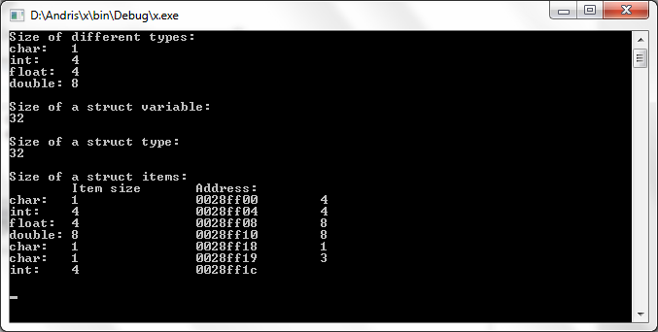
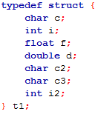

Size of a Variable
23 bytes
1
4
4
8
1
1
4
23 bytes

Slide 3
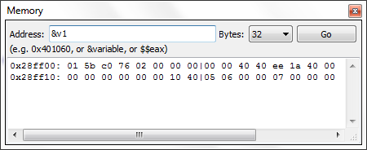
Allocated Memory
1
4
4
8
1
1
4

Slide 4


Allocated Memory
Struct in a File

Slide 5
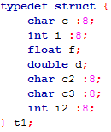

Allocated Memory
Struct in a File

Slide 6

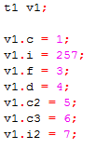
Allocated Memory
Bitfields
overflow

Slide 7

Take Home Message
You can’t be sure about the size of a struct
Always use sizeof()

Slide 8
Thank you for your attention
András Pásztor

