Slide 1
Demo – week 2
András Pásztor
13.10.2017
Pallida Cohort
Static class

Slide 2
Difficulties on the second week
Memoization
Prime numbers (Erathostenes)
String input (getch, getchar)
Palindrome searcher
Josephus problem

Slide 3
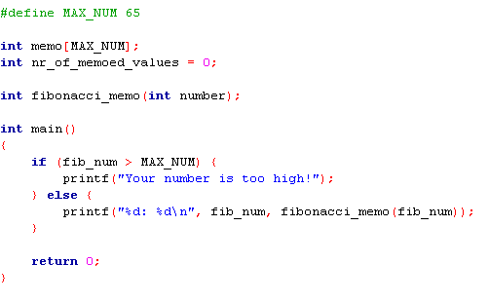
Memoization

Slide 4
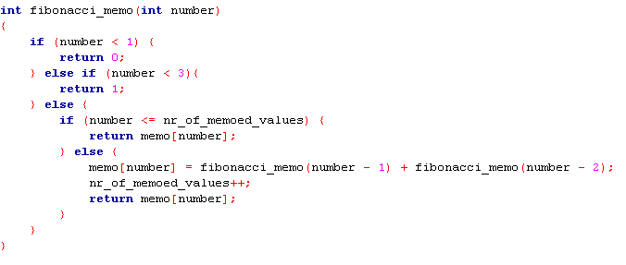
Memoization

Slide 5
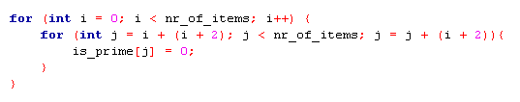
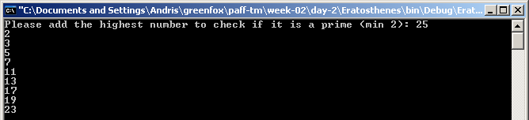
Prime numbers (Erathostenes)
1. Get number of items (the last number to check is it is a prime
2.
3. Fill is_prime with 1s
4.
5. Print out the primes

Slide 6
Palindrome searcher
odd character palindrome
even character palindrome
even = 1
even = 0
+1 +1
+2 +2
+1 +1+even
never
hannah
Palindrome’s length
Palindrome’s length
1
0
0
1
2

Slide 7

Josephus problem
Different methods
1: step-by-step
a) store the men in an array
int group[people]; // 1 is alive, 0 is dead
b) store the men in an integer
uint64_t group = 0; // 1 is alive, 0 is dead in binary
2: mathematical
a) bitwise
YouTube -> The Josephus Problem – Numberphile
b) mathematical equation
http://www.exploringbinary.com/powers-of-two-in-the-josephus-problem/

Slide 8
Josephus problem
solution with bitwise operations
In case of 41 soldiers the winner position is the 19th
41 = 00101001
<<
01010010
00010011 = 19
We have shift operator in C, but how to find the highest order bit?

Slide 9
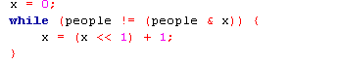
Josephus problem
solution with bitwise operations
Looking for the highest order bit
int people = 41;
X = 00000001
people = 00101001
people & x = 00000001
X = 00000011
people = 00101001
people & x = 00000001
X = 00000111
people = 00101001
people & x = 00000001
X = 00001111
people = 00101001
people & x = 00001001
X = 00011111
people = 00101001
people & x = 00001001
X = 00111111
people = 00101001
people & x = 00101001
X = 00000000
people = 00101001
people & x = 00000000

Slide 10
Josephus problem
solution with bitwise operations
Put the highest order bit to the lowest position
X = 00111111
people = 00101001
X++ 01000000
people <<= 1 01010010
people - x 00010010
People++ 00010011 = 19

Slide 11
Thank you for your attention

