Slide 1
Who am i?
Pataricza György
2 final exams to be a lawyer, I will finish it, but rather be a programmer
Worked as debt collector agent (on phone)
https://github.com/pataricza

Slide 2
@Onetomany @manytoone
Make it simple

Slide 3
The goal
I have a list of Todos
I have a list of people (Assignees)
They are in two different table in my MySQL database (named todo)
I want to register Todos (many) to an Assignee (one) with Spring JPA

Slide 4
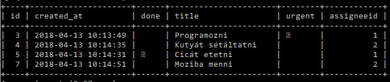

In mySQL

Slide 5
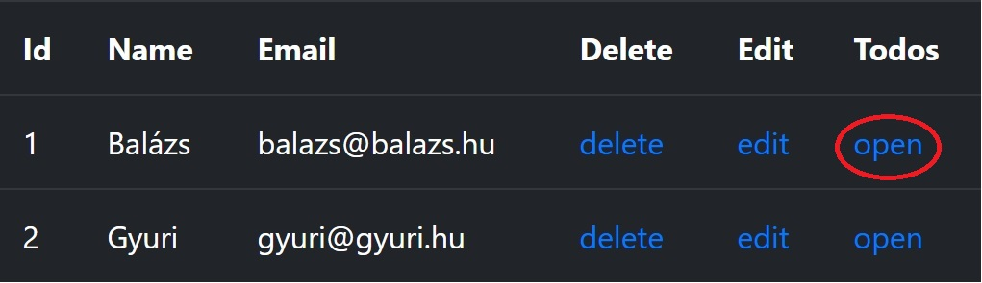

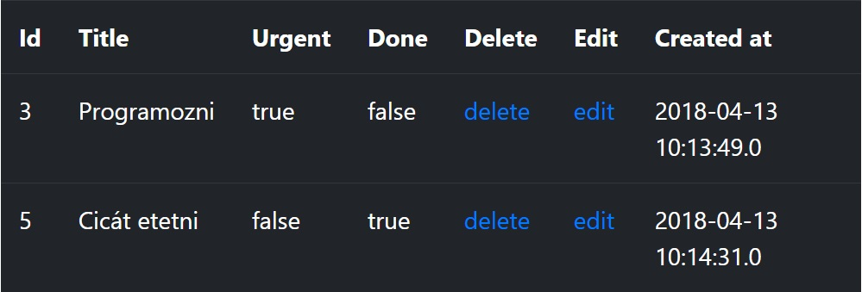

Slide 6
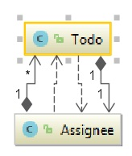
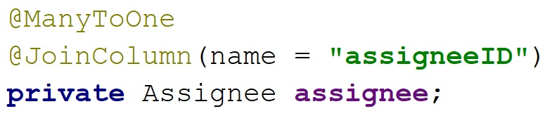
In my todo class
One todo can only
have one assignee.

Slide 7
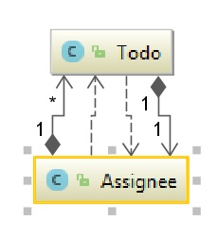
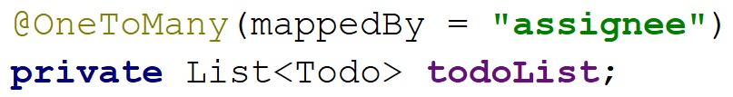
In my assignee class
One assignee can
have many todos.

Slide 8
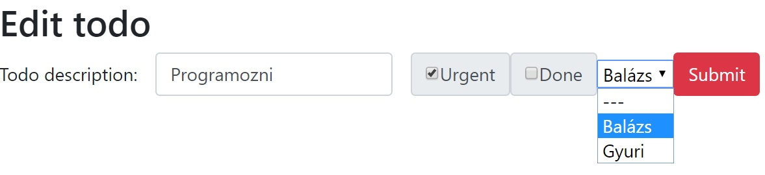
On the „web” (localhost)

Slide 9
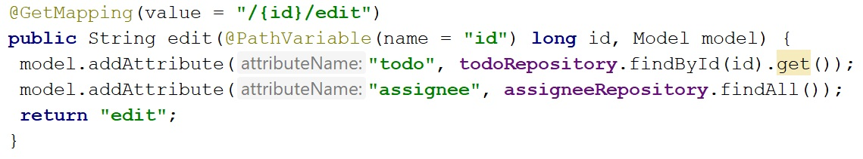
Controller (get)

Slide 10
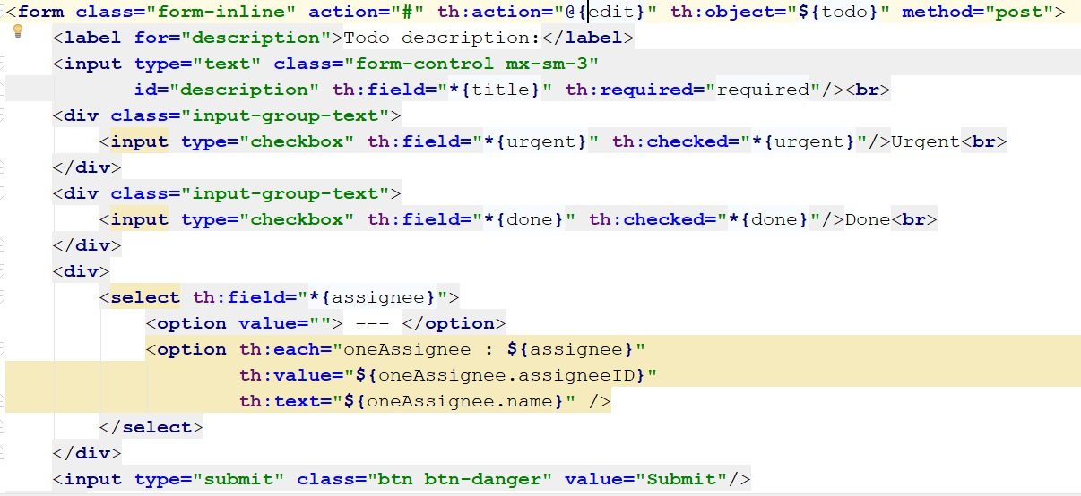
Thymeleaf

Slide 11
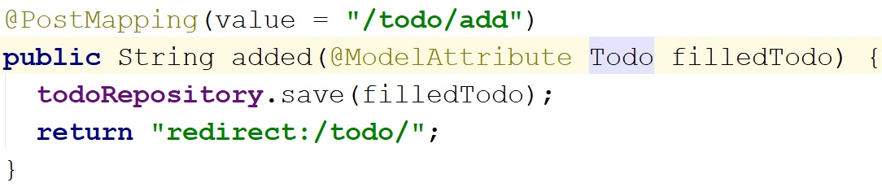
Controller (post)

Slide 12
In mySQL

Slide 14


