Slide 1
Demo
Brief intoduction of second week at GFA by Daniel Molnar

Slide 2
What I've learned this week
Day-1 Data structures:
Strings, vectors, map
Day-2 Pointers:
Pointers, passing pointers to function

Slide 3
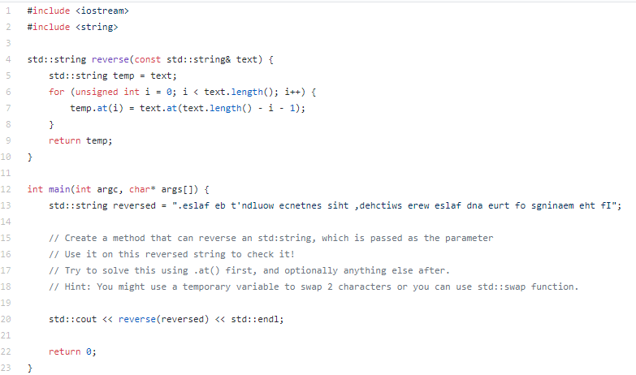

Slide 4
Day-3 File-IO:
File-handling: reading from / writing to files, passing files to functions etc.
Day-4&5:
Getting familiar with SDL library usage, drawing basic and more complex contents

Slide 5
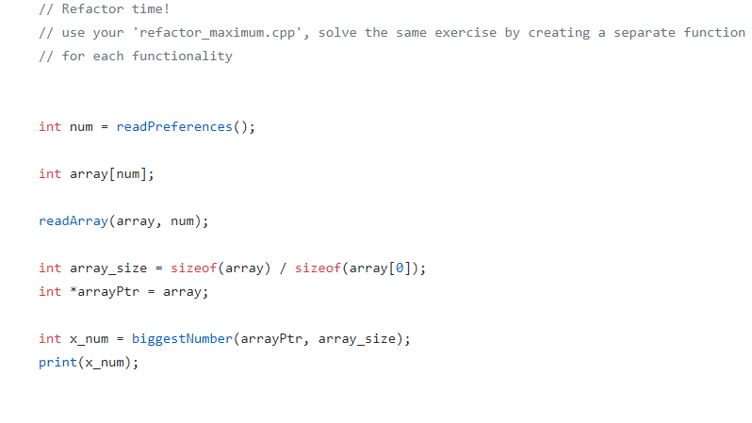

Slide 6
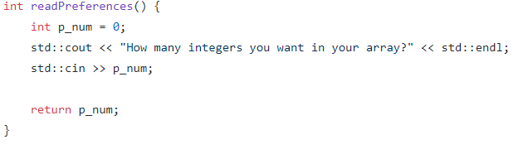
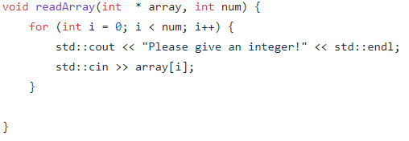

Slide 7
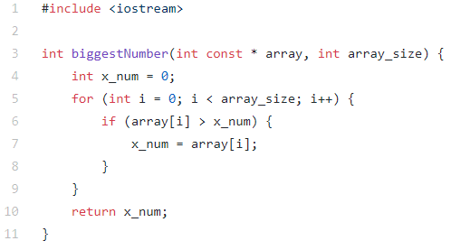

Slide 8
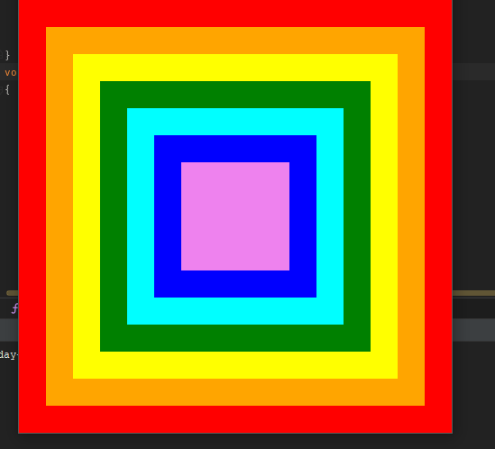
Rainbow-boxes

Slide 9
Thank you for your attention!
Have a nice weekend &
Don't forget to leave until 6pm!!!!44444

