Slide 1
theManAndTheMachine
Chapter #6
myWay
written by Viktor Salánki
alias
salankiv

Slide 2
The question
What is the optimal solution?
What is a solution?
What is that I can do solution?
And what is that I want to do solution?

Slide 3
The parking lot
256 cars
several attributes (type, color…)
1 parking lot
count everything
Hashmap – (1 * 8) + (1 * 8) + ...
Hashmap – 1 (with 8 * 8 * … * ...)

Slide 4
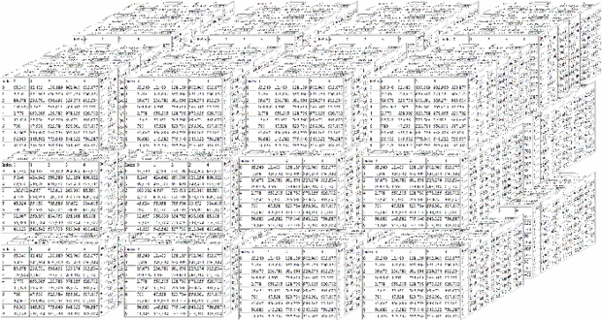
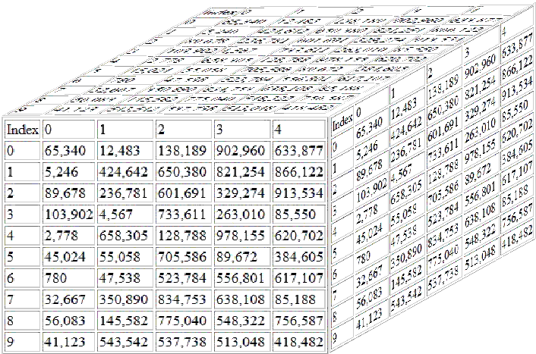
The beauty of arrays

Slide 5
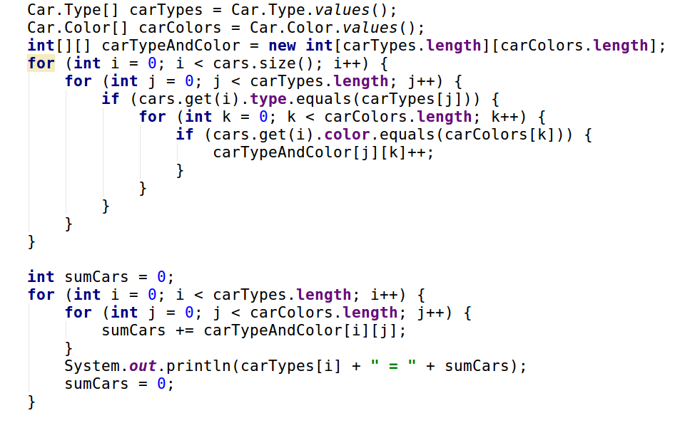
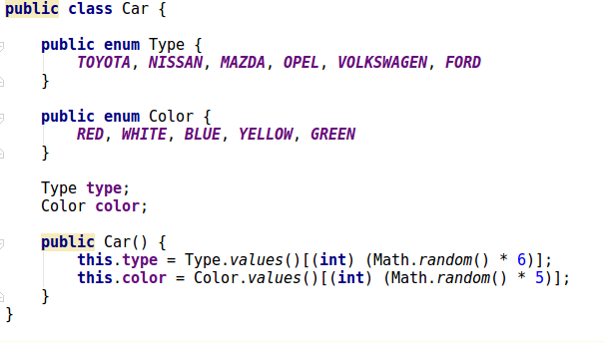
The beauty of arrays

Slide 6
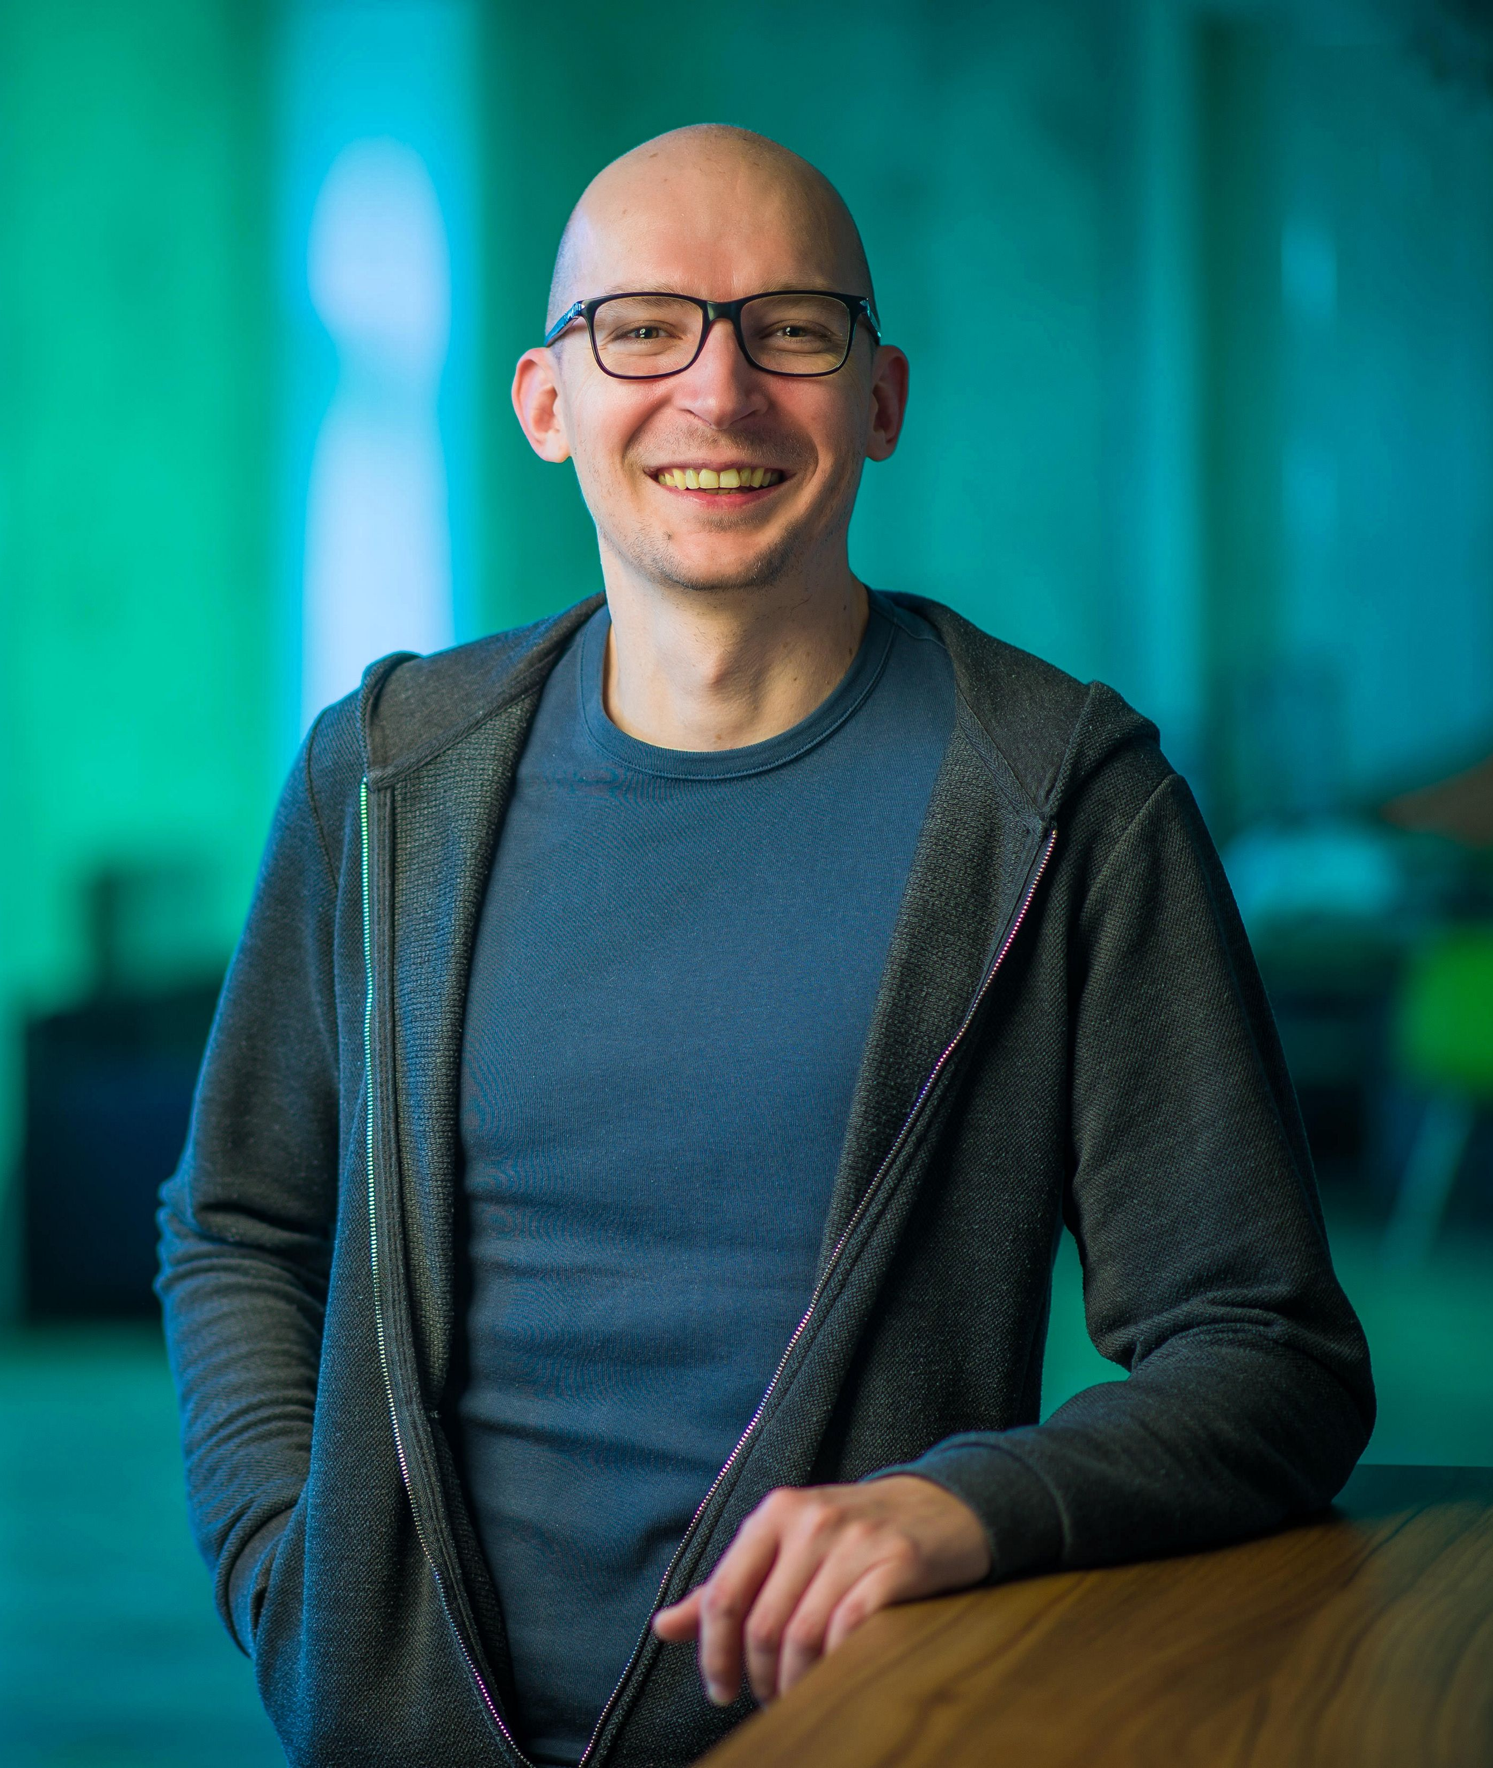

About the author
Experienced economist… with an INTJ personality *
*only 2% of humankind… although overrepresented in the group
Previously on GitHub
Chapter #2 – theConflict
Chapter #3 – theSoulfOfTheMachine
Chapter #4 – theRecursion
Chapter #5 – missing due to creative crisis...
https://github.com/greenfox-academy/salankiv.git

