Slide 1
theManAndTheMachine
Chapter #3
theSoulOfTheMachine
written by Viktor Salánki
alias
salankiv

Slide 2


„DY”
i

Slide 3

And the new logo???

Slide 4
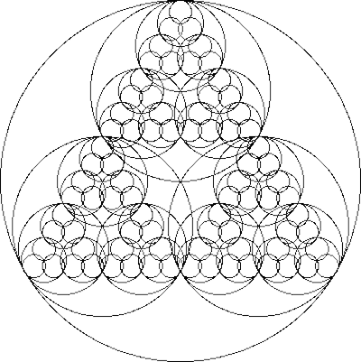
Fractals as example

Slide 5
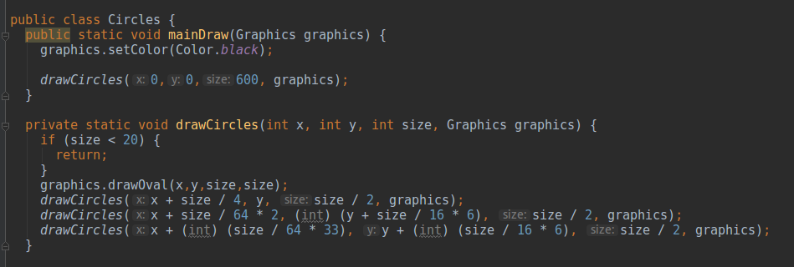
I asked for that… actually begged for it

Slide 6
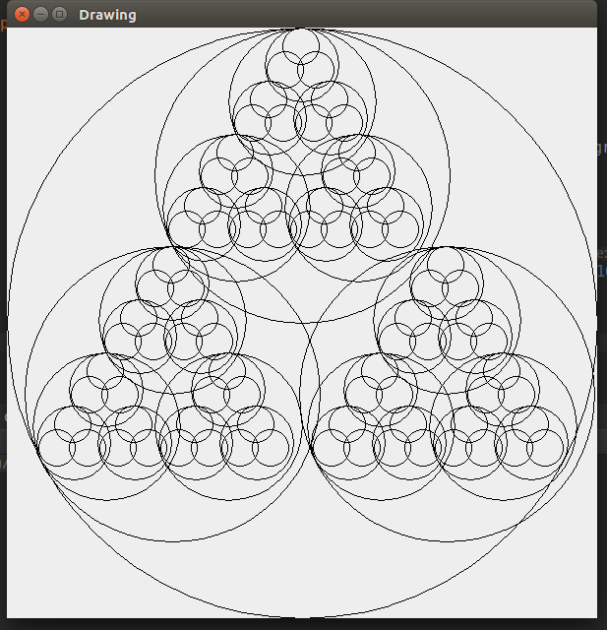
What have I done???

Slide 7
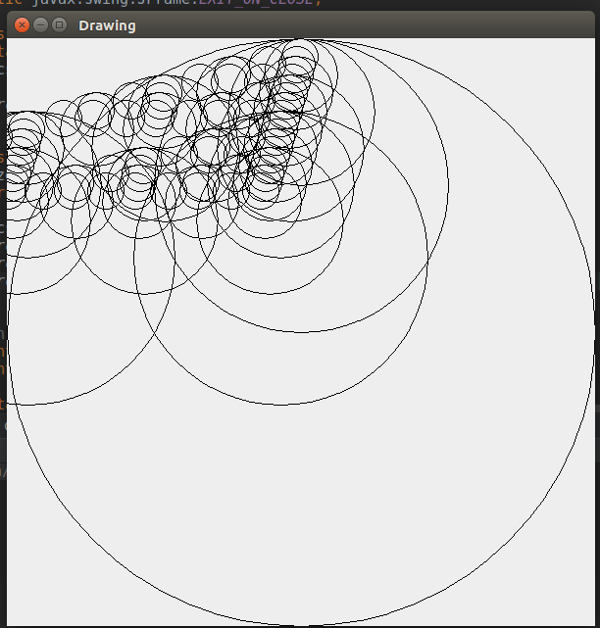
What should have I done???
(x - (int) (size / 4 * Math.cos(Math.toRadians(30))),
y + (int) (size / 4 * Math.sin(Math.toRadians(30))), size / 2);

Slide 8
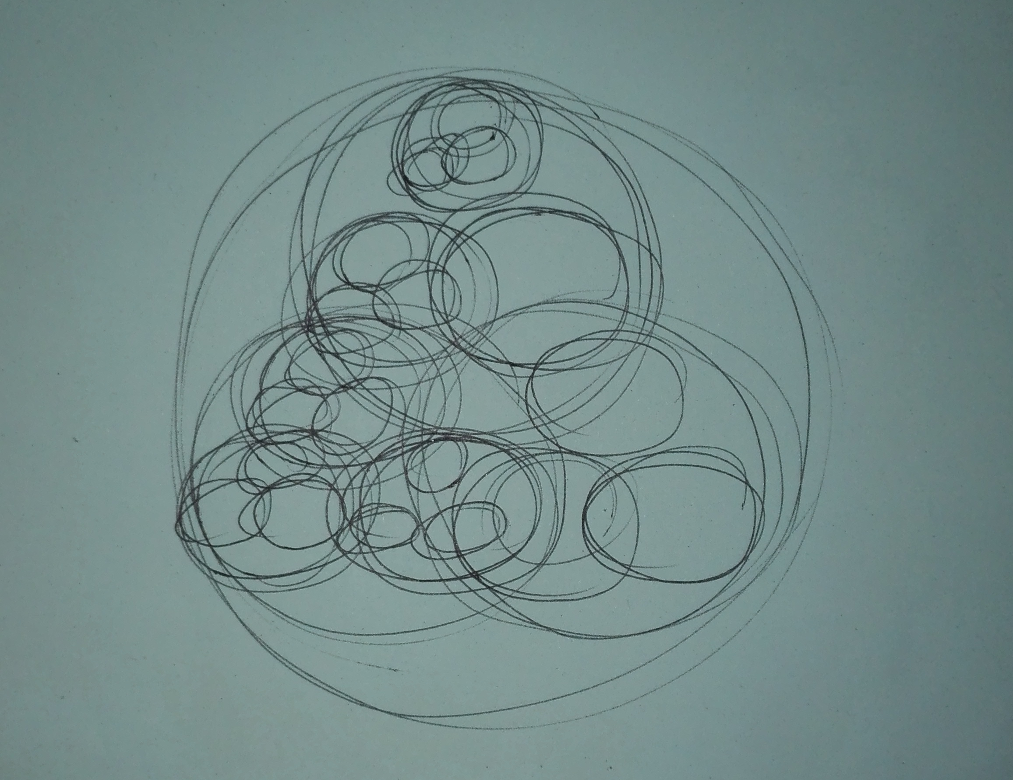
I had no other choice...

Slide 9



About the author
Studied law and economics… hoping that those will be useful in computer science in the future…
The book will be soon available on the shelves of bigger stores…
like Ape Store or Goggle Play.
Meanwhile, you can find it on GitHub:
https://github.com/greenfox-academy/salankiv.git

