Slide 1
theManAndTheMachine
Episode IV
Not hoping anything…
String example = "In a dishwasher far far away";
System.out.println(example.replace("dishwasher", "galaxy"));
Chapter #2
theConflict
written by Viktor Salánki
alias
salankiv

Slide 2


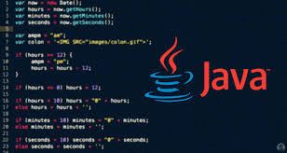
I was doing my regular loop...

Slide 3
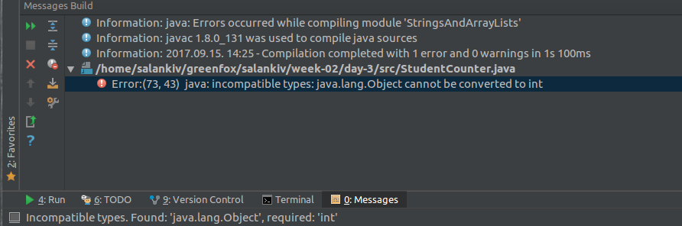
Wanna say something???

Slide 4
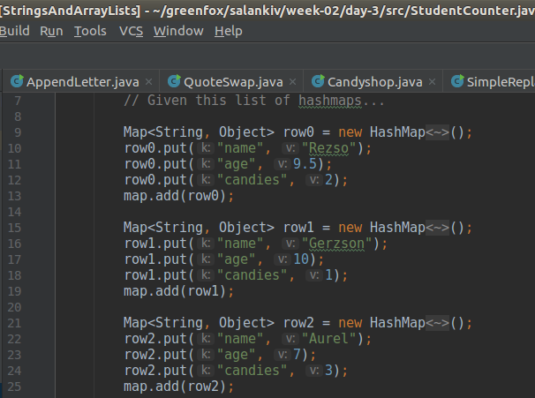
Number… WTF?!?!

Slide 5
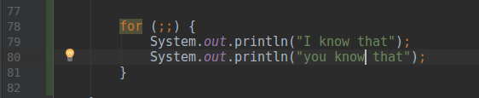
I know…

Slide 6
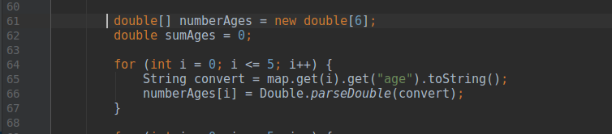
Number to string then to number… WTF?!?!

Slide 7
And lived happily ever after...
NOOOO!!!!
Definitely, want to have a lightning talk about that...

Slide 8


About the author
This book is definitely his masterpiece.
Wrote this book meanwhile struggeling with elements, A/C, lack of coffee and other essential stuff...
„Could not stop reading, this book is a must for rookie programmers...”
New York Roman, Times
„Still laughing at the loop jokes...”
The Courier
„The last one was better… :)”
The guy sitting next to me

