Slide 1
theManAndTheMachine
Chapter #4
theRecursion
written by Viktor Salánki
alias
salankiv

Slide 2
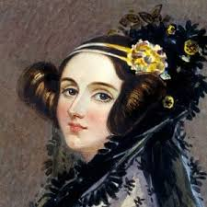
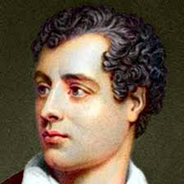
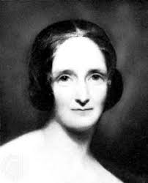
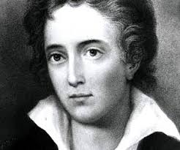
A little bit of history repeating...
extends
Friends bestFriend = new Friends();
bestFriend = ;

Slide 3
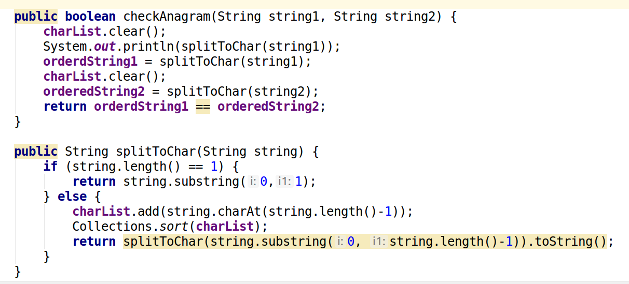
A tiny little exercise…
I created a monster
btw… it does not work

Slide 4
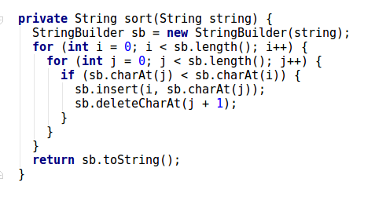
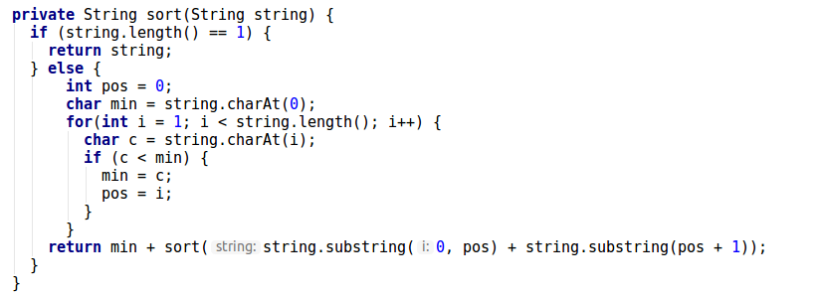
What would be the easier way?

Slide 5

Learning of the week

Slide 6
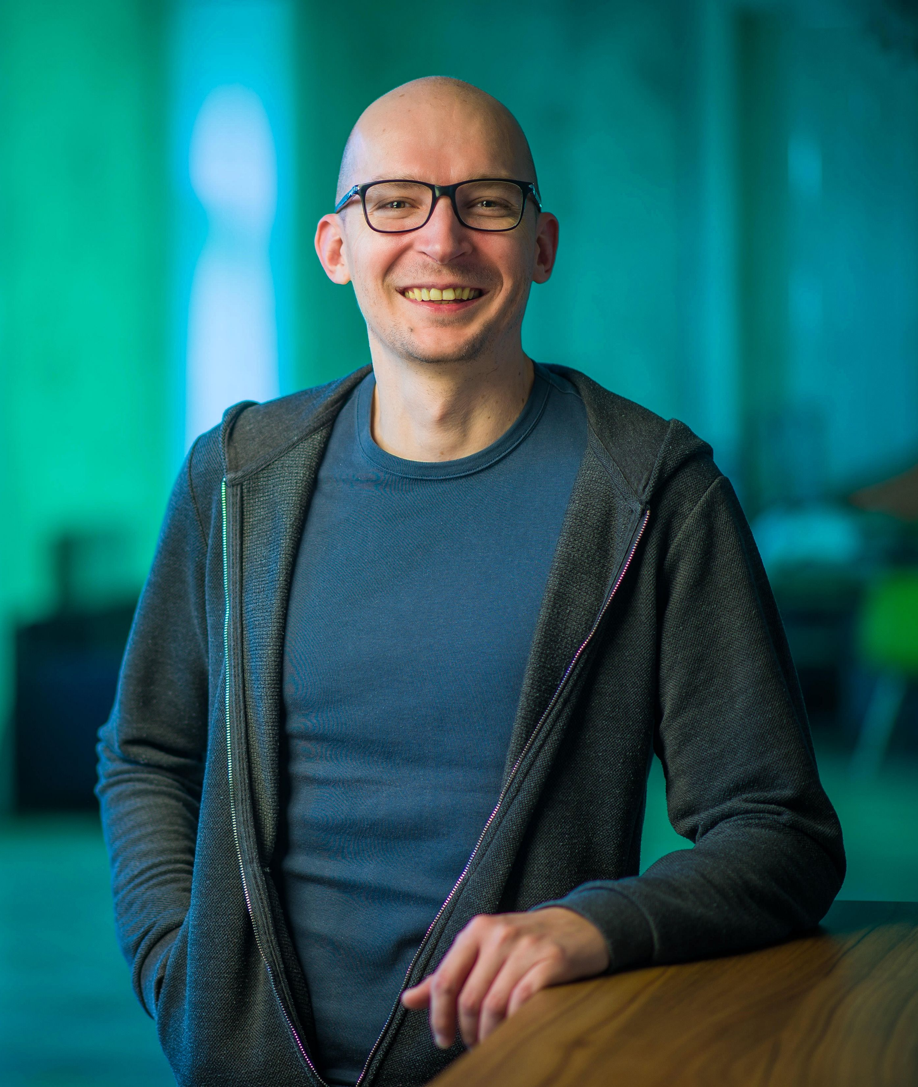

About the author
Studied law… therefore, he knows a lot about English Romantic literature.
Previously on GitHub
Chapter #2 – theConflict
Chapter #3 – theSoulfOfTheMachine
https://github.com/greenfox-academy/salankiv.git

