Slide 1
theManAndTheMachine
Chapter #7
epicFails
written by Viktor Salánki
alias
salankiv

Slide 2
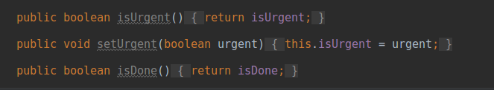
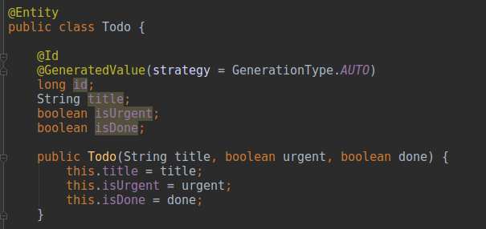
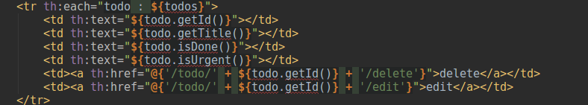
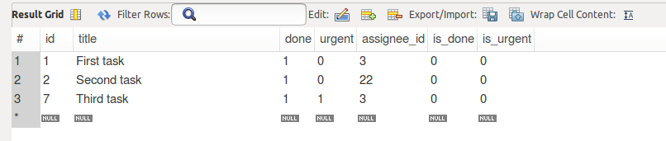
Fail #1

Slide 3
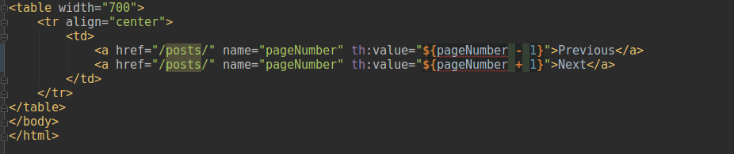
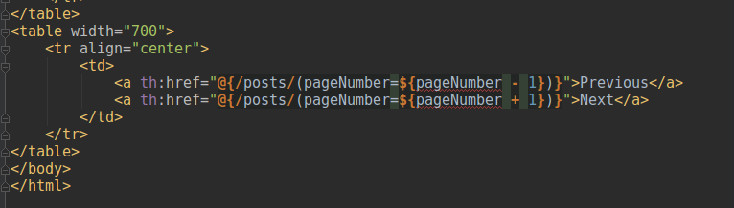
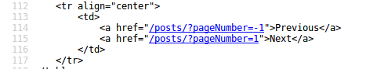
Fail #2

Slide 4
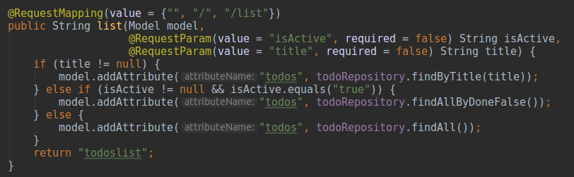
Fail #3
(title != null) != (title.isEmpty()) != (title.equals(null))
(findAllByDoneFalse()) != (findAllByDoneNot())

Slide 5

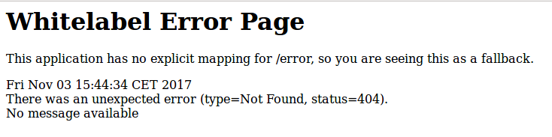

About the author
Previously on GitHub
Chapter #3 – theSoulfOfTheMachine
Chapter #4 – theRecursion
Chapter #5 – I know, I know… still missing
Chapter #6 – myWay
https://github.com/greenfox-academy/salankiv.git

