Slide 1
Demo
By PXP

Slide 2
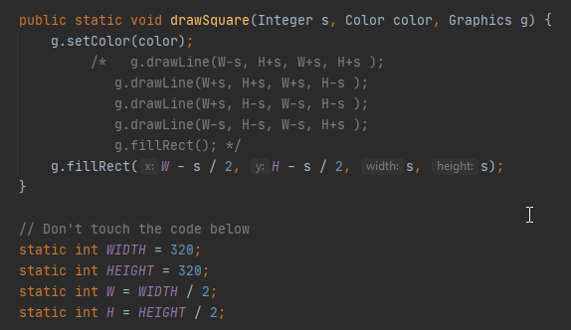
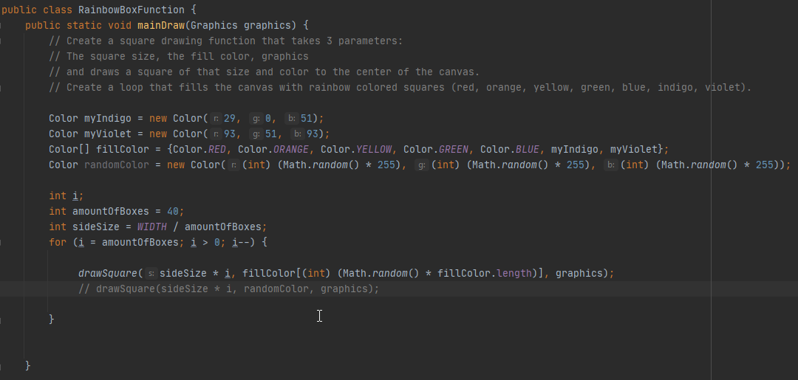

Slide 3
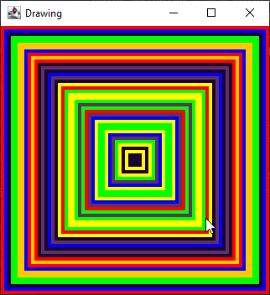
The product

Slide 4
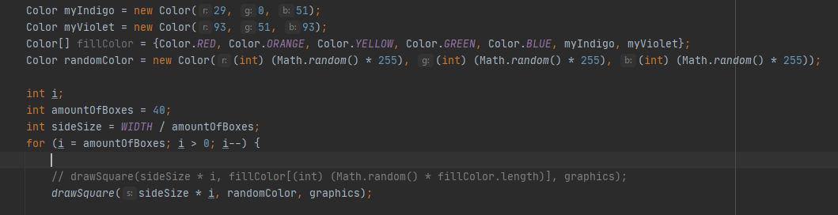

Slide 5
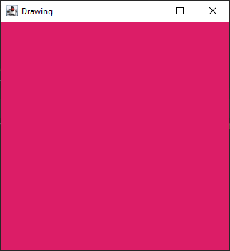
Any ideas on what's wrong here?

Slide 6

Little demonstration
Disclaimer:
Eye users with epilepsy tendencies are advised to turn off their devices for this section

Slide 7
TY VM! =)

