Slide 1
ECMAScript

Slide 2
Ecma International
/European Computer Manifacturers Association/
An organization that creates standards for technologies
Founded in 1961

Slide 3
ECMA-262
This is a standard published by Ecma International. It contains the specification for a general purpose scripting language.

Slide 4
A Scripting language
A programming language designed specifically for acting on an existing entity or system

Slide 5
ECMAScript
The specification defined in ECMA-262 for creating a general purpose scripting language.

Slide 6
JavaScript
A general purpose scripting language that conforms to the ECMAScript specification.

Slide 7
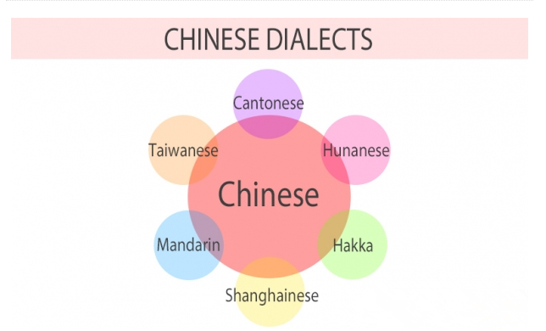

Slide 8

ECMAScript 6
/ES2015/
It is the sixth edition of the ECMA-262 standard, and features major changes and improvements to the ECMAScript specification.

Slide 9
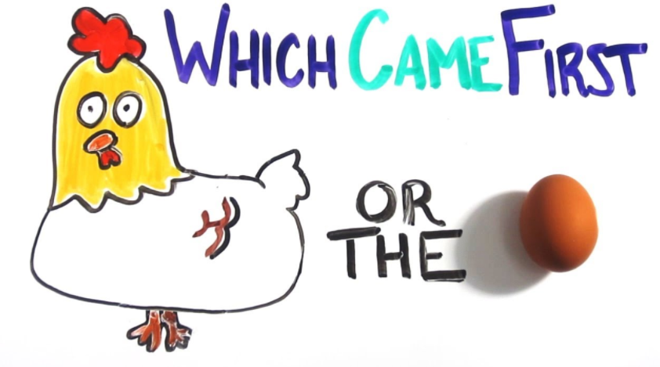

Slide 10
Recursion?

Slide 11
Thank You, Guys!

