Slide 1
Week 02
Basics
Alexandra Rujzam https://github.com/greenfox-academy/szapszap

Slide 2
What we learned this week
Arrays and Functions – and their syntax
Alexandra Rujzam https://github.com/greenfox-academy/szapszap

Slide 3
What we learned this week
Arrays and Functions – and their syntax
Data structures – strings, arrays and objects
Alexandra Rujzam https://github.com/greenfox-academy/szapszap

Slide 4
What we learned this week
Arrays and Functions – and their syntax
Data structures – strings, arrays and objects
Drawing shapes on HTML Canvas – lines, rectangles, squares
Alexandra Rujzam https://github.com/greenfox-academy/szapszap

Slide 5
What we learned this week
Arrays and Functions – and their syntax
Data structures – strings, arrays and objects
Drawing shapes on HTML Canvas – lines, rectangles, squares
Drawing project
Alexandra Rujzam https://github.com/greenfox-academy/szapszap

Slide 6
What we learned this week
Arrays and Functions – and their syntax
Data structures – strings, arrays and objects
Drawing shapes on HTML Canvas – lines, rectangles, squares
Drawing project
THERE IS NO SINGLE SOLUTION!
Alexandra Rujzam https://github.com/greenfox-academy/szapszap

Slide 7
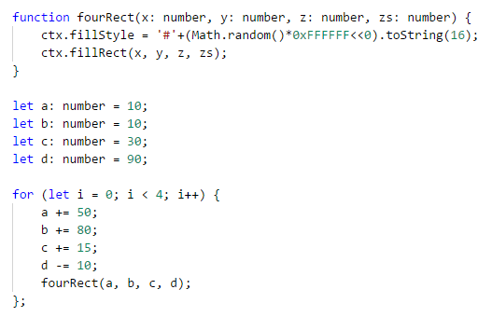

Alexandra Rujzam https://github.com/greenfox-academy/szapszap

Slide 8
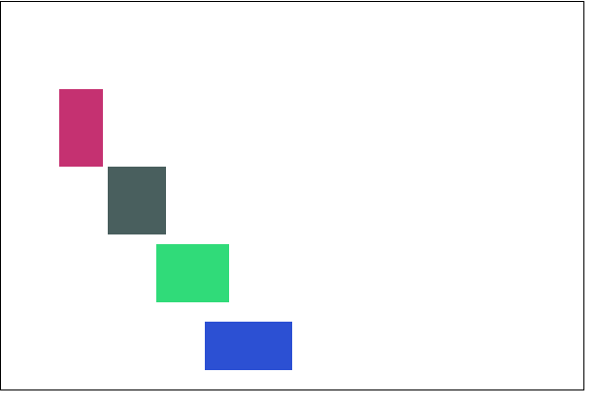
Alexandra Rujzam https://github.com/greenfox-academy/szapszap

Slide 9
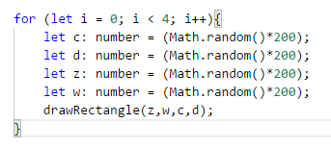

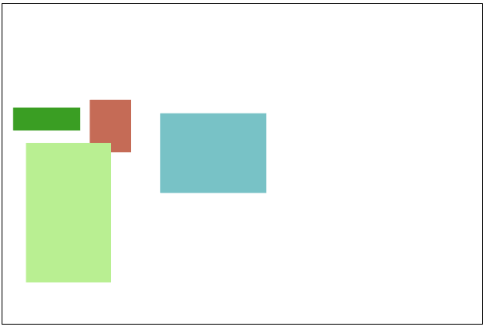
Alexandra Rujzam https://github.com/greenfox-academy/szapszap

Slide 10
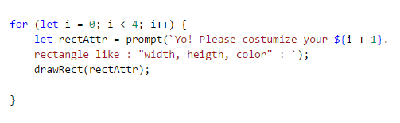

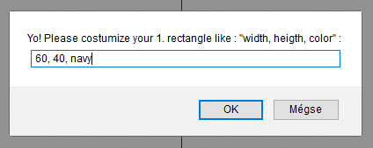
Alexandra Rujzam https://github.com/greenfox-academy/szapszap

Slide 11
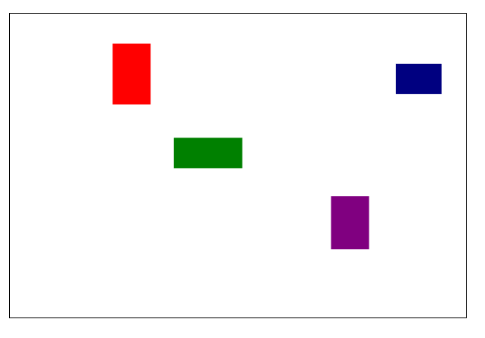
Alexandra Rujzam https://github.com/greenfox-academy/szapszap

Slide 12
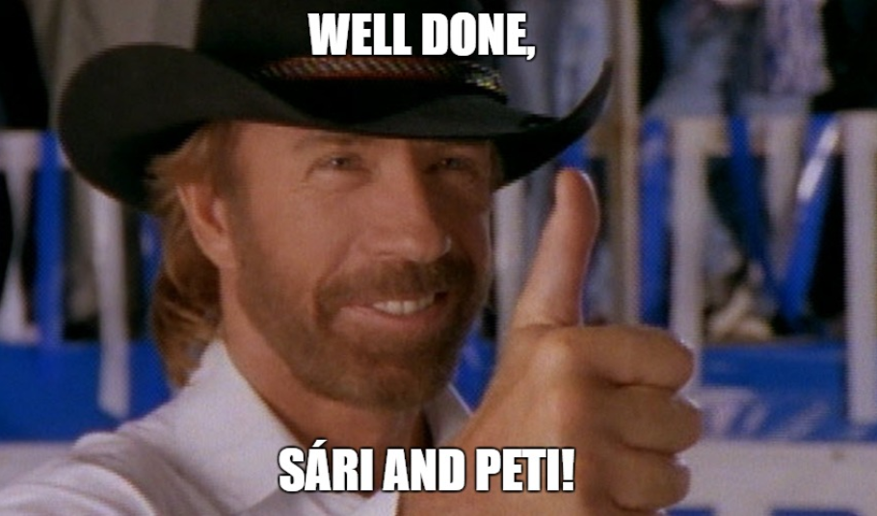

Slide 13
Thanks for watching!
(Or listening)
Alexandra Rujzam https://github.com/greenfox-academy/szapszap

