Slide 1
Week 04
Object Orientation
Alexandra Rujzam https://github.com/greenfox-academy/szapszap

Slide 2
What we learned this week
Stress Management Training
Trial Exam
Alexandra Rujzam https://github.com/greenfox-academy/szapszap

Slide 3

What we learned this week
Stress Management Training
Trial Exam
Inheritance
Alexandra Rujzam https://github.com/greenfox-academy/szapszap

Slide 4
What we learned this week
Stress Management Training
Trial Exam
Inheritance
Abstracts and Interfaces
Alexandra Rujzam https://github.com/greenfox-academy/szapszap

Slide 5
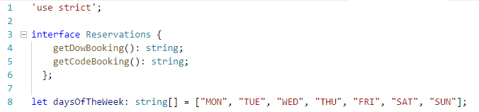

Slide 6
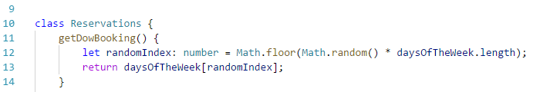

Slide 7
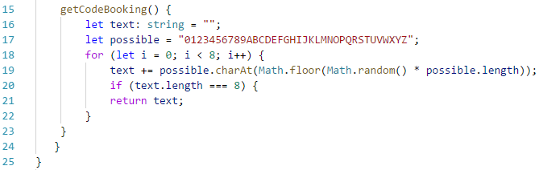

Slide 8
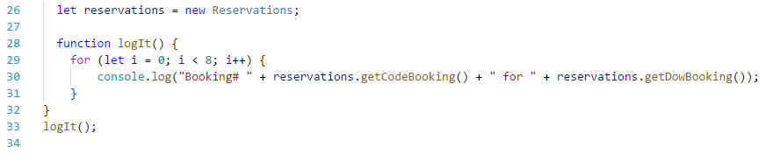

Slide 9
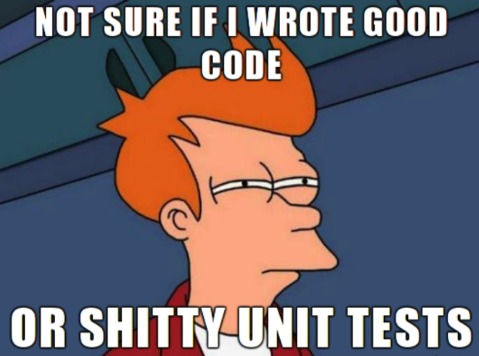
What we learned this week
Stress Management Training
Trial Exam
Inheritance
Abstracts and Interfaces
Unit Testing
Alexandra Rujzam https://github.com/greenfox-academy/szapszap

Slide 10
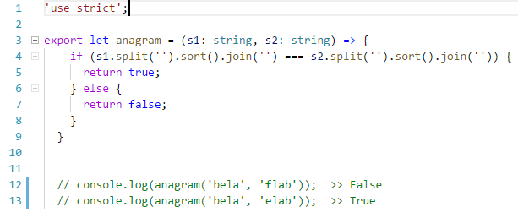
Sorting by Unicode

Slide 11
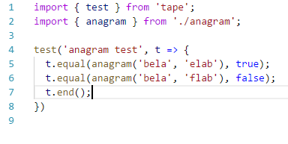

Slide 12
What we learned this week
Stress Management Training
Trial Exam
Inheritance
Abstracts and Interfaces
Unit Testing
Todo App
Alexandra Rujzam https://github.com/greenfox-academy/szapszap

Slide 13
Thanks for watching!
(Or listening)
Alexandra Rujzam https://github.com/greenfox-academy/szapszap

