Slide 1
Week 07
Backend + Forms
Alexandra Rujzam https://github.com/greenfox-academy/szapszap

Slide 2
What we learned this week
Express + Node + NPM + REST
Alexandra Rujzam https://github.com/greenfox-academy/szapszap

Slide 3
What we learned this week
Express + Node + NPM + REST
Tables and Forms
Alexandra Rujzam https://github.com/greenfox-academy/szapszap

Slide 4
What we learned this week
Express + Node + NPM + REST
Tables and Forms
Templating
Alexandra Rujzam https://github.com/greenfox-academy/szapszap

Slide 5
What we learned this week
Express + Node + NPM + REST
Tables and Forms
Templating
Reddit Project incl. MySQL
Alexandra Rujzam https://github.com/greenfox-academy/szapszap

Slide 6
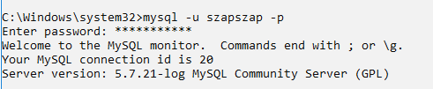
Launching MySQL

Slide 7

Launching MySQL

Slide 8
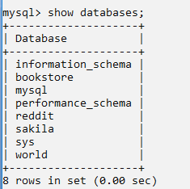
Changing to DB Reddit

Slide 9

Changing to DB Reddit

Slide 10
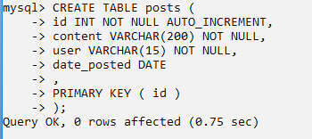
Let’s Create a Table Called Posts

Slide 11
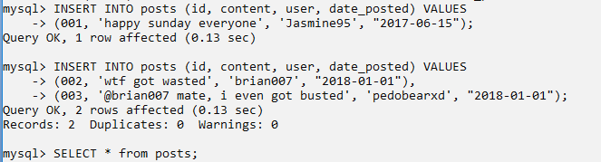
Add Some Data to It

Slide 12
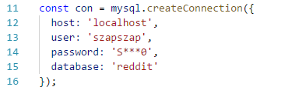
Create a Connection with the DB

Slide 13

Create a Connection with the DB

Slide 14
Create a Connection with the DB

Slide 15
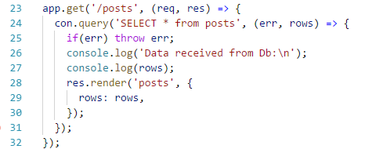
Execute Queries

Slide 16
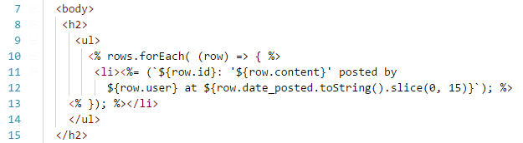
Display Data in the Browser

Slide 17
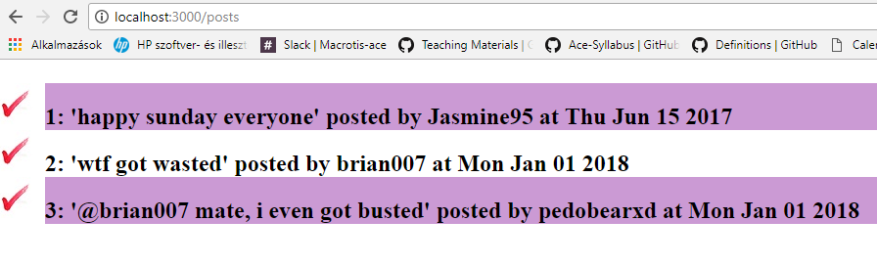
The Result

Slide 18
Thanks for watching!
(Or listening)
Alexandra Rujzam https://github.com/greenfox-academy/szapszap

