Slide 1
Week 08
XHR + Closure
Alexandra Rujzam https://github.com/greenfox-academy/szapszap

Slide 2
What we learned this week
Training / Dojo
Alexandra Rujzam https://github.com/greenfox-academy/szapszap

Slide 3
What we learned this week
Training / Dojo
Closure + .Bind + This
Alexandra Rujzam https://github.com/greenfox-academy/szapszap

Slide 4
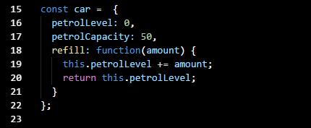

Slide 5
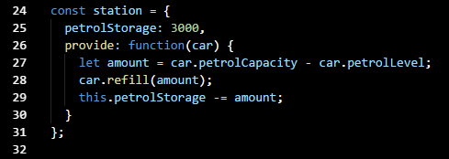

Slide 6
What we learned this week
Training / Dojo
Closure + .Bind + This
XHR + Playing with API-s + AJAX + DOM manipulation
Alexandra Rujzam https://github.com/greenfox-academy/szapszap

Slide 7
What we learned this week
Training / Dojo
Closure + .Bind + This
XHR + Playing with API-s + AJAX + DOM manipulation
Reddit Project
Alexandra Rujzam https://github.com/greenfox-academy/szapszap

Slide 8
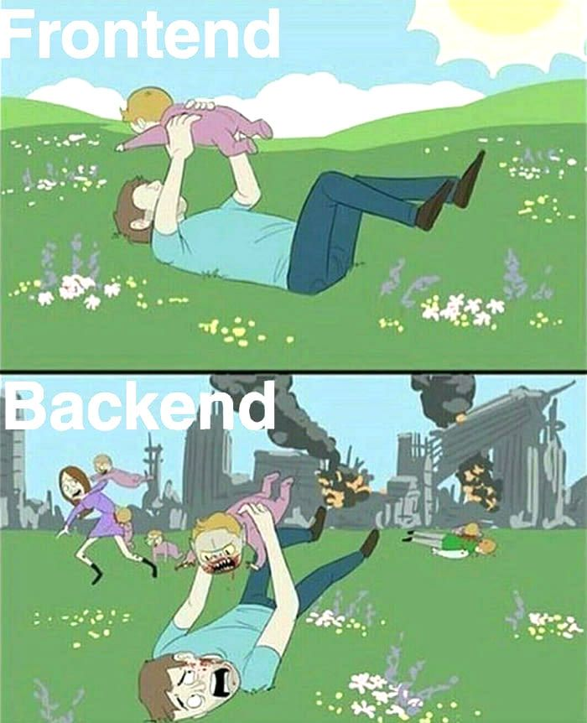

Slide 9
Thanks for watching!
(Or listening)
Alexandra Rujzam https://github.com/greenfox-academy/szapszap

