Slide 1
Week 03
Files and Drawing
Alexandra Rujzam https://github.com/greenfox-academy/szapszap

Slide 2
What we learned this week
Presentation Training
DOJO – Power of Thor, The Descent and Mars Lander-Ep1
Alexandra Rujzam https://github.com/greenfox-academy/szapszap

Slide 3
What we learned this week
Presentation Training
DOJO – Power of Thor, The Descent and Mars Lander-Ep1
File Manipulation and Error handling
Alexandra Rujzam https://github.com/greenfox-academy/szapszap

Slide 4
What we learned this week
Presentation Training
DOJO – Power of Thor, The Descent and Mars Lander-Ep1
File Manipulation and Error handling
Classes and Objects
Alexandra Rujzam https://github.com/greenfox-academy/szapszap

Slide 5
What we learned this week
Presentation Training
DOJO – Power of Thor, The Descent and Mars Lander-Ep1
File Manipulation and Error handling
Classes and Objects
Recursion
Alexandra Rujzam https://github.com/greenfox-academy/szapszap

Slide 6
What we learned this week
Presentation Training
DOJO – Power of Thor, The Descent and Mars Lander-Ep1
File Manipulation and Error handling
Classes and Objects
Recursion
Fractals
Alexandra Rujzam https://github.com/greenfox-academy/szapszap

Slide 7
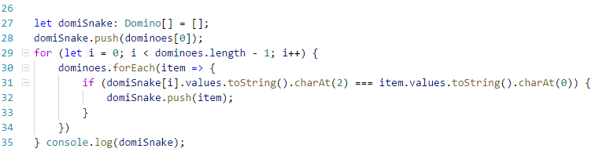
Alexandra Rujzam https://github.com/greenfox-academy/szapszap

Slide 8
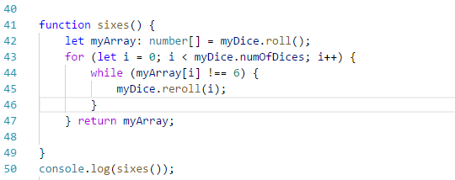
Alexandra Rujzam https://github.com/greenfox-academy/szapszap

Slide 9
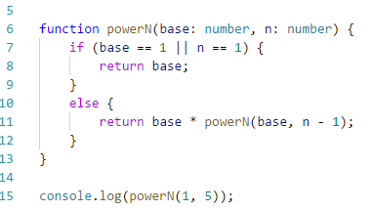
Alexandra Rujzam https://github.com/greenfox-academy/szapszap

Slide 10
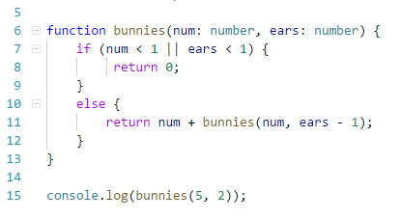
Alexandra Rujzam https://github.com/greenfox-academy/szapszap

Slide 11
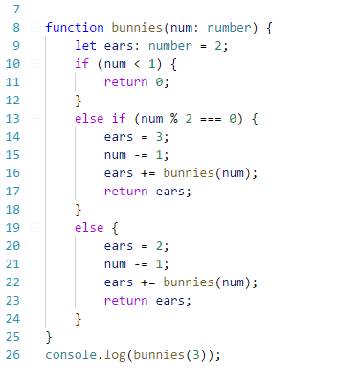
Alexandra Rujzam https://github.com/greenfox-academy/szapszap

Slide 12
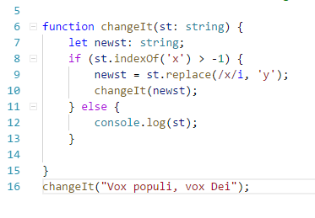

Slide 13
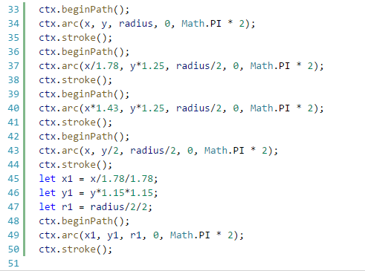

Slide 14
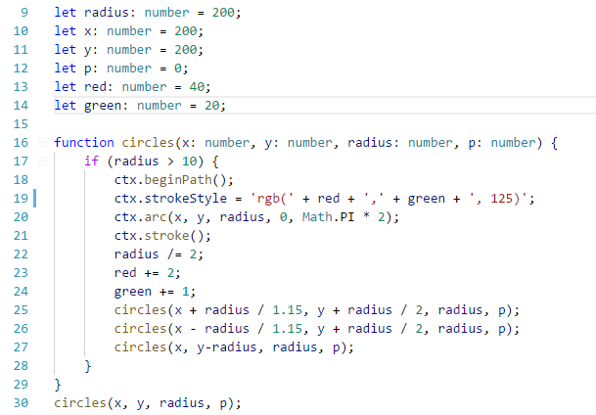

Slide 15
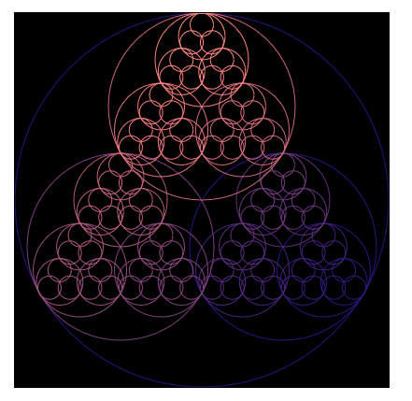

Slide 16
Thanks for watching!
(Or listening)
Alexandra Rujzam https://github.com/greenfox-academy/szapszap

